Slide 1
Strategy for Renewable Electricity in San Diego by 2020
Richard Caputo
San Diego Renewable Energy Society
Chapter of the American Solar Energy Society
20 Sept 2010

Slide 2
OUTLINE
A Point of View
National Level
Climate Change
Non-Carbon Options
Apply to San Diego
Energy Tribes
Goals for Choosing Renewable Energy (RE)
RE Resources Magnitude
Contribution Toward Peaking Needs
RE Cost including Battery Storage
Environmental Characteristics
2020 RE Projection
Conclusion

Slide 3
APPROACH
Take a Particular But General Point of View About:
Energy
Environment, and
Equity Issues
Identify Some Problems and Develop Solutions
Go Back and Identify Other Points of View
Revaluate the Problem and Solutions

Slide 4
Why This Approach ?
You can’t really talk about what you call a “problem” and what you call a “solution” without talking about different value systems
Some of us may not be disagreeing about technical data but about core values

Slide 5
A Particular Point of View
See the world as controllable
Nature is stable until pushed beyond discoverable limit
Environmental management requires:
certiﬁed experts to determine the precise locations of nature’s limits, and
statutory regulation to ensure that all economic activity is kept with those limits
Man is malleable, deeply ﬂawed but redeemable by long-lasting, and trustworthy institutions
Fair distribution is by need, and the need is determined by expert and dispassionate authority

Slide 6
People Causing Rapid Climate Change
Human Driven with 90% Probability ( IPCC,2007)
Carbon Dioxide (CO2) less than 300 ppm for last 650,000 yrs
Since 1750, CO2 from 280 to 380 pp (= + 0.5C)
100 ppm Swing Is a Large Number
Caused 1 Mile Thick Ice Over Chicago (280 to 180)
Without CO2 Reductions:
Unprecedented Warming with both flood and drought
Large Sea Level Rise
Large-Scale Species Extinctions --up to 80% by 2100
100s Millions of Climate Change Refugees

Slide 7
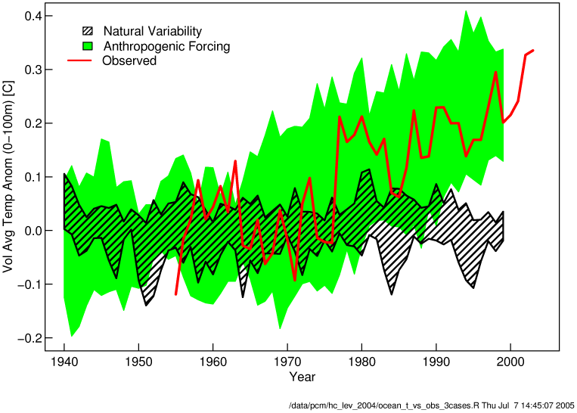
People driven simulations correlate well with observed upper-level ocean temperatures

Slide 8
Who Are Skeptics
Being paid by the fossil industry to introduce “doubt”
Most Who Own or Work in the Fossil Industry
Those Who Feel That Anything That Leads to a Greater Role for Government Should Not Be Supported e.g. smoking causes cancer, humans causing CC, etc
About 30% of U.S. Public Responding to General Media Saying Climate Change Is Due to Natural Variability, Scientists Seeking More Grants, or a Hoax, etc
AAPG (American Asso. of Petroleum Geologists) is the only scientific body of national or international standing known to reject the basic findings of human influence
Independent Skeptics Who Break with Scientific Establishment and Go It Alone, e.g.
- Freeman Dyson, Don Rapp, etc

Slide 9
Who Believes Humans Causing CC
IPCC – Intergovernmental Panel on Climate Change Made Up of ~ 2500 Scientists in the Field
- 4th Assessment Report finds that human actions are "very likely" (90% probability) the cause of global warming”
Signatories of Kyoto Agreement
- 187 Nations Signed and Ratified
- 1 Nation Signed but Not Intending to Ratify (U.S.)
- 2 Nations Have No Position (Afghanistan & San Marino)
32 National Science Academies
American Scientific Organizations such as: AAAS, ACS, AGU, AMS, AIP, APS, GSA, IUGG, AMS, AQA, ASM, SAF, AAP, ACPM, AMA, etc.

Slide 10
National Assessment
American Solar Energy Society (www.ases.org)
Reviewed 6 Renewable Energy (RE) Options
Reviewed Energy Efficiency (EE) in All Major Sectors
National Experts Participated
Ground rules:
Identify options
Assess cost in comparison with EIA national cost model with EIA conventional fuels estimates
Consider barriers and impediments
Realistic Projections
Results Added and Compared to CO2 reduction Goals

Slide 11
Contributors for Non-Carbon Sources
Buildings: Marilyn Brown, Therese Stovall, and Patrick Hughes (Oak Ridge National Laboratory)
Plug-In Hybrid Electric Vehicles: Peter Lilienthal and Howard Brown (National Renewable Energy Laboratory [NREL])
Overall Energy Efficiency: Joel Swisher (Rocky Mountain Institute)
Concentrating Solar Power: Mark Mehos (NREL) and David
Kearney (Kearney and Associates)
Photovoltaics: Paul Denholm and Robert Margolis (NREL) and Ken Zweibel (PrimeStar Solar, Inc.)
Wind Power: Michael Milligan (NREL)
Biomass: Ralph Overend and Anelia Milbrandt (NREL)
Biofuels: John Sheehan (NREL)
Geothermal Power: Martin Vorum (NREL) and Jefferson Tester (MIT)
Summary/Editor: Charles Kutscher, American Solar Energy Society

Slide 12
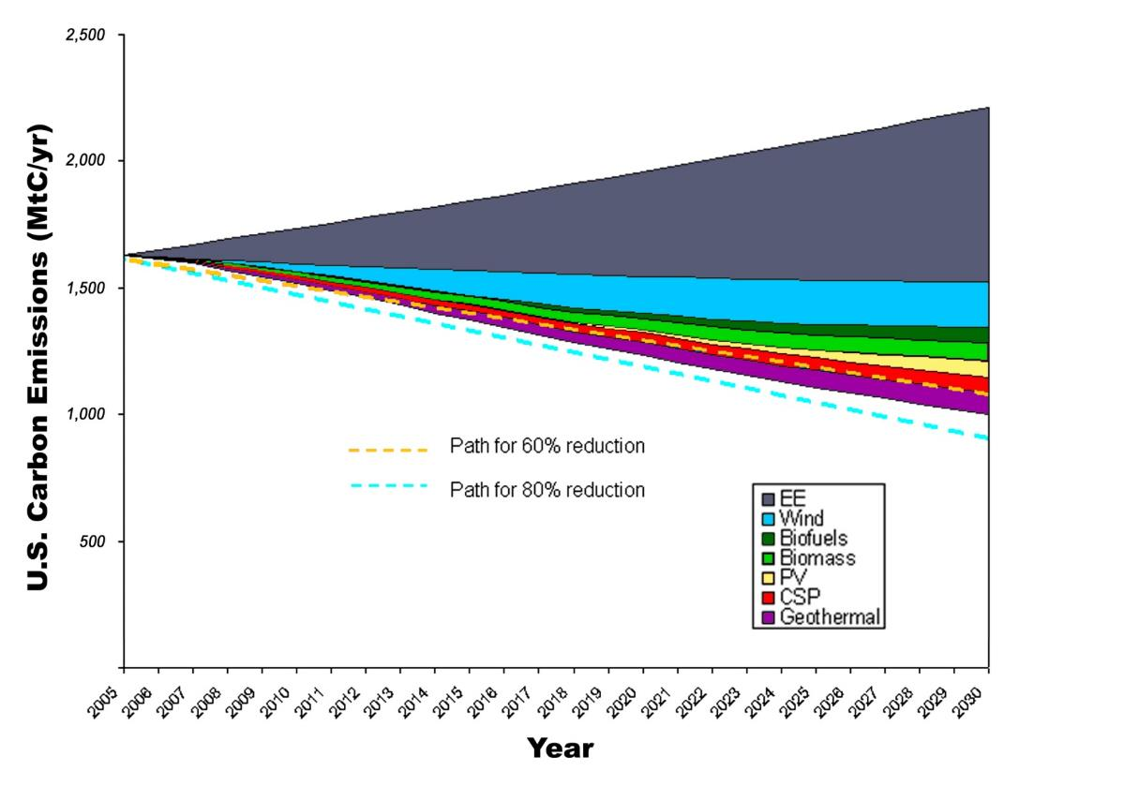
U.S. Carbon Emissions 2030 Potential

Slide 13
GOOD NEWS
ENERGY EFFICIENCY and RENEWABLE ENERGY
CAN
REDUCE CARBON EMISSIONS and MEET GOAL for the U.S.
AT
A REASONABLE COST

Slide 14
Renewable Contributions

Slide 15
Conclusions
Energy Efficiency Could Negate U.S. Emissions Growth
Six Renewables Can Provide Deep Cuts in Emissions
Provide about 50% of total electricity
Provide about 40% of liquid fuels in 2030
U.S. Has Abundant Renewable Resources Spread Throughout the Country
Wind Can Provide ~1/3 of Renewable Electricity and Remainder Split Evenly Among Other 4 Resources
EE and RE Can Begin Today to Tackle Global Warming
Continued R&D and Policy Support Will Help These Technologies Achieve Their Large Future Potential

Slide 16
Conclusions, continued
4 of 5 Renewable Electricity Options Depend on Transmission Wires
Wind
CSP
Geothermal
Biomass Electricity
Even On-site PV Depends on Wires in Grid for Back Up
Initially (up to 2025), Wires Bring RE to Regional Loads
Finally ( after about 2025), Wires Needed to Move Electricity to Other Regions
High Voltage DC Transmission Lines
Efficient Lower Cost Long Distance Energy Transfer
Will Enable Renewable Electricity to Exceed 50% and Combined with Additional Efficiency, Attain Further Reduction of Carbon Emissions

Slide 17
???
Carbon-free Solution Depends on:
Level Playing Field
Discontinue BAU Subsidies to Old Energy
Invest in New Energy
Place Dollar Cost on Carbon Release
Restructure Energy Infrastructure to Work with RE
Rate Structure
Smart Grid
Transmission Lines
Sustaining Support for a Century or More
Cooperating with Other Nations
A Level Playing Field Depends on Citizens Engaging the Political Process

Slide 18
Apply to San Diego Region
In the Renewable Energy Electric Sector

Slide 19
Overview of Perceptions and Conflicts Over Energy Issues
Use Cultural Anthropologists “Cultural Bias Theory” As a Framework (1)
Internally Consistent World Views
Enable Efficient Coping Strategies
ENERGY TRIBES in Collision:
Egalitarian
Individualism
Hierarchical
Fatalism

Slide 20
Major RE Power System Goals
1. To Minimize Fossil Fuel Use and/or Expensive Storage:
Sum of Renewables Should Approach Average Capacity Factor of Current SD Grid
San Diego Grid Capacity Factor ~ 0.54
Currently Is a Combination of Baseload, Intermediate and Peaker Power Plants
2. To Use Lower Cost Options
3. To Be Mindful of RE Impacts
4. To Balance RE Between Region and SD Cty

Slide 21
San Diego Regional Energy
Region is SD Cty, Imperial Cty and Northern Baja
2003 Study (3) Showed Almost All of Renewable Energy (RE) Available Outside San Diego Cty
About 42 GW out of 47 GW Total Technical Potential
Largest Single Resource Is Desert RE in Imperial Cty
70% of Total
SANDAG Set Goal of 50% RE from SD Cty
0ver 60% of Current Electricity from Outside SD Cty
2006 EWG Study Laid Out Approach to Reach 50% Goal (4)

Slide 22
SD Region RESOURCE MAGNITUDE, MW (5,8,10,11,12)
TECHNOLOGY | GROSS POTENTIAL | TECHNICAL POTENTIAL | CURRENT
CONC SOLAR, Total (San Diego) | 296,000 (35,000) | 35,400 (3,500+2900 ) | Zero
Roof Top PV | ? | 1500 to 4700 MW | 74 MW
GEOTHERMAL, Total (Baja California) | large | 2,500 to 4,000 (840) | 1260 MW (720)
WIND, Total (San Diego Cty) (Baja California) | 2,500 to 2,800 | 5700 (up to 960) (up to 4000) | 50 MW
BIO-Mass and Gas | ? | 120 to 180 | 39 MW
Small HYDRO, Total (San Diego Cty) (Imperial Cty) (Baja California) | ? | 170 (10) (up to 86) (up to 75) | 94.5 MW (8) (86.5)

Slide 23
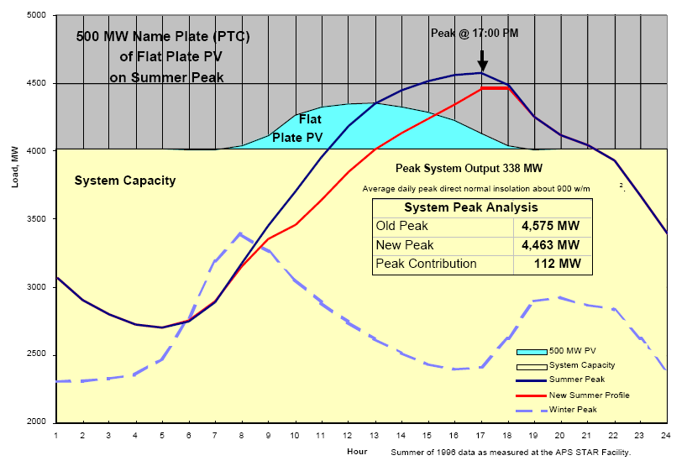

Slide 24
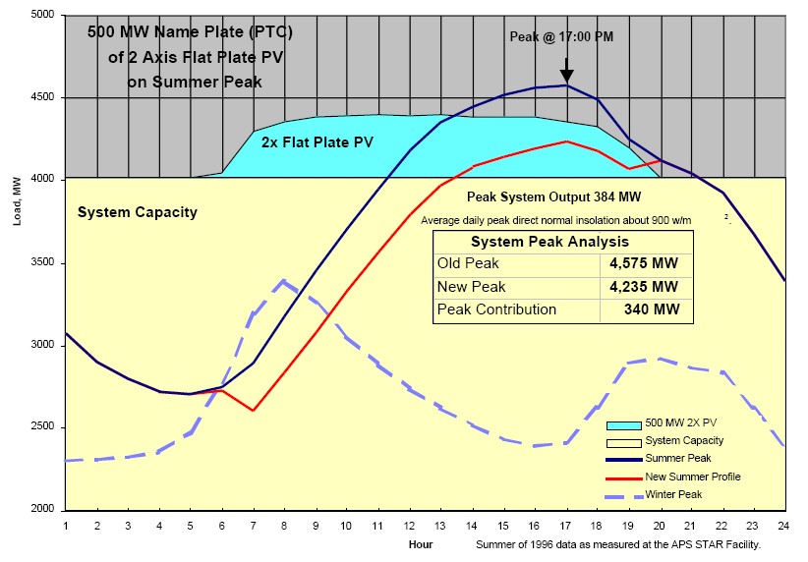

Slide 25
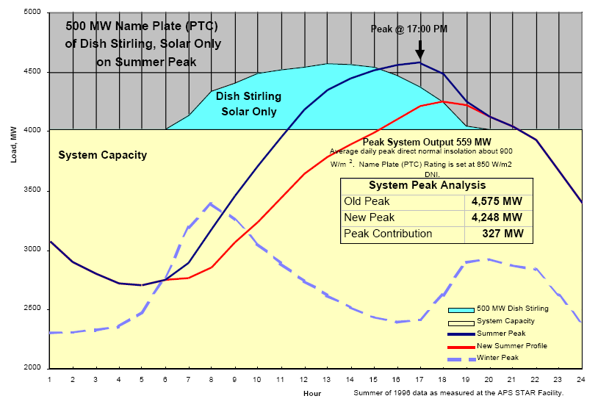

Slide 26
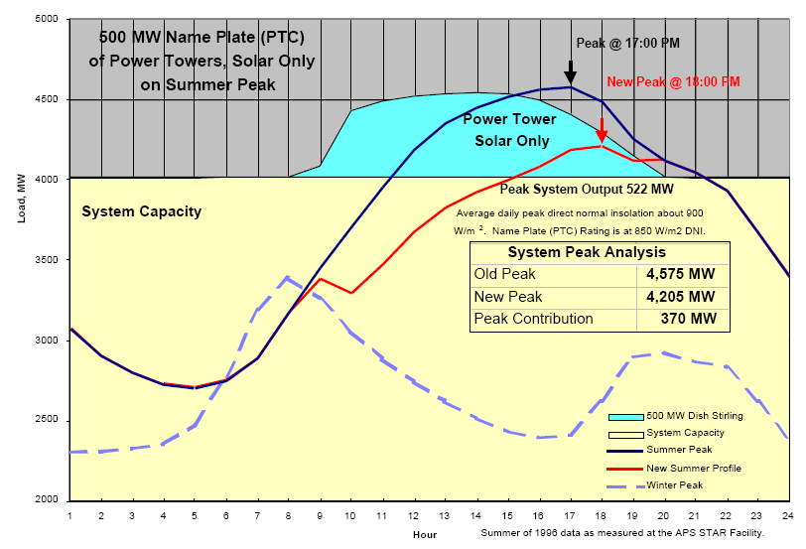
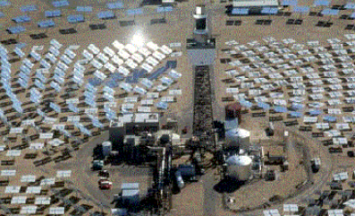
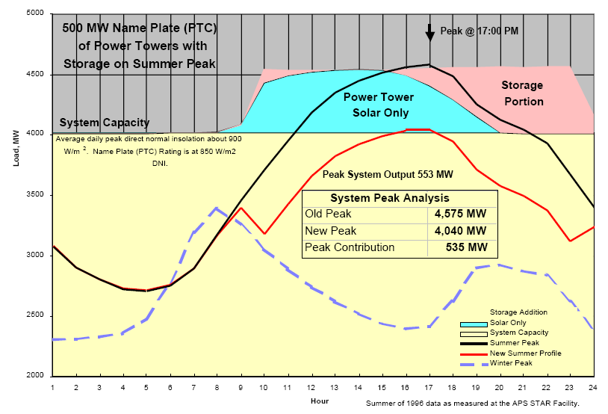

Slide 27
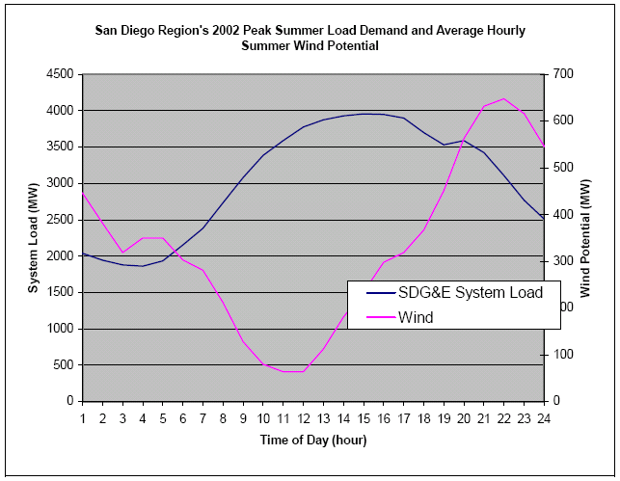
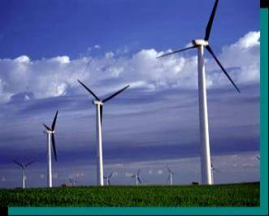
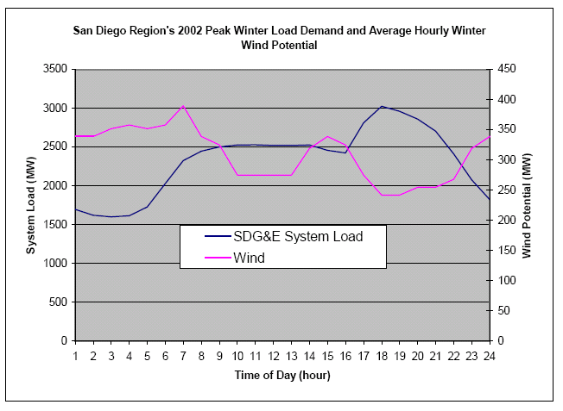
Summer Peak
Winter Peak

Slide 28
Contribution to Peak Power for RE with 500 MW Name Plate Rating, Approximation Based on Arizona Utility
RENEWABLE ENERGY TECHNOLOGY | PEAK CONTRIBUTION, MW | % PEAK
Flat PV | 112 - 300 | 22-60 (13)
2X Tracking PV | 340 | 68
Dish-Stirling | 327 | 65
Parabolic Trough or Central Receiver | 370 | 74
PT or CR plus Thermal Storage | 535 | 107
Hybrid Dish-Stirling | 562 | 110

Slide 29
Goal of Balanced RE Grid
To Minimize Use of Fossil Fuels and Expensive Storage
Need To Have a Mix of Renewables to Both Provide Energy and Stable Grid:
Mid-day Power --- flat on-site PV
Sunrise to Sunset Power --- concentrating solar
Sunrise to Sunset w Inexpensive Thermal Storage --- concentration solar thermal
Baseload --- geothermal or bio-electric

Slide 30
Renewable Energy COST, cents/kWh (6, 7,9) levelized with current subsidies extended, 2009$
TECHNOLOGY | EARLY $/KW | PLANTS cents/KWh | LATER $/KW | PLANTS cents/KWh | Capacity Factor
Bio-Gas | 3,000 | 11 | 3,000 | 11 | 0.85
Wind | 2,000 | 7 | 1,700 | 6 | 0.40
Geothermal | 3,850 | 8 | 3,750 | 8 | 0.92
Bio-Mass | 3,000 | 11 | 3,000 | 11 | 0.85
Small Hydro | 1,700 | 7-9 | 1,800 | 8-10 | 0.30
Parabolic Trough - 6 hr storage Dish Stirling | 6,350 4,000 | 18 13 | 3350 2200 | 10 7 | 0.41 0.28
Flat Plate PV Residential, 3.8kW Commercial100kW 3rd Party,10 MW Utility IPP, 10 MW | 6,000 5,500 4,750 4,750 | 15 8 16 19 | 4,100 3,900 3,300 1,700 | 10 5 10 12 | 0.19 0.19 0.19 0.21
Concentrating PV | 6,000 | 15 | 3,000 | 10 | 0.30

Slide 31
2020 Energy Cost Without Current Subsidies, cents/kWh
Technology | With Subsidies | Without Subsidies | Capacity Factor
Bio-Gas | 11 | 12 | 0.85
Wind | 6 | 8 | 0.40
Geothermal | 8 | 12 | 0.95
Bio-Mass | 11 | 12 | 0.85
Small Hydro | 9 | 11 | 0.53
Parabolic Dish-Stirling | 10 7 | 14 10 | 0.41 0.28
Flat Plate PV - Residential - Commercial 3rd Party10MW | 10 5 8 | 17 12 20 | 0.19 0.19 0.19
Concentrating PV | 10 | 13 | 0.30

Slide 32
Delivered Energy Cost from Utility Battery Storage

Slide 33
Using Battery Storage
Utility Battery
VRB Flow Battery
Based on 2 MW Unit with 6 Hr at $6.3 M
Round Trip Efficiency = 66%
Doubles the Cost of PV Mix
Raises EC from 10 to 20 cents/kWh
If 50% Residential and Commercial in PV Mix, and
If 50% PV Mix Goes Through Storage
More Than Doubles the Cost of Wind Energy
- 7 to 17 cents/kWh
Battery Storage Is Expensive

Slide 34
Environmental Impacts
To Minimize Local and Global CO2 Impacts, U.S. To Reduce CO2 by 80% by 2050
All RE Options
Avoid Onerous Impacts of CO2
Desirable As a Class of Options
Among RE Options, There Are a Range of Lesser and Local Impacts

Slide 35
TECHNOLOGY | ATTRACTIVE FEATURES | UNATTRACTIVE FEATURES
BIO-GAS | Disposes of Significant Green House, Smog Producing and Bad Smelling Gas Commercially Available - Inexpensive Baseload Power - Near Urban Area | - Must Mitigate Exhaust Pollutants
GEOTHERMAL | Renewable Source (when properly managed) Commercially Available - Inexpensive Baseload Power | Need to Manage Impacts - Scrubbers for Air Pollution - Dispose of Spent Brine - Waste Drilling Fluids and Tailings Needs Access to Transmission Line Can Be Depletable
BIO-MASS | Commercially Available Baseload Power | - Must Mitigate Exhaust Pollutants Limited and Variable
HYDRO | Renewable Commercially Available | - Need to Manage Impacts Especially Fisheries, Wildlife, Cultural, Recreational & Scenic

Slide 36
TECHNOLOGY | ATTRACTIVE FEATURES | UNATTRACTIVE FEATURES
PARABOLIC TROUGH and CENTRAL RECEIVER | Very Large Resource Good Peak Power Match Inexpensive Heat Storage and/or Hybrid Operation Extends Operation After Sunset | Capital Intensive Significant Environmental Land Impacts (scrapes all land) Needs Flat Land (<1%slope) - Needs Access to Transmission Needs Water for Wet Cooling
PARABOLIC TROUGH | Installed Cost, O&M, Operation Are Known | Eventual Commercial Cost Must Be Reduced Cost Effective in 60 MW Size Minimum Land is 0.6 mi2
CENTRAL RECEIVER | - Eventual Commercial Cost Likely Less Than Trough | Commercial Cost and O&M Not Proven Cost Effective in 100 MW Size and Minimum Land Is 1.0 mi2

Slide 37
TECH | ATTRACTIVE FEATURES | UNATTRACTIVE
Conc. PV and DISH-STIRLING | Very Large Resource No Cooling Water Needed in Desert Good Peak Power Match Can Use Irregular Land with Steeper Slope No Site Grading Needed & Compatible with Ranching Wide Range of Commercial Sizes Can Integrate into Load Center as Part of Industrial Site or Large Home Development | No Thermal Storage Production Scale-Up Needed To Reduce Cost Capital Intensive Needs Access to Transmission Lines for Large Plants
DISH-STIRLING | - Hybrid Operation Extends Operation After Sunset (when dual fuel engine developed) Hybrid Efficiency is High (~ 38%) | Need to Develop Dual Fuel Engine Using CH4 or Biofuels for Hybrid Operation

Slide 38
TECH | ATTRACTIVE FEATURES | UNATTRACTIVE FEATURES
WIND | Proven Commercial Technology Low Capital and Energy Costs Reciprocal Availability to Solar Displace Evening Burning of Fossil Fuels Provide Energy During Off-Peak to Power Emerging Huge Load of Pluggable Electric Vehicles Good Dispatching with Accurate Wind Forecasting | Almost No Peak Displacement Impacts Viewscape (good or bad) Environmental Impacts Such as Bird/Bat Kills (can be mitigated with good layout design) Needs Minimum Separation Distance to Residences (~ 0.5 to 1 mile) to Avoid Sound Impact
FLAT PV On-Site | Installed Cost, O&M, Operation Are Known Roof-top Avoids Land Use Issues Operates Within Grid Without Transmission Lines Reduces Distribution Costs | Capital Intensive Summer Power Reduced 20% Due to High Temperatures Poor peak load reduction

Slide 39
2020 RE Projection
To Minimize Fossil Fuel Use and/or Expensive Storage
To Use Lower Cost Options
To Be Mindful of RE Impacts
To Balance Between In and Out of SD Cty

Slide 40
Projection of SD Region Renewable Energy Sources, 2020 Avg Capacity Factor = 0.37
RE Source | Power, MW | Share RE Power | Capacity Factor | Energy, GWh/y | Share RE Energy
On-Site PV | 600 | 19% | 0.18 | 950 | 9%
Large Scale PV | 300 | 9% | 0.20 | 530 | 5%
Sunrise to Sunset Tracking Solar | 850 | 27% | 0.29 | 2,160 | 21%
Sunrise to Sunset with Thermal Storage | 500 | 16% | 0.41 | 1,800 | 17%
Wind | 600 | 19% | 0.40 | 2,100 | 20%
Baseload Geothermal, Biomass, etc | 350 | 11% | 0.90 | 2,760 | 27%
TOTAL RE | 3,200 | 100% | 0.37 | 10,300 | 100%

Slide 41
SD County Share of Total Renewables
 |  |  |  | 2020
CENTRALIZED, MW |  |  |  | SD County |  | Region
Concentrated Solar |  |  |  | 100 |  | 1350
Geothermal |  |  |  | 0 |  | 270
Wind |  |  |  | 250 |  | 600
Other:
Biomass |  |  |  | 35 |  | 35
Biogas |  |  |  | 35 |  | 35
Small Hydro |  |  |  | 10 |  | 10
Total Centralized,MW |  |  |  | 430 |  | 2300
DECENTRALIZED, MW
On-Site PV |  |  |  | 595 |  | 600
Large Scale PV |  |  |  | 150 |  | 300
TOTAL POWER, MW |  |  |  | 1175 |  | 3200
SUMMARY for SD County | Centralized |  | Distributed | Total
Power MW = | 14% |  | 23% | 37% | plus solar thermal and on-site CSP
Energy GWh/y = | 17% |  | 11% | 28%

Slide 42
Results by 2020
RE Total = 50% of Total Grid Energy
RE avg Capacity Factor = 0.37
Compared to 0.18 for on-site PV
Compared to 0.54 for Current Grid
SD County Share of Total RE
37% Power
28% Energy
RE from Outside SD Cty Less Than Current Import Capacity of Transmission System:
1925 MW less than 2600 MW (excluding Sunrise)
Should Displace Currently Imported Fossil Energy
No New Transmission Wires Needed

Slide 43
Results, continued
Balancing 10 RE Technologies Could Achieve:
Grid Capacity Factor of About 0.37 to Contribute to Stable Grid and Minimize Use of Expensive Storage
50% SD Energy by 2020 to Minimize Fossil Use
Balancing of RE Environmental Impacts
Lower Average Cost (in 2020 w/o current subsidies)
RE in Baseline Projection Costs $1200 M/yr
Doubling on-site PV Increases Cost by $60M/y
Tripling on-site PV Increases Cost by $ $115M/y
By Displacing 50% of Grid Energy by 2020, Would Take Major Step in Reaching 80% Reduction of GHG by 2050

Slide 44
Barrier to Long Term Solution to CC
What Made Sense from One Particular Point of View Is Not Supported by Other Views
Solutions Stymied by Lack of Consistent Political Support in the U.S.
Government Policies Flip-Flop from Administration to Administration
e.g. NFC to Reagan/Bush to Clinton to Bush to Obama
Need Framework to:
Understand Conflict, and
Devise Strategy to Overcome This Barrier

Slide 45
A Framework for Conflicts Over Energy
Use Cultural Anthropologists
“Cultural Bias Theory”
Made Up of Internally Consistent World Views
Coping Strategies (Not Personality Types)
Enable Efficient Decision Making When Faced with Complex Situations
4 ENERGY TRIBES:
Egalitarian
Hierarchical
Individualism
Fatalism

Slide 46
HIERARCHICAL
See the world as controllable
Nature is stable until pushed past discoverable limits
Environmental management requires certiﬁed experts to determine the precise locations of nature’s limits
Statutory regulation to ensure that all economic activity is kept with those limits
Man is malleable, deeply ﬂawed but redeemable by ﬁrm, long-lasting, and trustworthy institutions
Fair distribution is by need, and the need is determined by expert and dispassionate authority

Slide 47
EGALITARIAN (core ecologists)
Nature is fragile and intricately interconnected
Man is seen as essentially caring (until corrupted by coercive institutions such as markets and hierarchies)
We must all tread lightly on the earth --- almost any impact is unacceptable
It is not enough that people start off equal ---- people must end up equal
Trust and leveling go hand in hand, and institutions that distribute unequally are distrusted
Voluntary simplicity (conservation) is the only real solution to our environment problems

Slide 48
INDIVIDUALISM
View nature as benign, resilient, and able to recover from any exploitation
Man is inherently self-seeking and atomistic
Trial and error in self-organizing ego-focused networks (unfettered markets) is the way to go
Those that put in the most in should get the most out
Inequity is good and a natural part of the world of people
Institutions that work with the grain of the market are what society needs

Slide 49
FATALISTIC
Neither rhyme nor reason makes sense in nature
Man is ﬁckle and untrustworthy
Fairness is not to be found in this life
There is no possibility of effecting change for the better
Learning about nature is impossible
A reasonable management response would be, “why bother”

Slide 50
EACH ENERGY TRIBE NOT COMPLETE
Have Strong Capabilities
Have Blind Spots
To Formulate and Implement Effective Approach Would Require a Blending of All

Slide 51
Hierarchicals
STRONG AREAS
Can Create Structure and Rules
Enforce Property Rights
To Redistribute Resources to Limit Inequalities
To Limit Environmental Damage
Many Ways to Solve Internal Conflicts
Can Increase Resource of People
SHORTCOMINGS
Tends to Lack Transparency and Moves Toward Central Control
Would Lead To:
Corruption
Arbitrary Use of Power
Tunnel Vision
Lack of Innovativeness
Moral Fragmentation

Slide 52
Egalitarians
STRONG AREAS
Distrust of Central Control
Demands Transparency of Transactions
Protests Inequalities
Protest ANY Environmental Impacts
SHORTCOMINGS
Local Impacts Trump Global
No Official Leadership
Wants to Avoid Activities That Produce Inequalities
Will Limit Economic Production

Slide 53
Individualism
STRONG AREAS
Can Increase Resources of People
Distrust of Central Control
Innovative
Well Organized and Disciplined
SHORTCOMINGS
Will Accumulate Resources Unequally
Lead To Social Instability
Does Not Recognize Environmental Damage as a Problem
Avoids Solutions That Involve Role for Govt.

Slide 54
Fatalistics
STRONG AREAS
Can Strengthen Egalitarians by Continually Replenishing Moral Outrage to Keep Organization Together
SHORTCOMINGS
Can Not be Part of Any Constructive Solution to Any Problem

Slide 55
Energy Tribes Views of Climate Change - Causes - Solutions

Slide 56
How EGALITARIANS See Climate Change
Causes:
Profligate Consumption
Obsession with Economic Growth which Generates Great Inequities
Environmentally Unsustainable Production
Solutions:
Live in Harmony with Nature and Each Other
Solutions Must Be Proven to Have Innocuous Impacts
Approaches with any local impacts need to be excluded from contributing to global solutions
Industrialized Countries Need To Fundamentally Reform
Political Institutions
Unsustainable Lifestyles

Slide 57
How HIERARCHICALS See Climate Change
Causes:
Continued Use of Fossil Fuels Will Wreak Havoc
Lack of Global Governance to Limit Global Markets and Protect Global Commons
Those Who Are Skeptical of Global Intergovernmental Treaties Based on Science and Expert Advice
Solutions:
To Limit Population Growth
To Limit Economic Growth
To Gradually Change to non-GHG Energy
All Governments Formally Agree on Emission Cuts

Slide 58
How INDIVIDUALISM See Climate Change
Causes:
Much Ado About Nothing
Naïve Eco-freaks Who Think the World Can Be Better by Wishing It So
International Bureaucrats Looking to Expand Budgets
Solutions:
Even If Climate Change Is Occurring, Results Not Catastrophic Nor All Negative
This Is Not New, i.e. we are faced with uncertainty and challenges that need to be tackled boldly by diverse competing agents for the benefit of all
Innovative Business As Usual

Slide 59
Does Mother Nature Care About Tribal Perceptions ?
Reality of What Is Happening Physically on the Planet Is Indifferent to Human Views

Slide 60
Examples of Overlap of Views
All Tribes | None
Hierarchical & Egalitarians | - Too Much Consumption/Fossil Use Human Caused Climate Change - Distributed PV and Solar Are Good - Energy Efficiency Is Good
Hierarchical & Individualism | - Market Economics is Important - Need to Minimize Barriers to Large Energy Projects
Egalitarians & Individualism | - Distrust Central Authority

Slide 61
Characteristics of Energy Tribes Theory
Tribes arguing from different premises
Will never fully agree
Each distils certain elements of experience and wisdom that are missed by the others
Each needs the others:
each is incomplete in some important aspect
each represents a part of what is needed
Unfortunately, Each Tribe Thinks It Is Complete In It’s World View,
it is almost a moral issue to violate any of its precepts

Slide 62
To Use Energy Tribes for Policy Framework
Policy Approach Should Be:
Reviewed Through the “Eyes” of Each Energy Tribe
Reasonable to More Than One Particular Tribe
Any Short Comings from Tribe’s View Needs to Be:
Acknowledged, and
Accommodated To Some Extent
Overall Approach for Long Term Policy Stability:
All need to be respectful and inclusive,
KEEP EVERYONE in the (messy) PROCESS
Be Pragmatic not Doctrinaire for the Long Haul

Slide 63
Limitation to Energy Tribe Framework
Little Evidence That Different Energy Tribes Are Willing to Be Less Doctrinaire and More Pragmatic
U.S. Congress:
Increasingly Stringent in Imposing Personal View on Entire Process
Fails to See Need/Value of Other Views
Fail to See Limits to Own Perceptions
If Pragmatism Is Required for the Long Haul, There is Little Basis for Optimism

Slide 64
Any Areas of Specific Agreement ?
When State/Federal Programs Stimulate RE and EE, an Area of Agreement Emerges:
On-site Distributed Solar, and
Energy Efficiency in Profit Making Situations
These Contribute to About 3/5s of the Solution
Reasons for Support
Egalitarians See It As Having No Impacts
Individualism See It As a Business Opportunity
Hierarchicals See It As Part of Long Term Plan

Slide 65
Can Lack of Pragmatism Be Overcome for Other 2/5 of Solution ?
1. Can a Public Education Program Encourage Citizens to:
Vote for Pragmatic (moderate) Candidates ???
Avoid Doctrinaire Candidates ???
2. Can a 3rd Political Party Be Formed ???
Can We Build on This Initial Area of Overlap, e.g. Distributed Solar, EE, Bio-fuels ?
Can a Proactive Program be Designed to Reduce Conflicts Over Remaining RE ?

Slide 66
Proposed Next Steps
Continue Support for On-site Solar and EE
Use Public Participation Process (PPP) to Encourage Support for Rest of Renewables
- Focus on Areas of High Conflicts Such As:
Solar Power Plants
Wind Farms
Waste Biomass Plants
Biomass Liquids from Wastes and Low Productivity Land
Geothermal Plants
Transmission Lines
- Bring Stakeholders Together in Different Conflict Zones
- Use PPP Professional to Broker Dialogue and Develop Consensus

Slide 67
Public Participation Process, continued
For Each Conflict Zone,
Find Areas To Be Placed Off Limits
Find Areas To Be Develop
Develop Each Opportunity with Multiple Energy Tribe Buy-in
Streamline Approval Process
Example Is Desert RE Conservation Plan in CA

Slide 68
CA Example: Desert RE Conservation Plan
Major Elements
Established by Governor
35 Stakeholders plus federal and state agencies
Covers Mojave and Colorado Deserts
To provide binding, long-term endangered species permit assurances
To facilitate renewable energy project review and approval processes
Establishes Renewable Energy Action Team (REAT) To Oversee Implementation

Slide 69
Need to Extend This Process to All Renewables In Conflict in All Geographic Areas

Slide 70
References
Caputo,R., Hitting the Wall: A Vision of a Secure Energy Future, Morgan and Claypool, Dec. 08
Tackling Climate Change, Chuck Kutschler, editor, American Solar Energy Society, Jan. 2007
3. San Diego Regional Renewable Energy Study Group, Potential for Renewable Energy in the San Diego Region, August 2005
4. Promise of Renewable Energy in San Diego, SANDAG Energy Working Group, Renewable Energy Team, Butler,B., R. Caputo, S. Fralick, S. Debenham, 5June06
5. Powers, B., San Diego Smart Energy 2020, E-Tech International, Oct. 2007
6. Comparative Costs of California Central Station Electricity Generation Technologies, CEC-200-2009-017-SD,Aug.2009
7. Solar Advisor Model (SAM), version 2010.4.12,
8. Potential for Renewable Energy in San Diego County, Scott Anders et al, San Diego Rnewable Energy Group, Aug 2005
9. Wiser,R., et al, Tracking the Sun: The Installed Cost of Photovoltaics in the U.S. from 1998 to 2007, Lawrence Berkeley Laboratory, Feb 2009
10. Caputo,R., Butler,B., The Use of “Energy Parks” to Balance Renewable Energy in the San Diego Region, ASES Solar2007 Conference, Cleveland, July 2007
11. Anders, S., Bialek, T., Technical Potential for Rooftop PV in the San Diego Region, 2010
12. www.gosolarcalifornia.ca.gov/
13. Herig, C., Using Photovoltaics to Preserve California’s Electric Capacity Reserves, NREL/BR-520—32279, Sept 2001

Slide 71
Richard Caputo P.O. Box 1660 Julian, CA 92036 760-765-3157 richardcaputo@sbcglobal.net www.sdres.org www.ases.org

