Slide 1
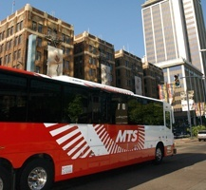
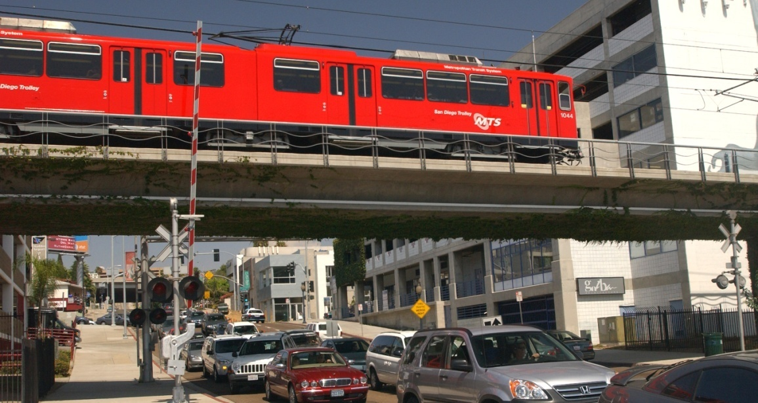
Paul Jablonski
Chief Executive Officer, MTS
Notes:
Thank you. I’m Paul Jablonski, CEO of the Metropolitan Transit System

Slide 2
The MTS Story
Where we’ve been?
What we are today?
What will transit look like in the future?
What are our challenges to sustainability?
Notes:
Pleasure to be here
Transit is my passion
Key to establishing sustainable economies, growth strategies and ecologies
Will focus on these four topics:
We’re we’ve been
A look at today’s MTS system
Where we’re headed
The sustainability challenges we face

Slide 3
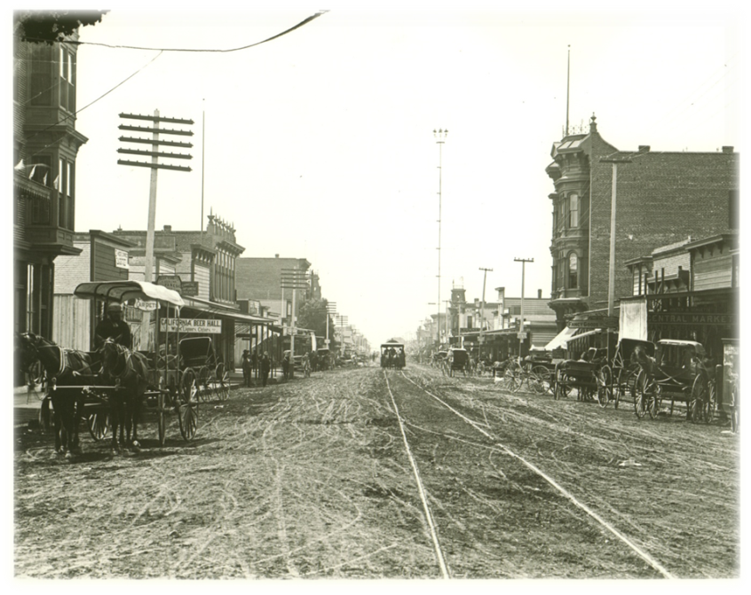
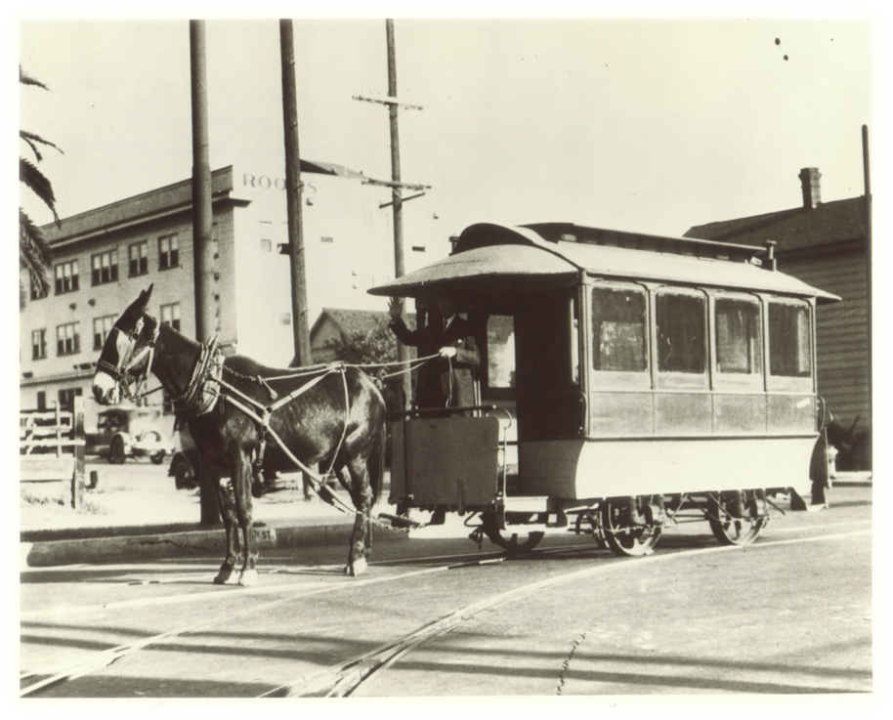
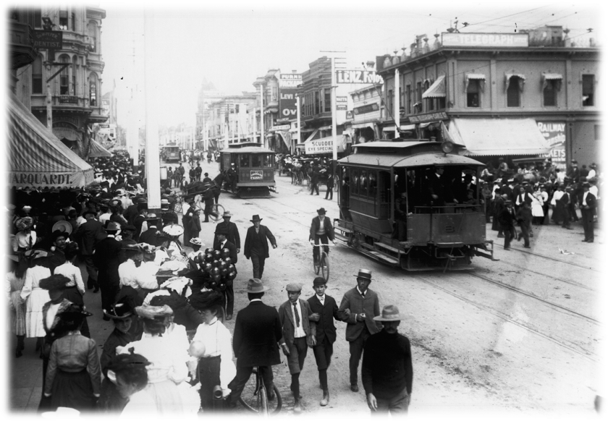
Where We’ve Been
Notes:
Here’s how it all started…
1886, horse drawn vehicle up Broadway
Upper left--- fifth avenue
Lower left – one of the first San Diego Electric Railway cars, which started operating in the late 1800s

Slide 4
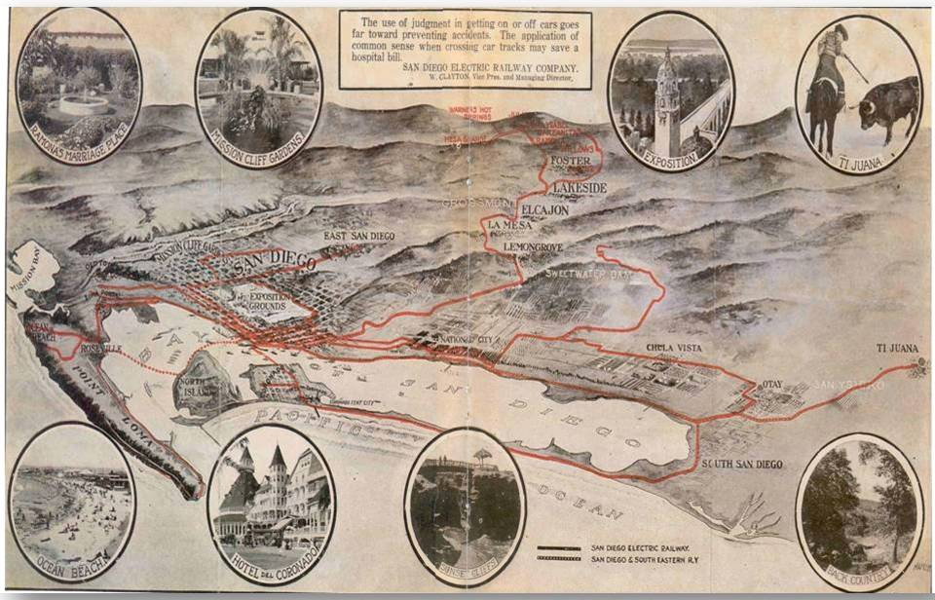
Notes:
By 1915, big network of streetcars
Border to downtown
Point Loma to El Cajon
Up to La Jolla over a causeway at the opening of Mission Bay
Spreckles built to promote development along El Cajon Boulevard

Slide 5
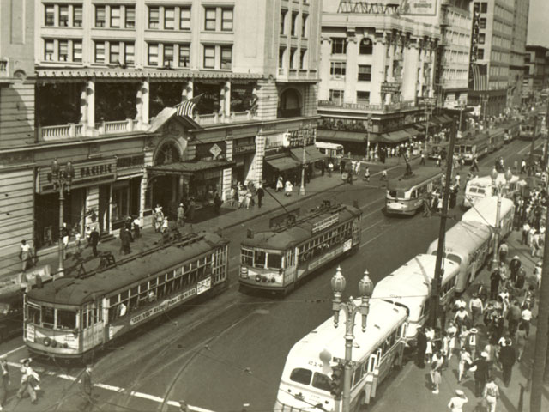
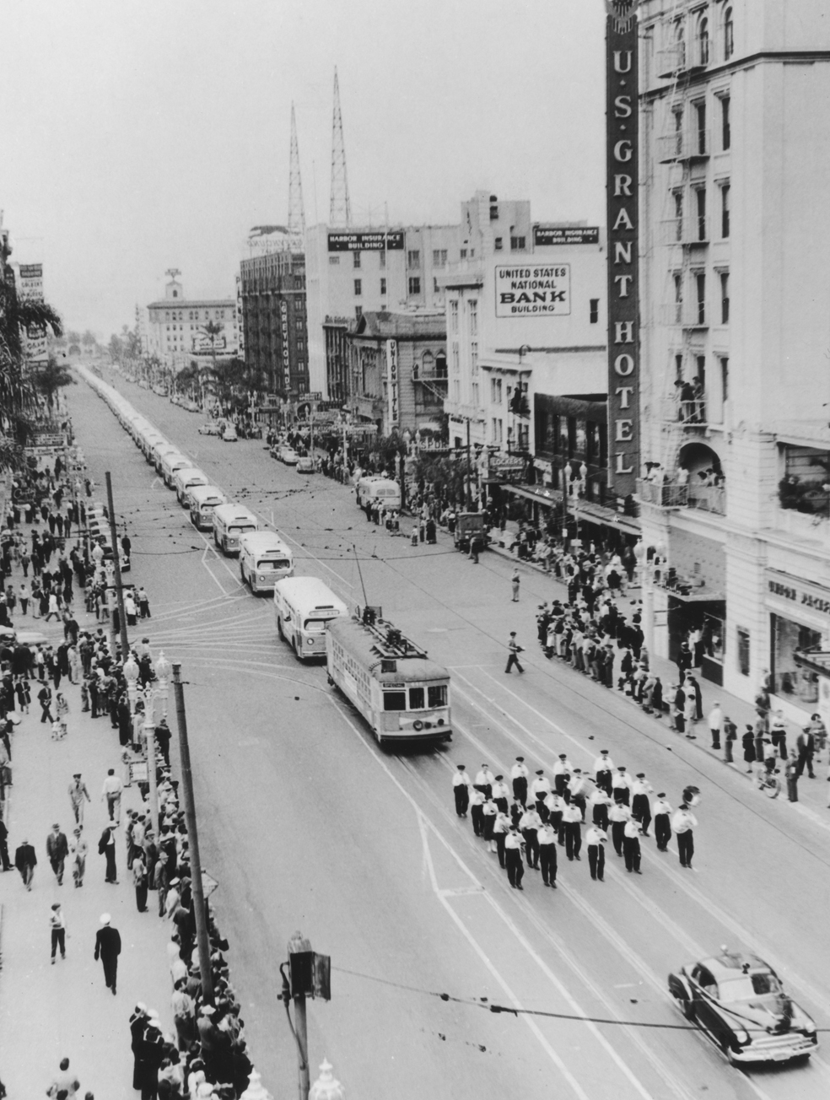
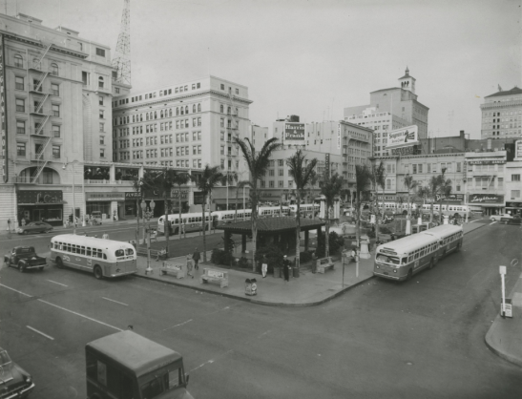
Notes:
Light rail use expanded until the early 1920s…
In the late 20s, buses began to displace rail lines.
One-by-one rail lines were discontinued.
Our bus routes 2, 7 and 11 were all old route numbers for trolley lines.
Finally, on April 23, 1949, the last San Diego Street Car made its run up Route 7 from San Diego to La Mesa.
That day, a bus parade up Broadway, led by the last trolley car, ushered in a new era for transportation.

Slide 6
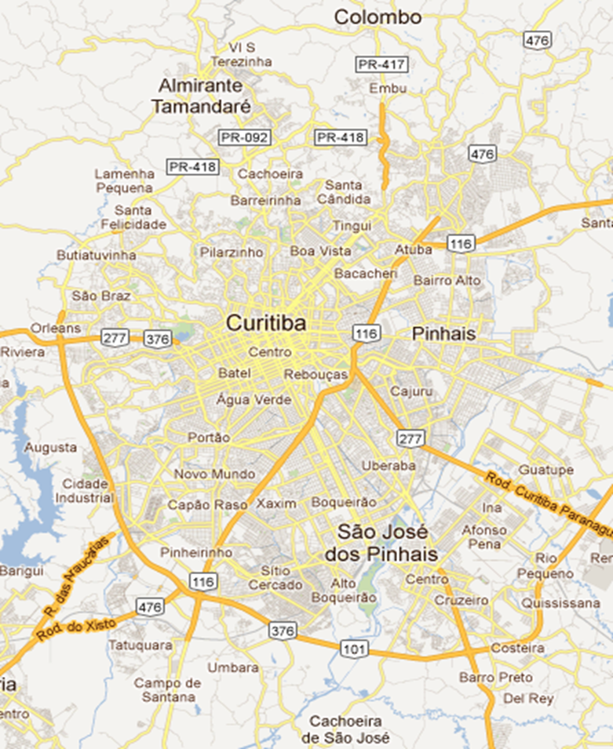
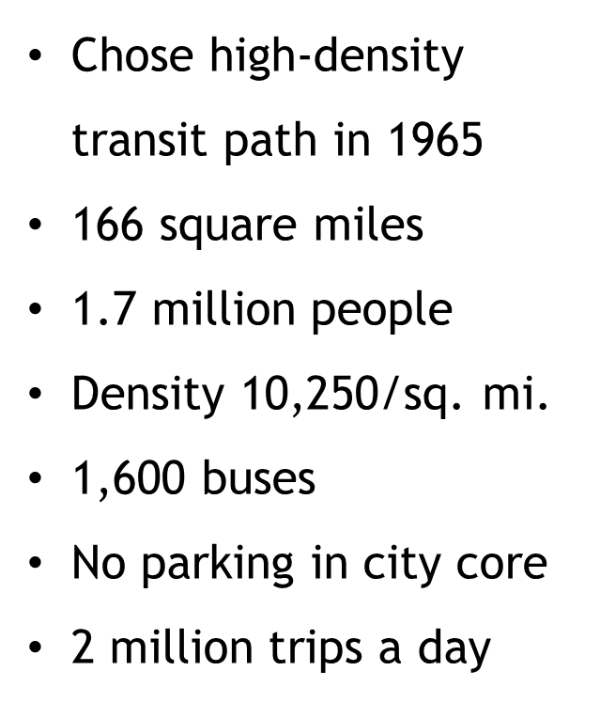
Curitiba
Notes:
Quick diversion
About 15 years after this region went to buses, Curiitiba, Brazil, made a drastically different decision
“Why can’t you be like Curitiba,” people ask.
It all has to do with planning.
In 1965 ,Curitiba, knowing it was going to grow rapidly, decided that public transportation would be the backbone of its city….
Today, the urban core of Curitiba is about 166 square miles.
1.7 million people live there.
No parking is allowed in the city core.,
As a result that have 1,600 buses carrying about 2 million people a day.

Slide 7
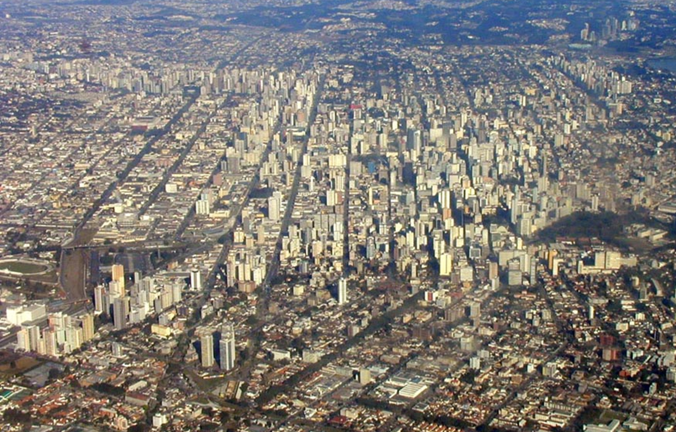
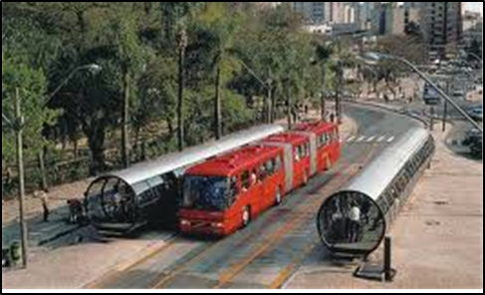
Notes:
Here’s what it looks like,
And the inset shows one of its rail-like Bus Rapid Transit stations.

Slide 8
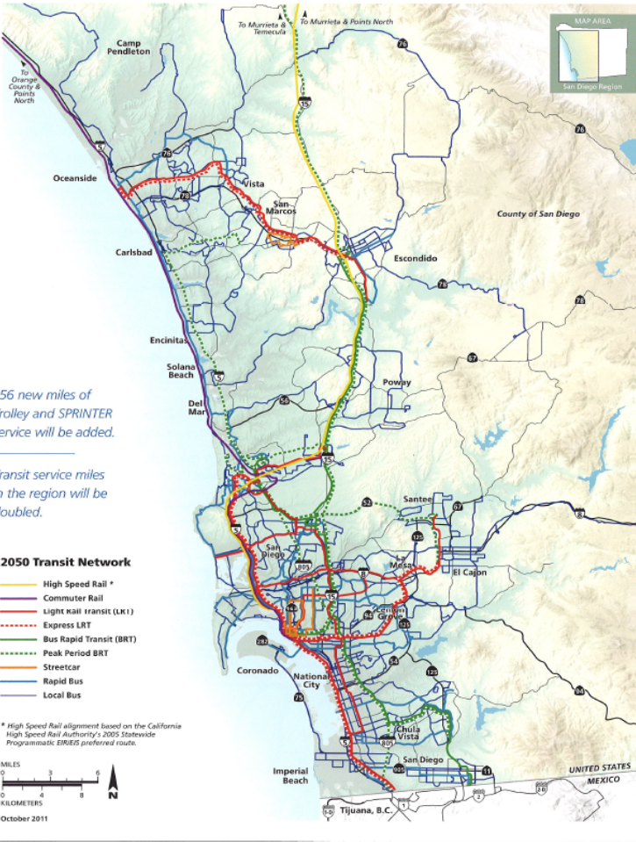
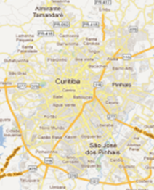
A Different Path
578 square miles in urbanized zone
1.8 million people
Density: 2,300/sq. mi.
Multiple destinations
Extremely hard to serve with transit
300,000 trips a day
Notes:
About the same time, San Diego, and the rest of the nation, was busy building freeways.
Our region sprawled.
Today, about the same population is spread over a much wider area.
Our density is about 20% of Curitiba’s.
It is a much hard region to serve with public transit.

Slide 9
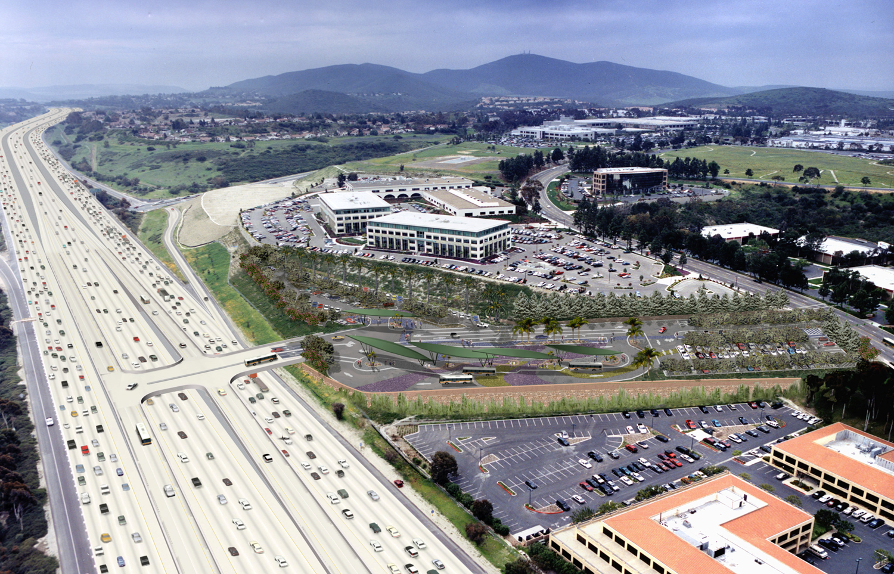
Notes:
As a result of the path we chose, we now have a built environment that is much harder to serve with transit.
Neither path is right or wrong, it just the result of different choices.

Slide 10
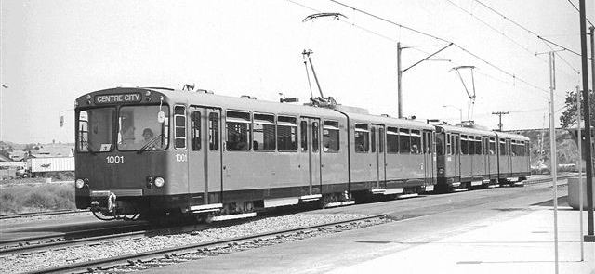
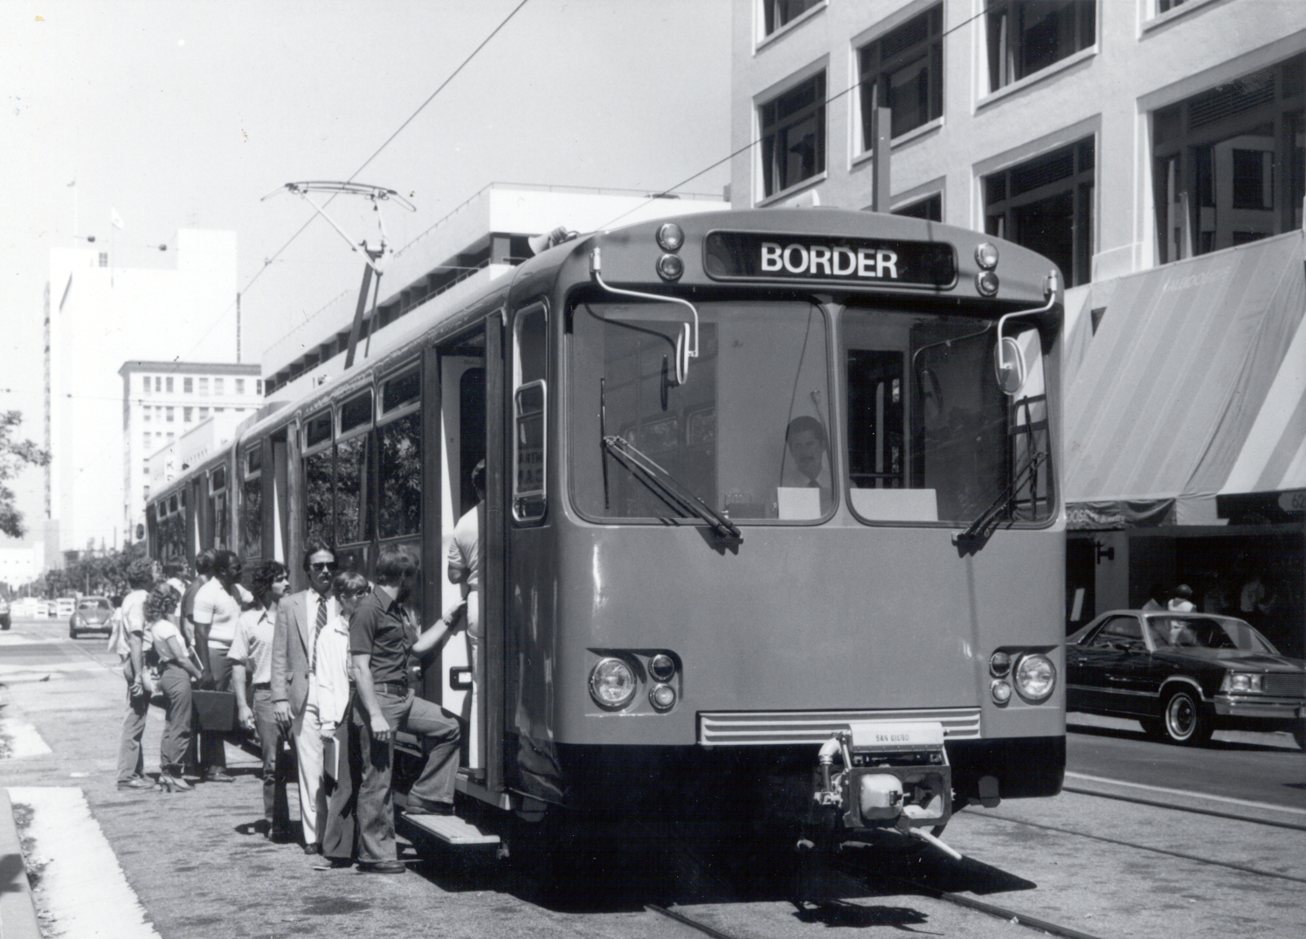
Notes:
After about 30 years, our freeways were overcrowded
A new push to reintroduce light rails started here in San Diego
In 1981,the South Line, as it was called then, led the nation’s renaissance of light rail development.
It is still held up as a national model, studied by every system that has built light rail since. And there are more than 20 cities now with light rail systems.
We have expanded the system incrementally over the last 30 years

Slide 11
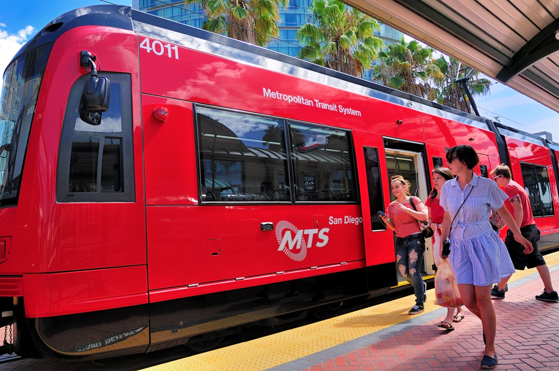
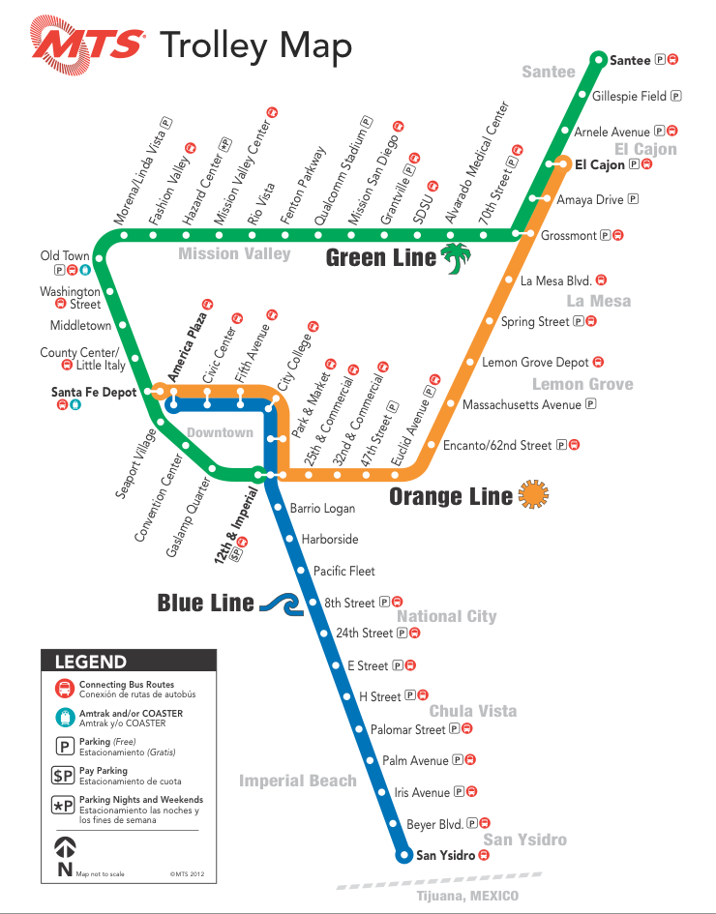
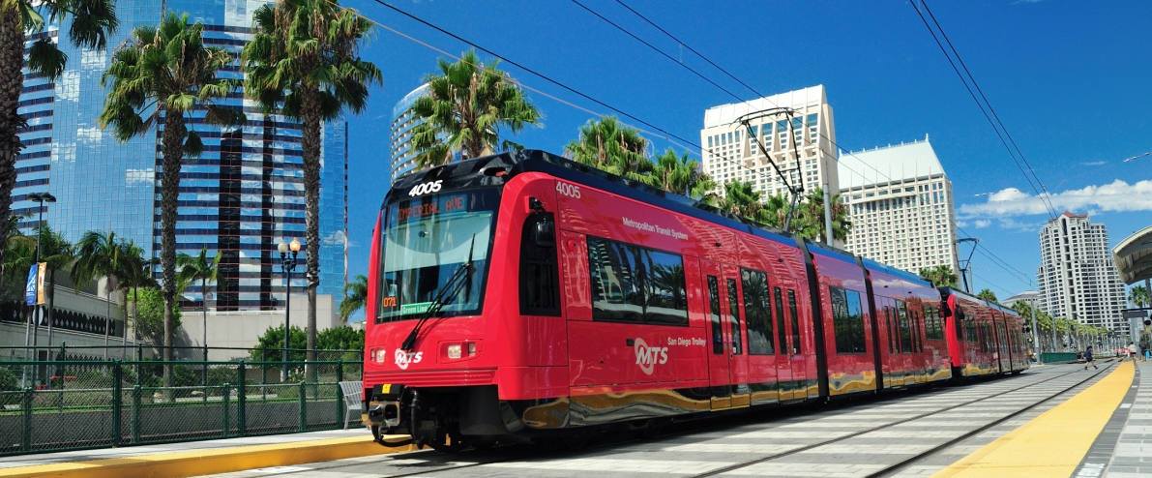
Notes:
So this is where we are today…
Three lines (describe)
And recently, we have updated our entire fleet)

Slide 12
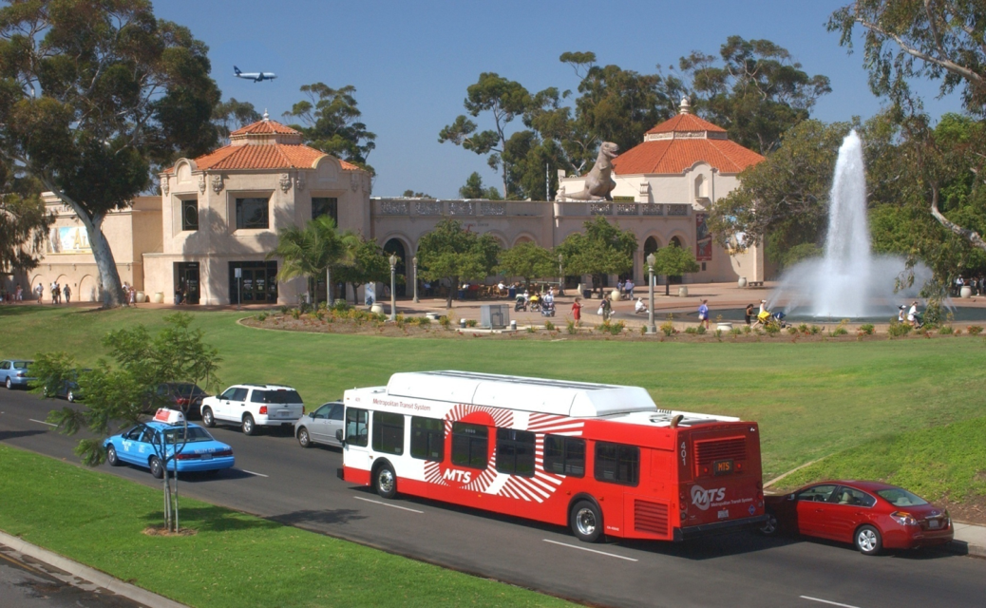
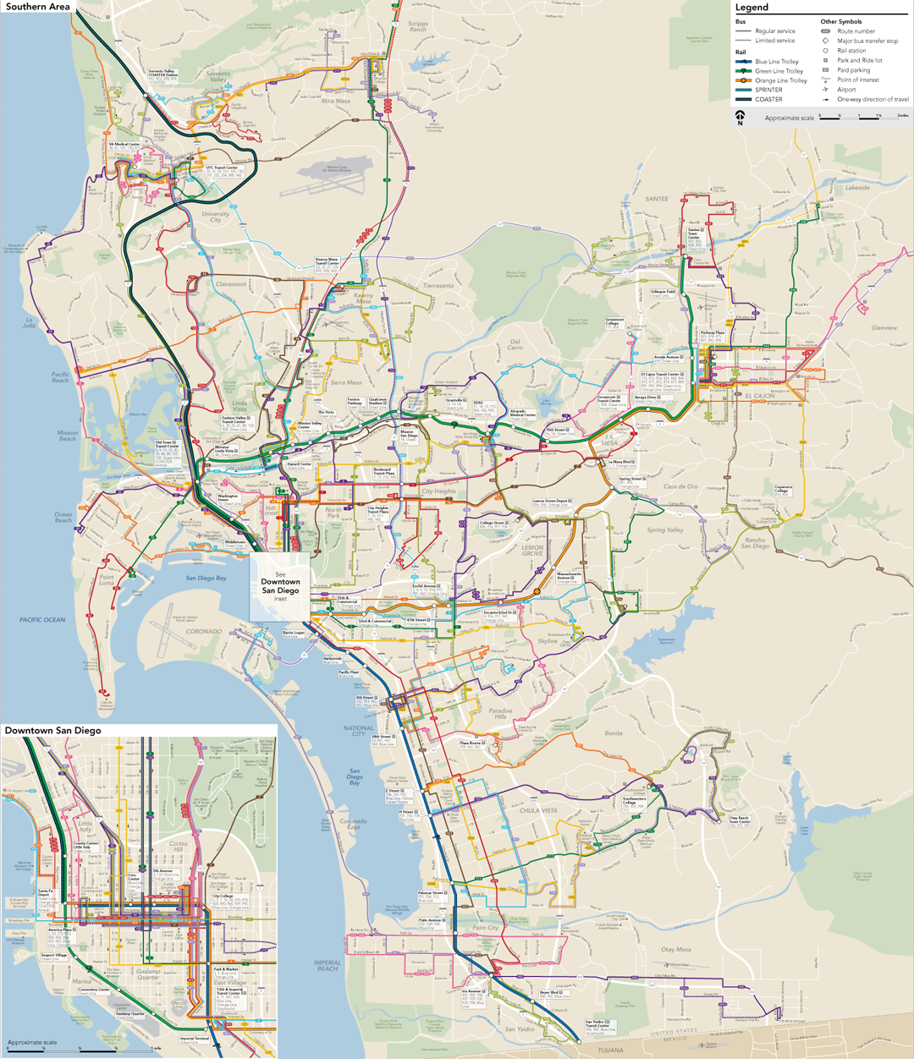
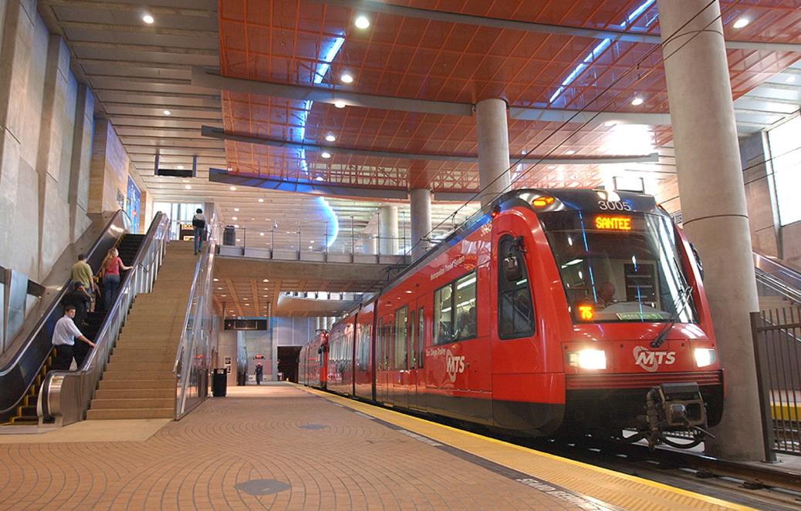
MTS
53 miles of Trolley tracks
90+ Bus Routes
300,000 trips/day
$244 million operating budget
1,500 employees
1,000 contract employees
Notes:
Today, we have a very healthy mix of modes
53 miles of track
90+ bus routes
$250 million operating budget
1,500 employees
1,000 contract employees

Slide 13
Operating Efficiency
Source: Independent Taxpayers Oversight Committee
System | Farebox Recovery |  | Operating Cost per Boarding |  | Subsidy per Boarding |  | Operating Cost per revenue mile
 | Rail | Bus | Rail | Bus | Rail | Bus | Rail | Bus
MTS | 54.3% | 38.1% | $2.00 | $2.66 | $0.91 | $1.65 | $ 7.87 | $ 7.62
Dallas | 12.6% | 11.5% | $6.29 | $6.52 | $5.50 | $5.77 | $22.66 | $ 9.00
Denver | 31.1% | 26.6% | $3.56 | $3.71 | $2.45 | $7.43 | $ 8.96 | $ 7.43
Los Angeles | 18.3% | 26.5% | $3.62 | $2.58 | $2.96 | $1.90 | $17.41 | $10.86
Minneapolis | 40.3% | 31.0% | $2.46 | $3.59 | $1.47 | $2.48 | $12.78 | $10.53
Phoenix | 28.1% | 16.9% | $2.72 | $5.35 | $1.96 | $4.45 | $12.43 | $ 6.35
Portland | 34.7% | 22.8% | $2.51 | $3.95 | $1.64 | $3.05 | $13.06 | $11.28
Sacramento | 30.2% | 21.9% | $3.12 | $4.27 | $2.18 | $3.34 | $11.75 | $10.68
Salt Lake | 37.2% | 17.2% | $2.09 | $4.89 | $1.31 | $4.02 | $ 8.62 | $ 6.42
Santa Clara | 15.2% | 13.9% | $5.81 | $6.29 | $4.93 | $5.41 | $18.77 | $13.22
9-Peer Ave. | 27.5% | 21.3% | $3.58 | $4.48 | $2.71 | $3.59 | $14.05 | $ 9.52
Notes:
But no matter how big or small, the key to public transportation and to sustainability is operating efficiency
This chart , compiled by a third-party audit committee, has all the key indicators for MTS and compares it to other similar transit agencies….

Slide 14
Pension Reform
Every employee contributes
New union employees are in 401k
Paid off variable pension obligation bonds three years early
Notes:
We have got a handle on our pension obligations….

Slide 15
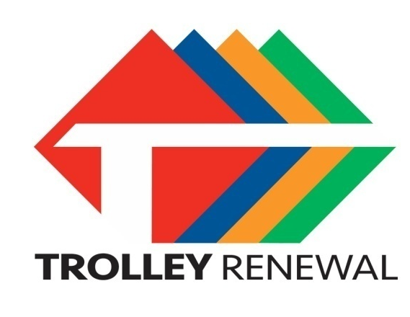
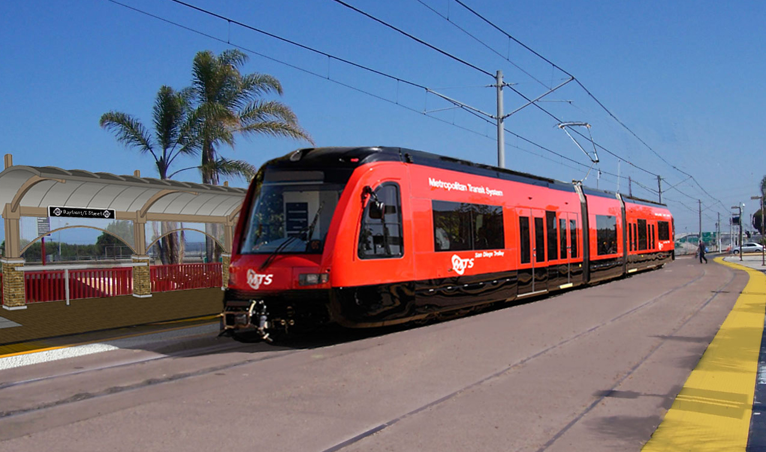
State of Good Repair
Notes:
Sustainability is also taking care of what you already have…
Our biggest project right now is the rebuilding of our Trolley Blue Line.
First built in 1981 on an existing rail line, many of its components are at the end of their useful life.
We are replacing overhead catenary, installing new track, new crossovers, new signals, new grade crossings and new substations. There also will be new station platforms from Old Town through Downtown, out to La Mesa and down to the border.
It’s all to thoroughly modernize our nation’s oldest light rail line and to bring low floor cars to our entire system.
We are already operating low-floor cars on the Green Line and Orange Line.

Slide 16
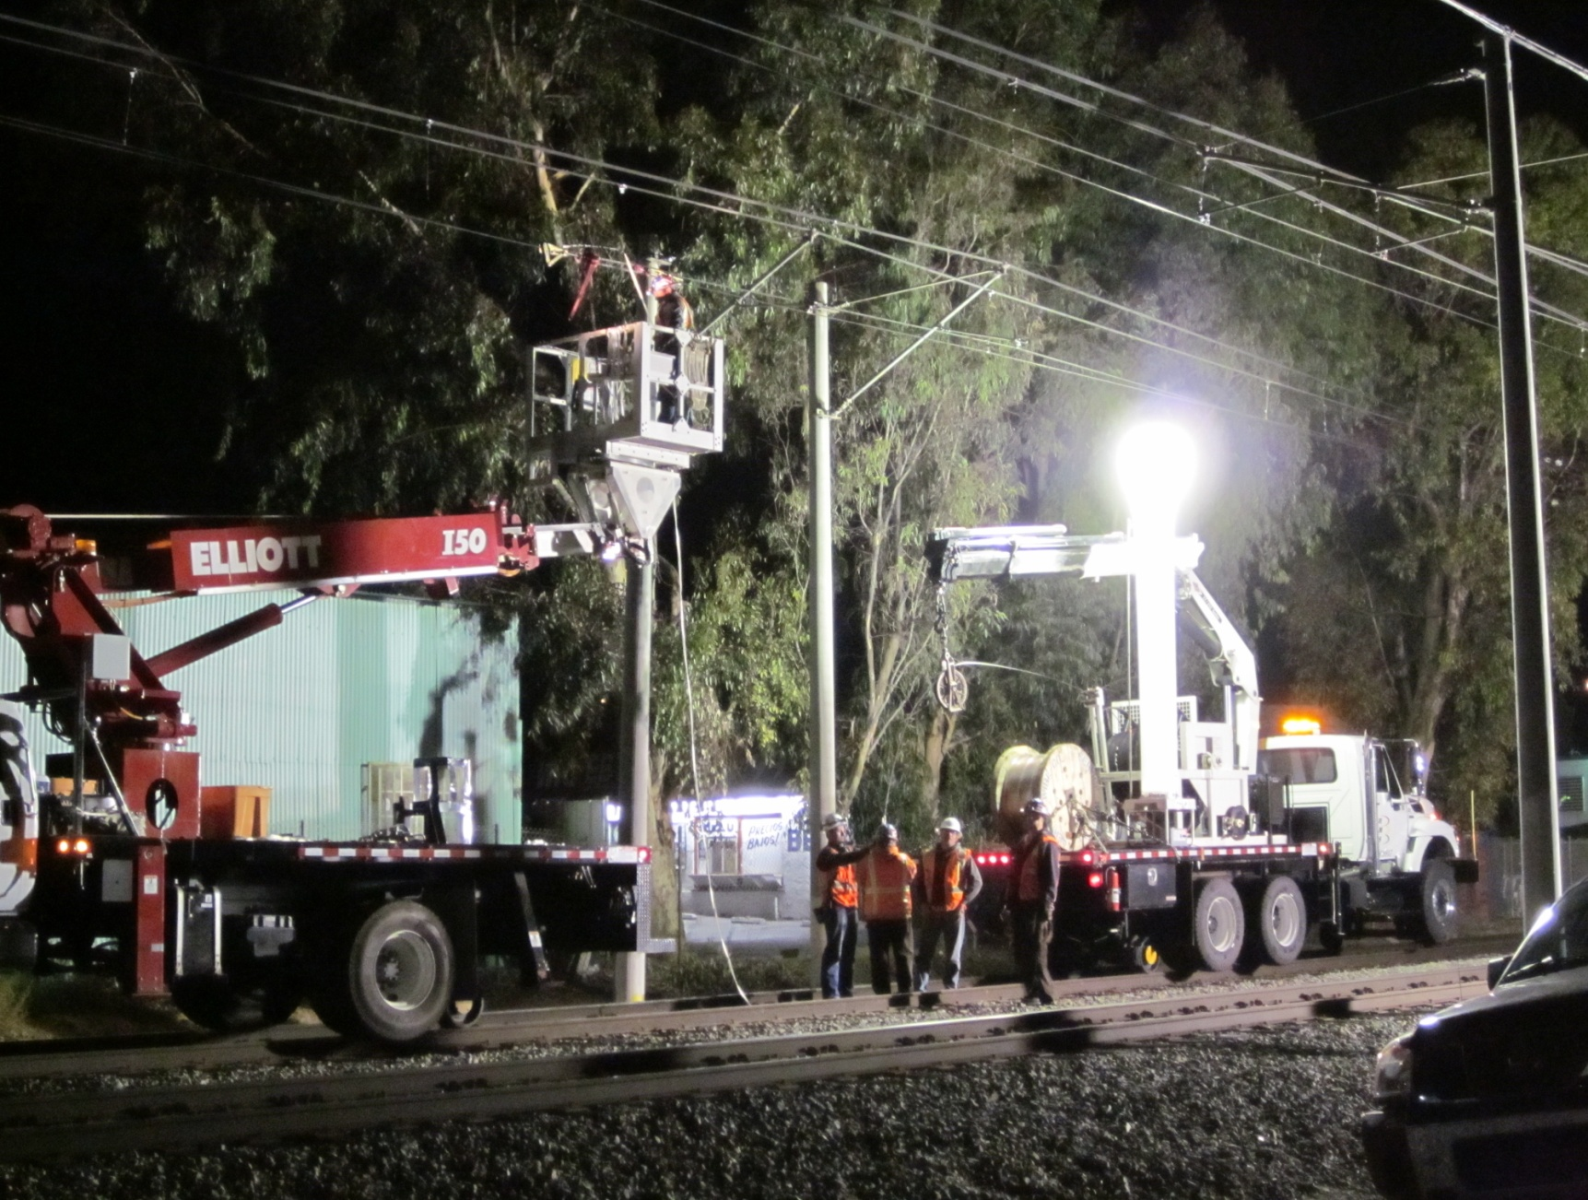
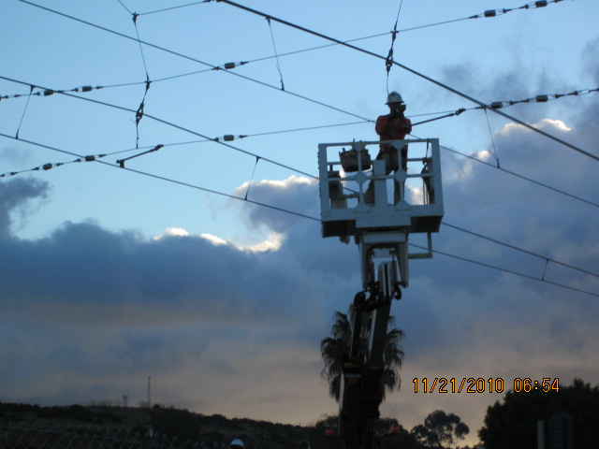
Catenary Replacement: 2010
Notes:
It is a project that will approach $600 million
UsedARRA money, State bond money and local taxes
Great example between agencies to identify funds and to coordinate construction

Slide 17
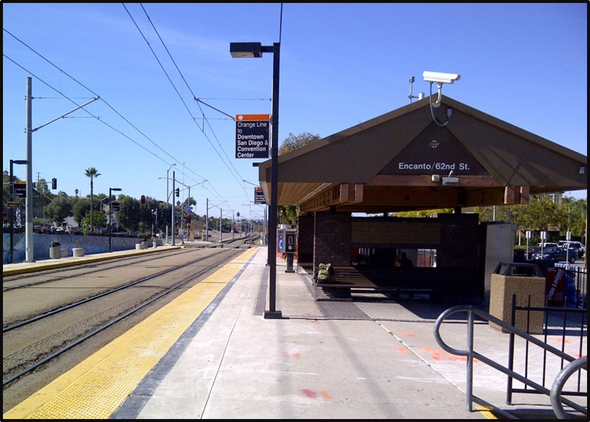
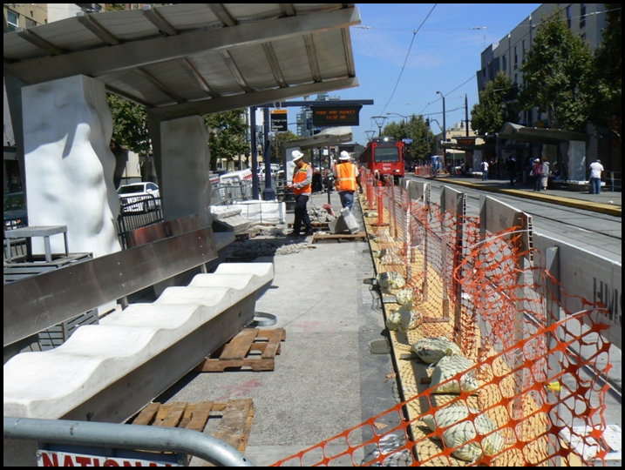
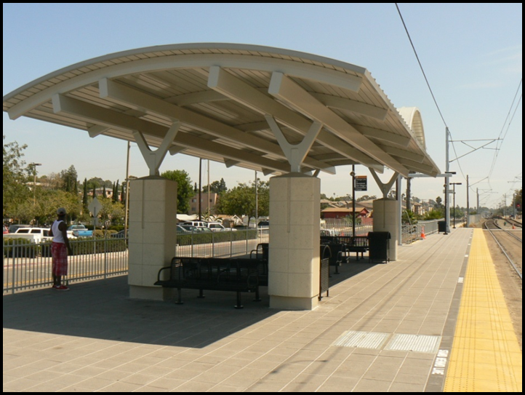
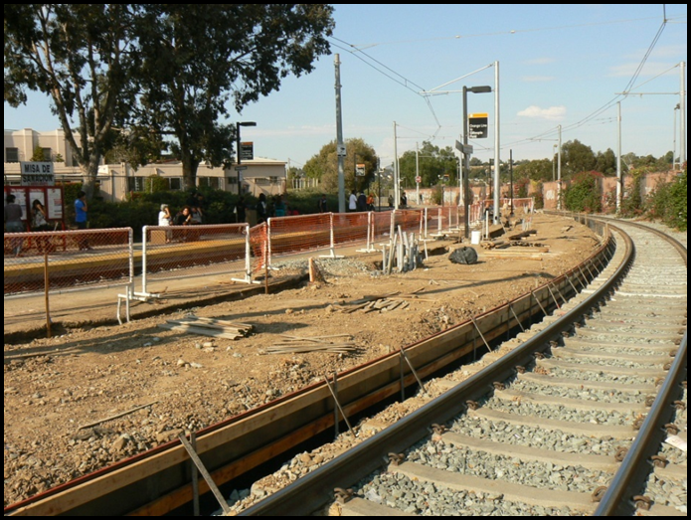
Platforms, Shelters, Rail: 2011
Before
After
Notes:
Replaced shelters and platforms in 2011 along the Green and Orange Lines

Slide 18
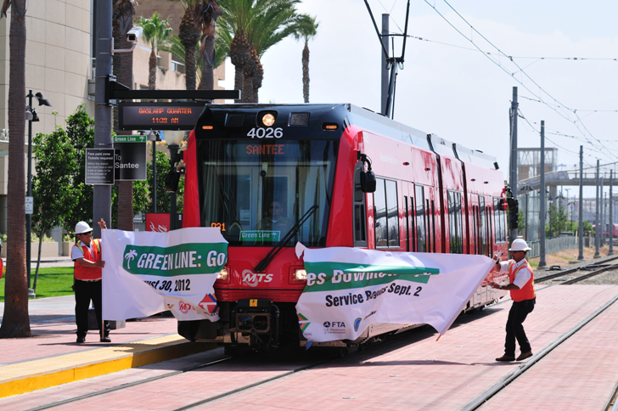
Green Line Extension: 2012
Notes:
Relaigned Green Line to have go through Old Town all the way to Downtown in 2012

Slide 19
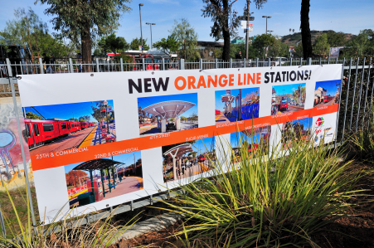
Low Floors on Orange Line 2013
Notes:
Opened Orange Line in January 2013

Slide 20
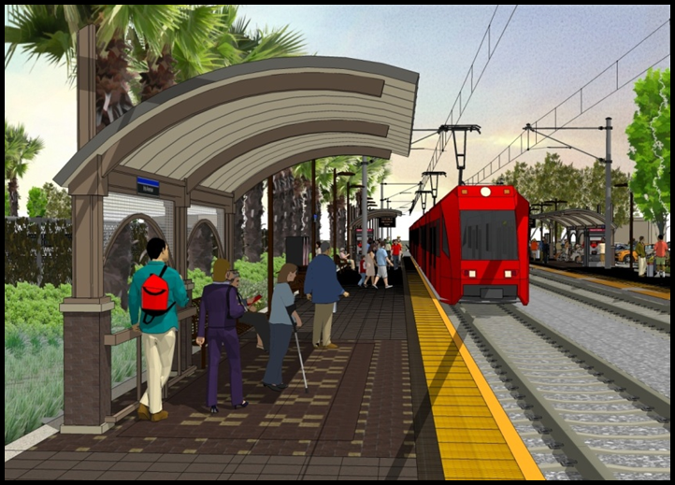
Blue Line: 2013/14
Notes:
Will start Blue Line work next month and expect to begin low-floor operations in fall 2014

Slide 21
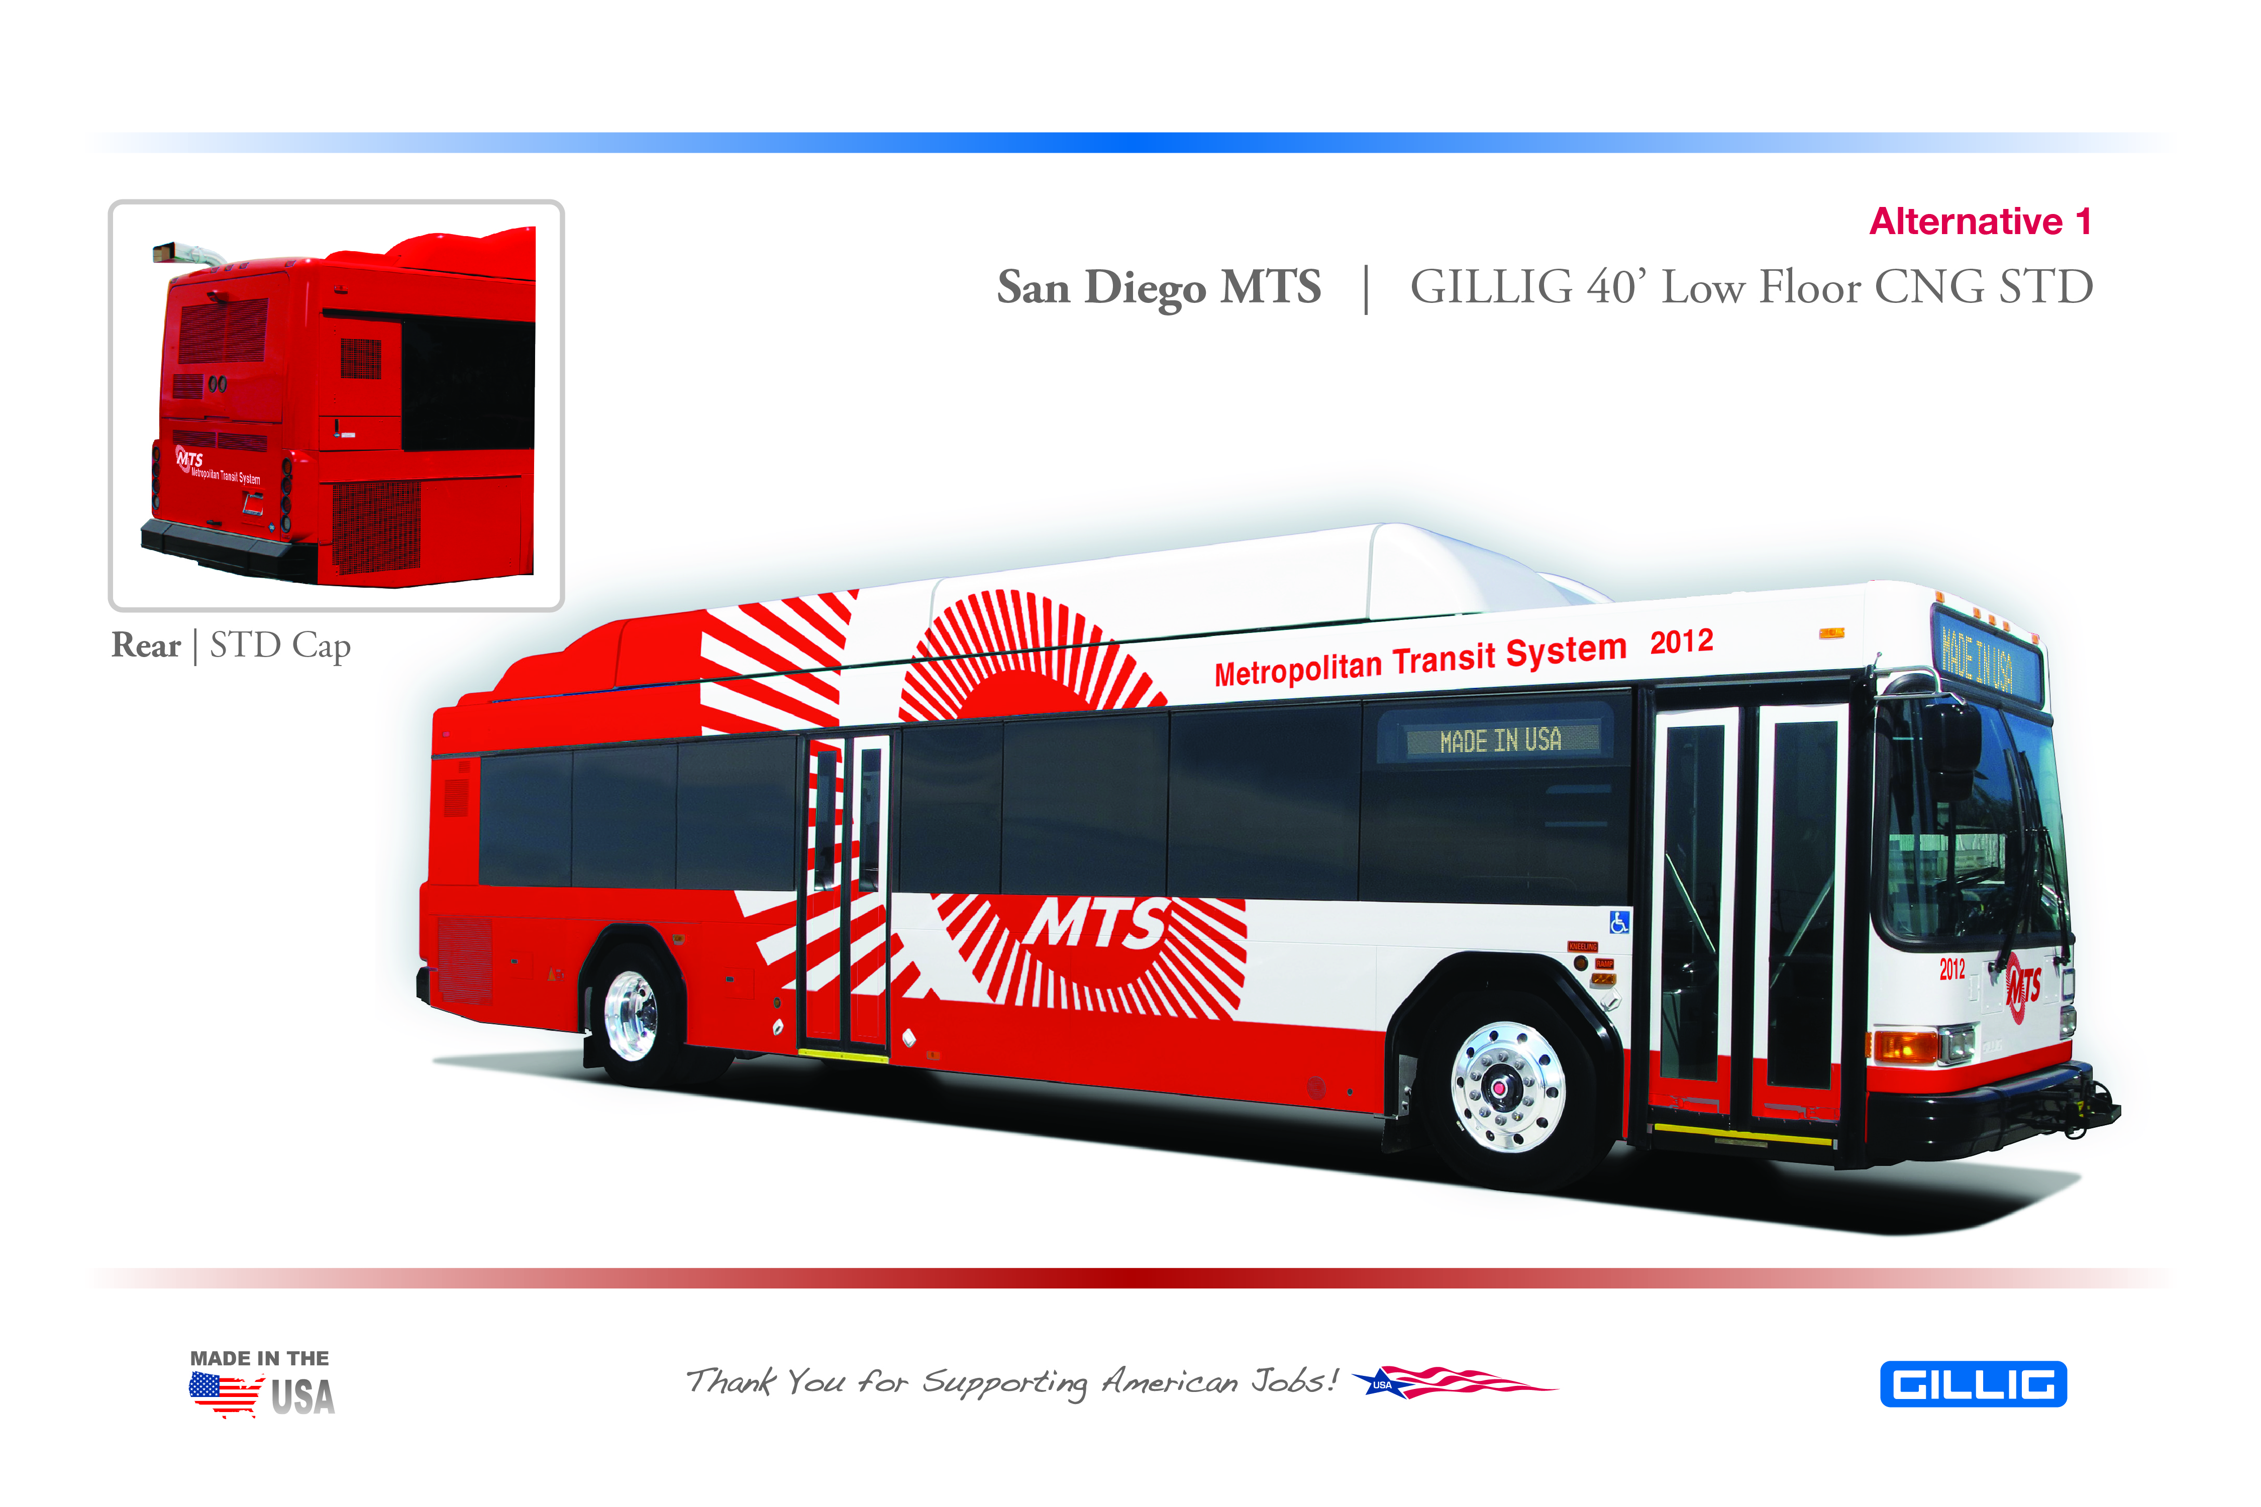
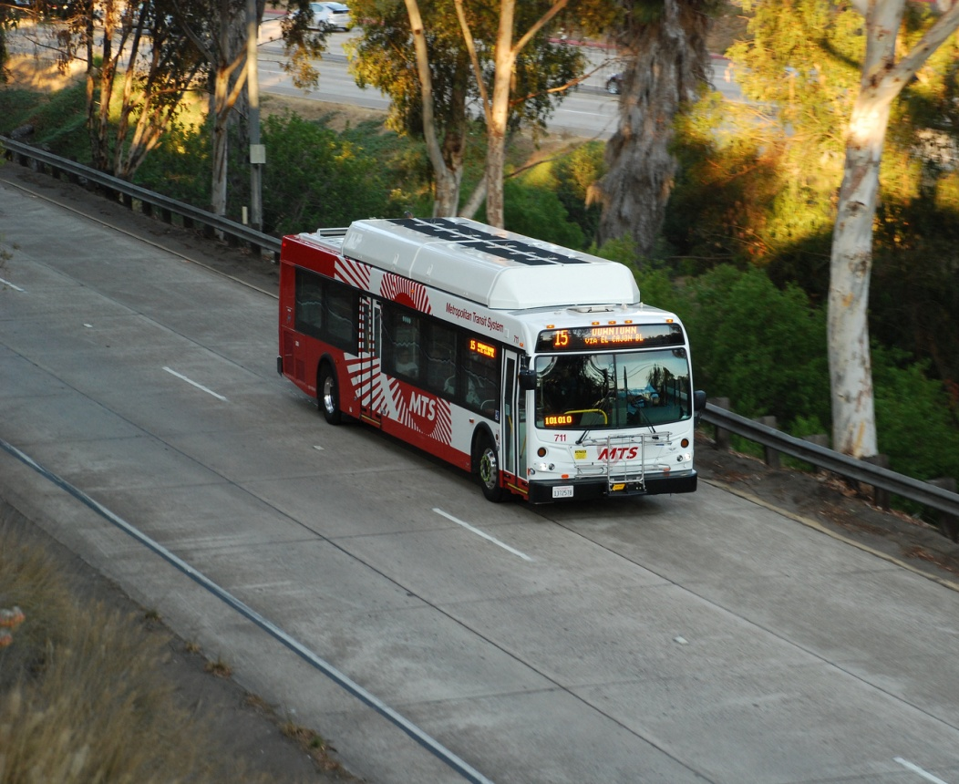
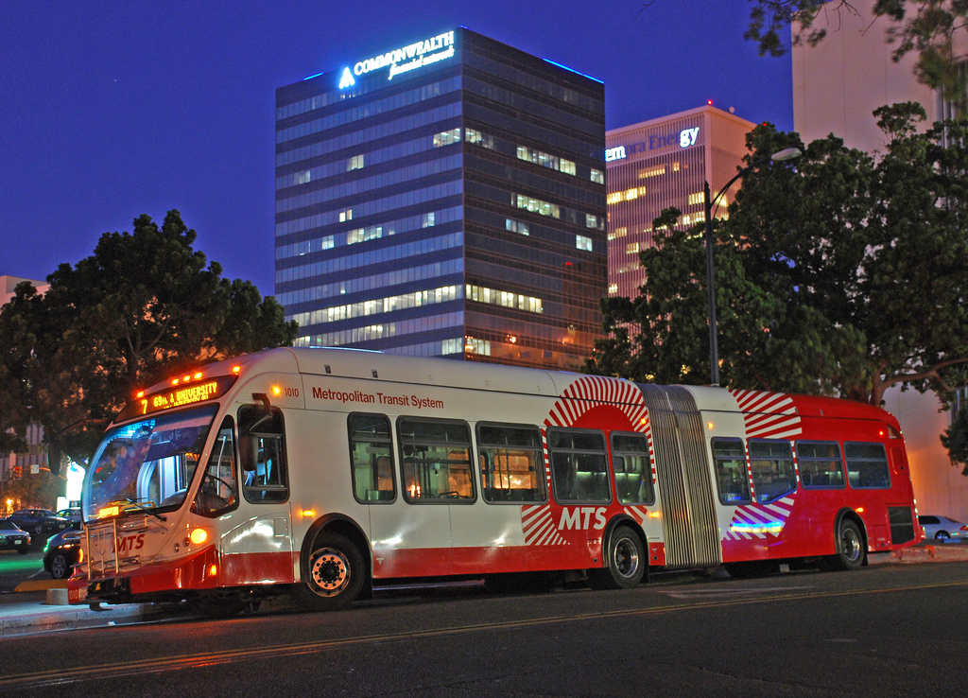
New Flyer Artic
Gillig
New Buses
New Flyer 40-foot
NABI
Notes:
We’ve also invested in new buses
Fleet is now 80 percent CNG
We have some gas hybrids
Fleet has never been cleaner or better maintained

Slide 22
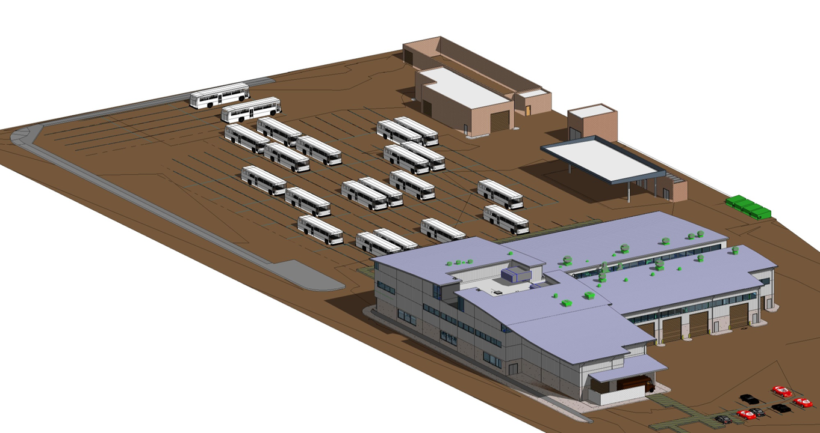
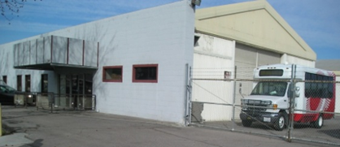
Facilities
East County Bus Facility
Notes:
Also investing in our real estate assets
New South Bay Maintenance Facility
This is a rendering of our new facility in El Cajon, which will have a Silver LEED designation

Slide 23
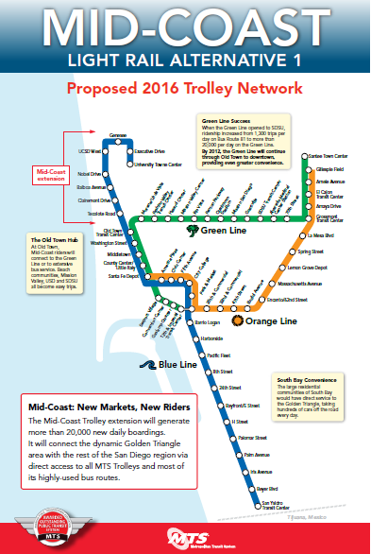
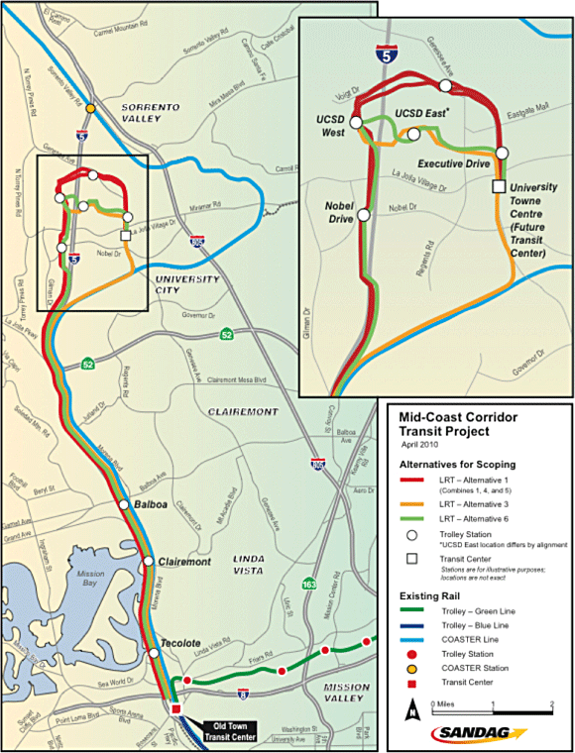
Notes:
So what likes ahead
Mid-Coast Trolley
11.6 miles from Old Town to UTC through UC San Diego
Supported by all stakeholders

Slide 24
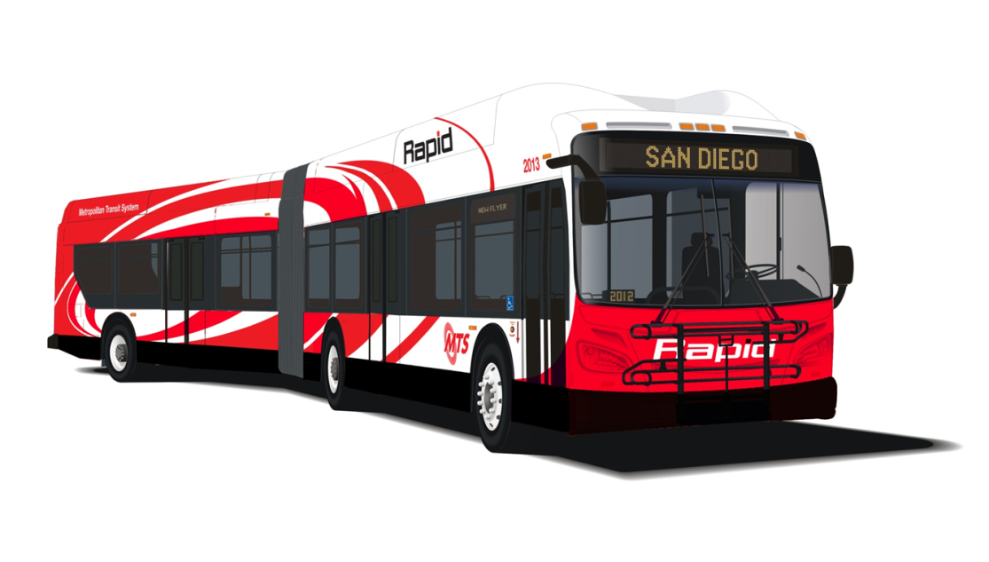
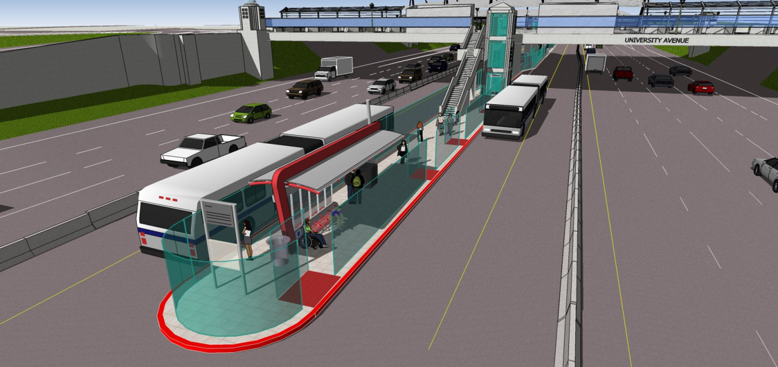
BRT Routes
Dedicated Stations
Centerline Stations
Notes:
Bus Rapid Transit routes will be introduced next year
New level of service
Higher frequency, center platforms on I-15 in mid-city, dedicated lanes in the South Bay, signal prioritization on El Cajon Blvd., next arrival signs and more.

Slide 25
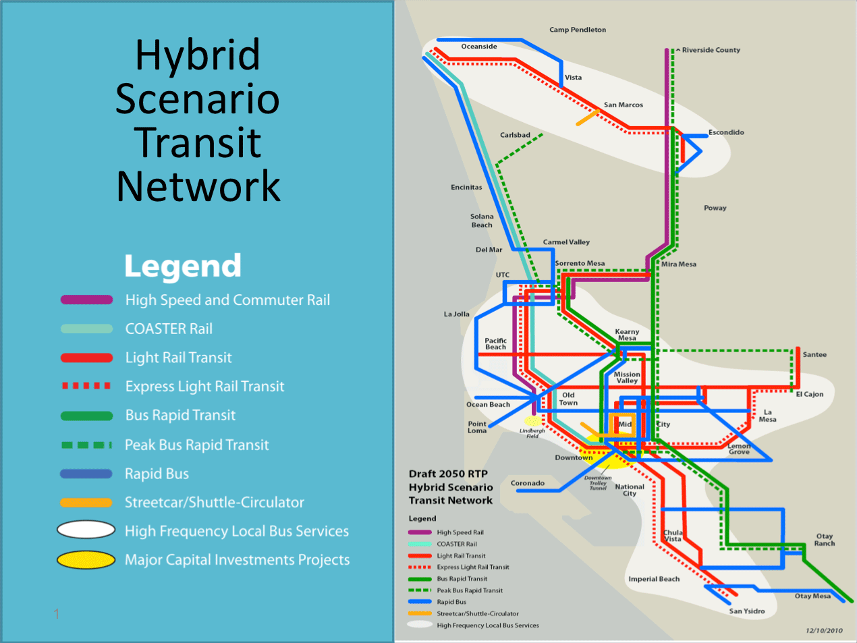
Notes:
This is the 2050 plan for public transit.
More rail.
More BRT.
More frequency.
Longer span of service.
All the things we need to encourage an even higher use of public transportation.
It is a good vision of how we can evolve and provide a greater share of the region’s transportation needs.

Slide 26
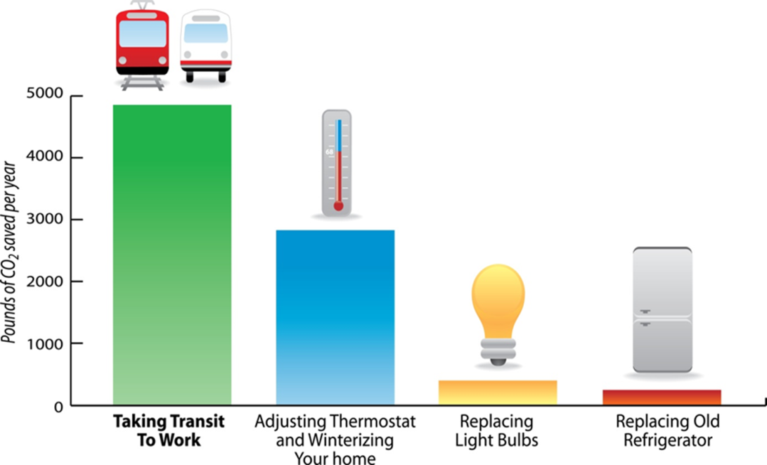
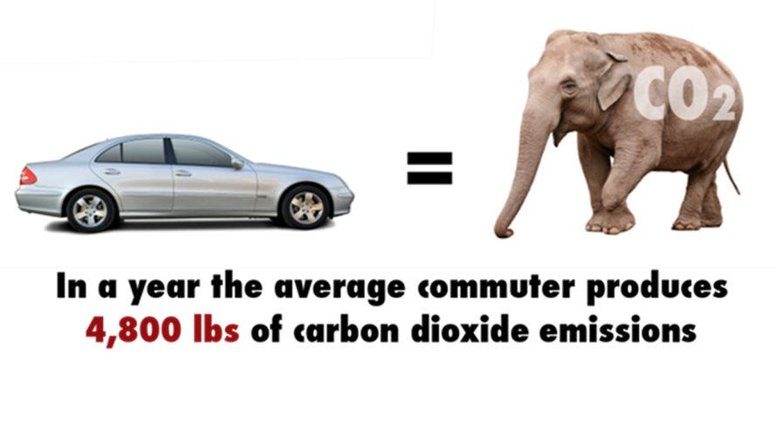
Sustainability Threats w/o Transit
Notes:
In addressing sustainability, I think the question could be flipped:
How will our region’s sustainability goals be achieved withhout transit.
The environment will definitely suffer without more people using transit.
If you want to lower your individual carbon footprint, there is no bigger way to make a positive impact than to give up your car and ride transit…
It is astounding how much greenhouse gases are put into the air by each car.

Slide 27
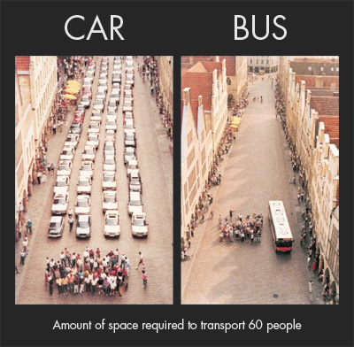
Notes:
Our built environment will suffer.
Some people oppose our BRT project because buses use Broadway. They are opposed to utilizing off-street parking for bus layovers.
They want our buses and trolleys to stop at the outskirts of downtown and have everyone transfer to small fans just minutes from their final stop.
This picture illustrates two things…
Buses transport many more people and have a far less impact on the downtown environment than cars
Secondly, downtown San Diego is expected to grow by tens of thousands of people over the next couple of decades…. That growth cannot be supported without public transportation. Streets would be gridlock. Parking would be insufficient and if you could lease a space, the cost would be astronomical.
2008 study revealed that a downtown development scenario relying more heavily on transit could eliminate the need for 21,000 new parking spaces.
At about $20k per space (in an above-ground structure)O that’s a savings of about $450 million. That buys a lot of transit.

Slide 28
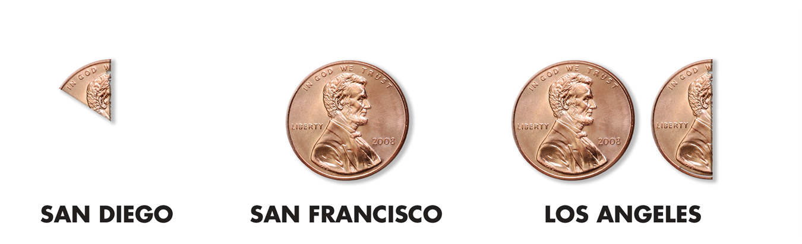
Threats to Sustainability
Notes:
The real threat is money
The state robbed us of taxes that caused us to raise fares and cut service.
That has been resolved, but that source of funds is always at risk.
Level of public subsidy is very low in San Diego compared to other systems.
So, to ensure that our system is sustainable, I urge you all to support more transit, vote for initiatives that pay for more transit, and ride transit as often as you can.

Slide 29
Paul Jablonski
Chief Executive Officer, MTS
Thank you

