Slide 1
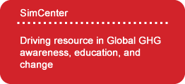
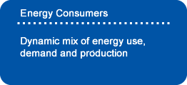
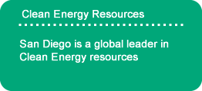
Mission – Sustainable San Diego
To create a community driven informational user-guide that employers a region to achieve a high level of sustainability through shared resources, collaboration and implementation guidance that can be duplicated and implemented globally.
March 2014

Slide 2
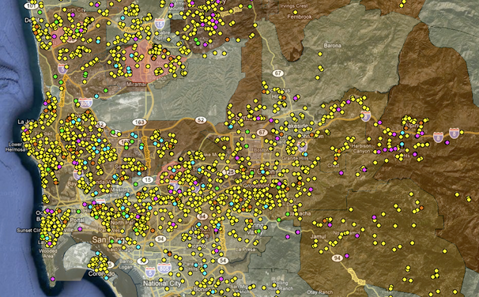
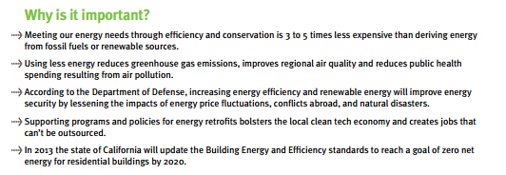
Sustainability is the ability to maintain a certain status or process in existing systems. The most frequent use of the term “sustainability” is connected to biological or human systems in the context of ecology. The ability of an ecosystem to function and maintain productivity for a prolonged period is also sustainability.
Empowering a community through education to Live a sustainable Lifestyle
Solar Installations in San Diego - 2011

Slide 3
Who Benefits from our Objectives?
Housing units, 2012 | 1,169,057
San Diego real estate market consists of over 111 million square feet of office space, 190 million square feet of industrial space, and 136 million square feet of retail space. Cassidy Turley
Our target are those that benefit the most and who have the largest impact on sustainability.

Slide 4
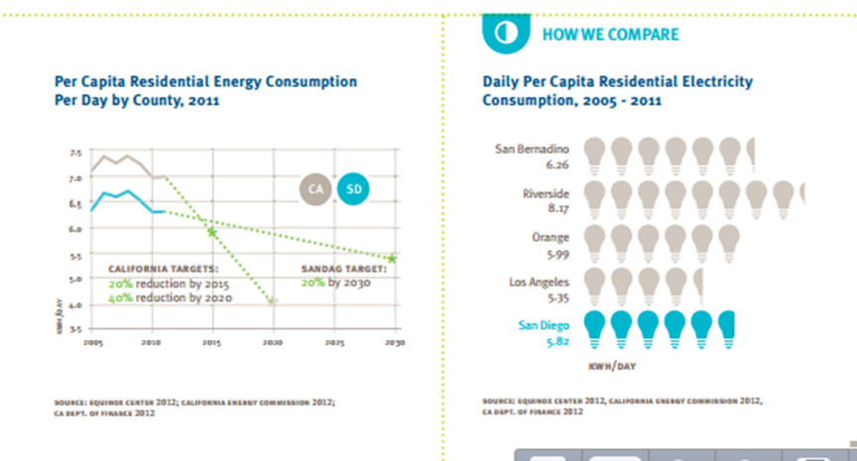
San Diego is already on the path to sustainability
In 2011, San Diego Gas & Electric (SDG&E), the region’s energy utility, reached its goal of increasing renewable energy sources to 20 percent of total sales. Compared to the previous year, solar installations per 100 residents in the county increased on average by 46 percent, due to substantial expansion of both residential and non-residential installations.
In 2011, environmental technology jobs represented 8 percent of all new jobs created in San Diego regional technology start-ups, a slight increase from 2010. The City of San Diego hosted 44 of the 96 new environmental technology start-up jobs in San Diego County over the last year.

Slide 5
A target change towards sustainability adoption
“Climate Change” has become one of the most powerful combination of words globally but little is being done in education for the largest potential impact of those that can make change happen, the energy consumption users.
There is a tremendous amount of focus on governments to adapt clean tech solutions but change is slow when demand for low hanging fruit is high; oil & coal. Our global economies are driven by fuel resources of which very little is clean energy at less than 10%, with only a 14% estimated marketed projection by 2025.
Less than 1% of our global market exported energy is renewable. eia
Promote energy savings
Provide proven solutions
Education format
Collect and report data
Duplicate in other communities
The end user pays a significant price in being the driver in the global economy of energy commodities and therefore has a different motivation than the global market in the adoption of clean tech and is the primary leader at about 19% clean energy production/use today.

Slide 6
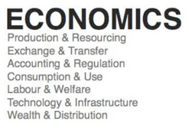
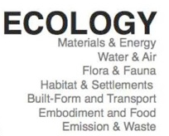
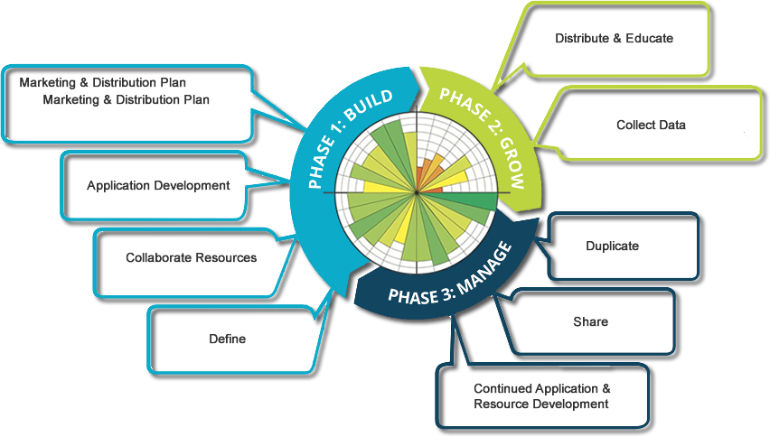
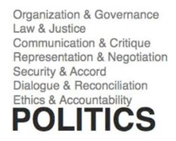
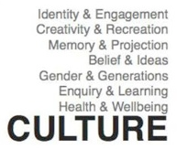
A plan from Local to Global Sustainability

Slide 7
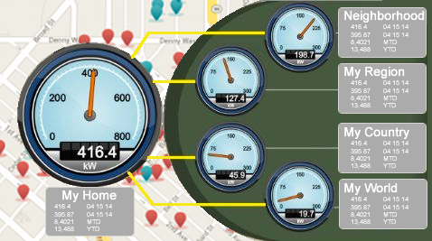
San Diego Sustainable Resource Application
Our solution is a Simple user tool that allows for user (building owner, tenant, home owner, renter, facility manager) collection of building resource assessment data.
Data is then applied to applicable resources for sustainability plan implementation, tasking and management
Data is recorded for tracking and comparison to local, regional and global datasets.
Practical, proven, real world data analysis and mapping that demonstrates global economic prosperity with a long term accountable impact in the improvement of our sustainable quality of life.

Slide 8
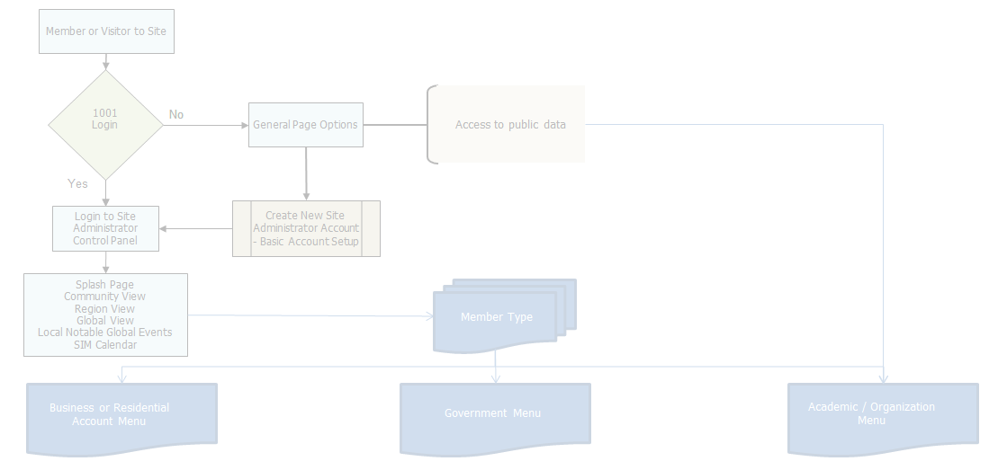
San Diego Sustainable Resource Application
The collection of data presents the largest obstacle in GHG assessments. Automation of data collection will become a primary component in making the planning process cost, resource and time, effective.
Upon collection and analysis of building data provide intuitive, visual and accountable reporting that effectively demonstrates GHG, financial, and life-flow benefits.
Facility detailed energy consumption and resource use today, as impacted by change and as applied to specific goals for benchmarking and tracking.
Collective community data that allows building owners access to compare their GHG with others within their community, in the region, and around the world.
Cost Benefit Focus that allows implementation based on highest reward and return on investment.
Life-flow Benefit Focus that allows implementation based on best use of resources, space to improve workspace productivity.

Slide 9
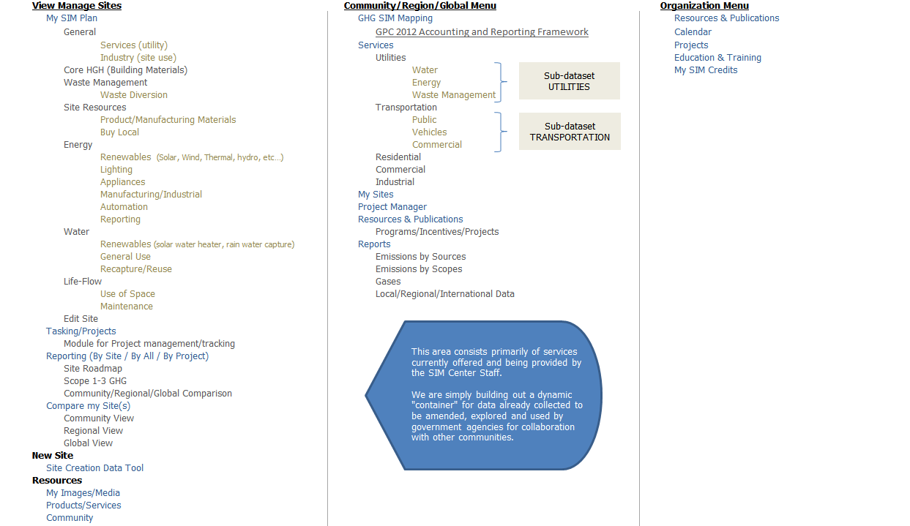
Application Resource Flow
Type and Level of user interaction determines data flow, resources and tools available.

Slide 10
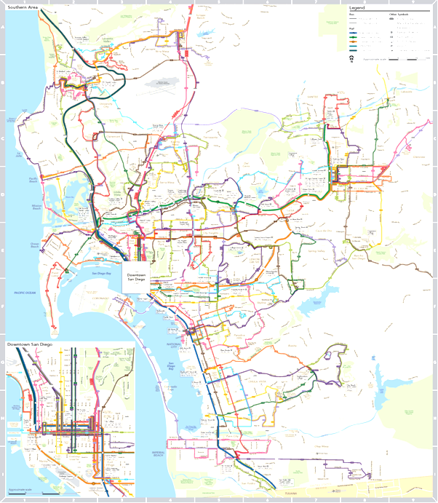
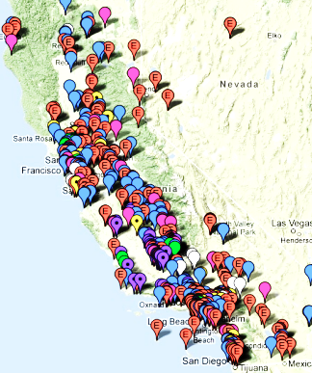
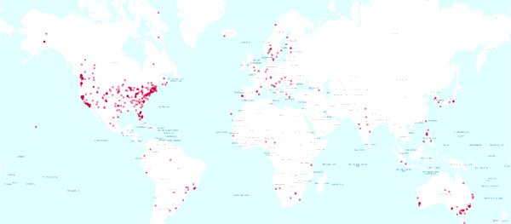
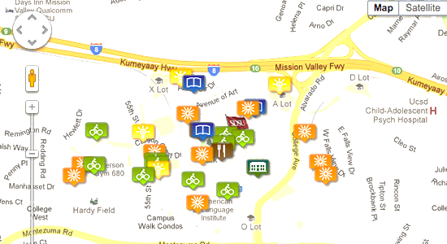
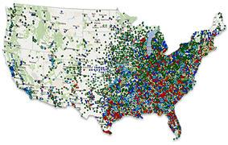
Data & Resource Management
Building Data
Community Data
City Data
Regional Data
National Data
Global Data

Slide 11
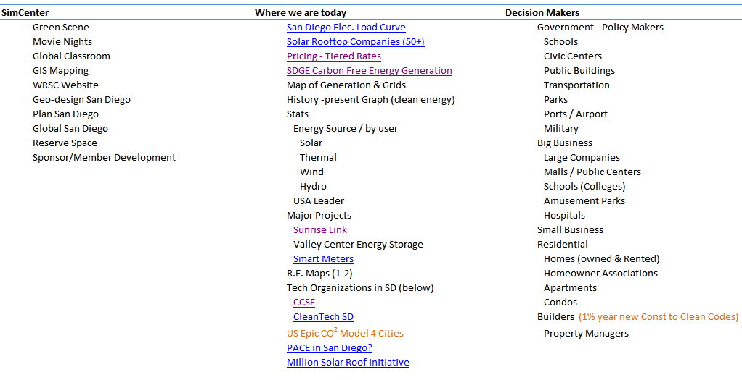
Project Planning & Development

Slide 12
Community Resource Leaders

Slide 13
Project Contacts
David Raine
dave@dyotech.com
760-580-4271
Jamaal Knight
jamaalknight@gmail.com
Stephen Johnston
sjohnston@cleanandrenewable.com
Peter Meisen
Geni.org@gmail.com

