Slide 1
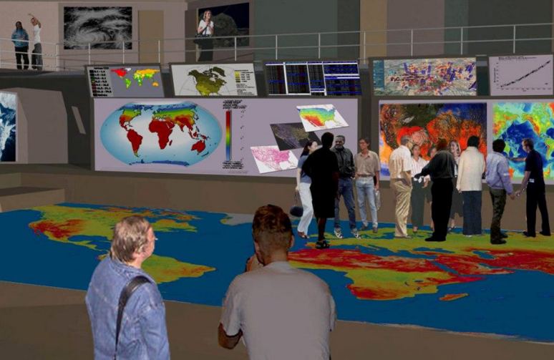
SIMCenter Austin
Visualizing sustainable solutions to global and local problems so we make informed choices quicker.
World Resources Simulation Center wrsc.org
~~~~~~~~~~~~~~~~~
Where do we go to grapple with the challenging issues of our time?

Slide 2
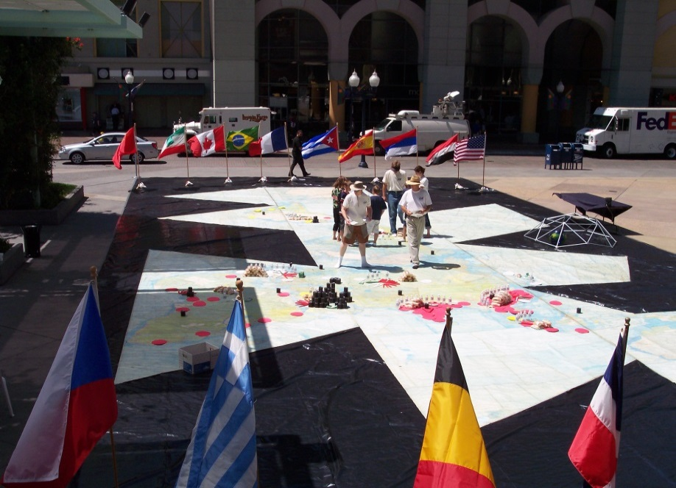
The Big Why?
“How do we make the world work for 100% of humanity
in the shortest possible time through spontaneous cooperation without ecological damage
or the disadvantage to anyone”
World GameTM mission
Using the Dymaxion Map, the original World GameTM (now called Global Game) simulations began in 1969.
Now we can visualize all global data digitally.

Slide 3
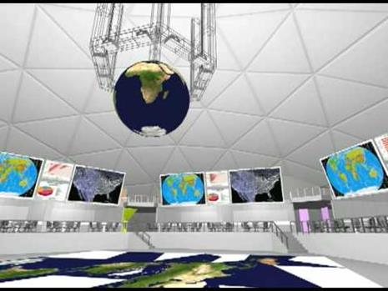
What is the SIMCenter?
The SIMCenter is an immersive visualization facility that fosters global understanding and collaborative problem-solving.
Participants can literally "see" past trends, future projections and compare choices for the future.
The large digital floor displays layered mapping (GIS) that accelerates understanding of global and local trends.
Where do we go to grapple with the most challenging issues of our time?

Slide 4
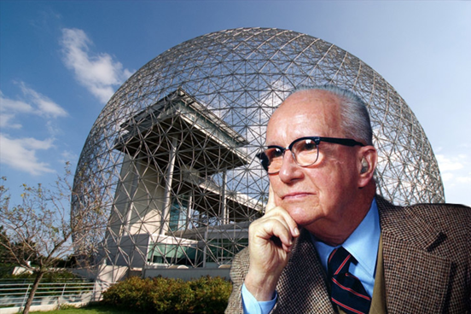
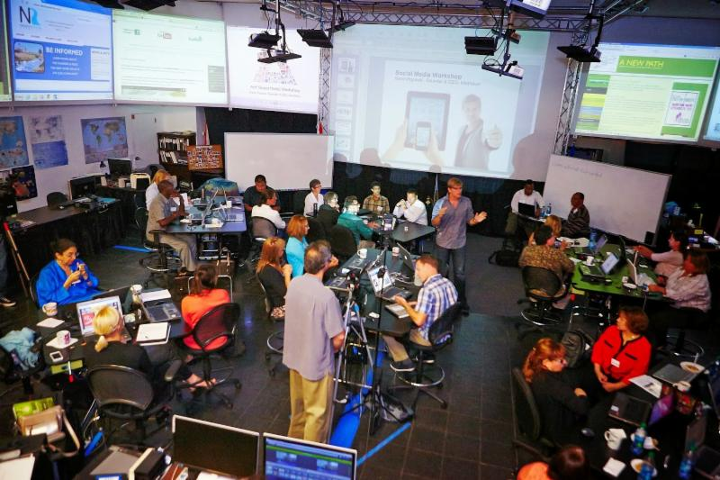
What’s the SIMCenter History?
Buckminster Fuller proposed the World Resources Simulation Center to be built as the US Exhibit for the 1967 International Expo in Montreal, Canada.
The SIMCenter was also proposed, but never built at Southern Illinois University in Carbondale, Illinois.
There is now a demonstration facility operating in San Diego, California. www.wrsc.org

Slide 5
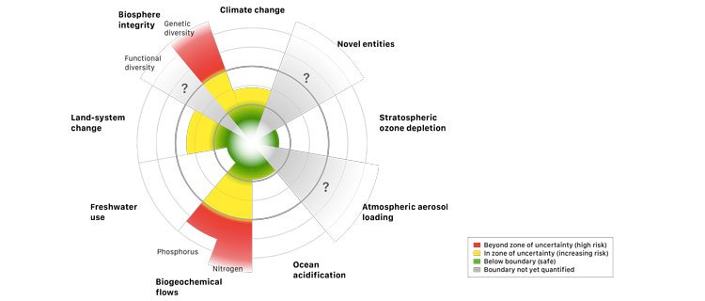
Why is the SIMCenter needed now?
Global and local problems are accelerating faster than decision-makers can respond. There are many “wicked problems” that require solutions now.
Climate change
Fishery loss
Aquifer depletion
Zika virus spread
Biodiversity loss
Sea level rise
1.3 billion without electricity
Ocean plastic pollution
Hunger, poverty, war
+++

Slide 6
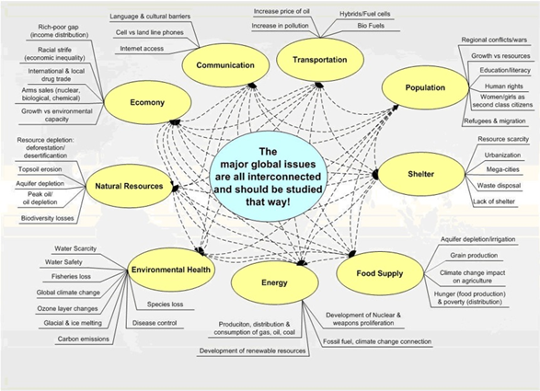
How are Global Issues Interrelated?
All issues today are interconnected, so it's critical we see these relationships and solve problems beyond traditional silos.
We need regional planners, designers, entrepreneurs and engineers to identify optimal solutions and share them everywhere.

Slide 7
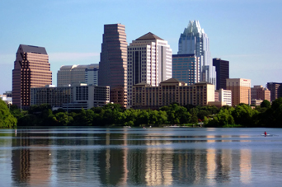
Why Austin ?
The City of Austin is a leader in the Sustainable Cities movement* and a world leader in clean energy
University of Texas – with IC², Clean Energy Incubator, Austin Technology Incubator and more
Technology Hub – high tech companies to participate with the technology required, plus being a hotbed of innovation
Texas– a national leader of wind energy production in the United States. We do everything bigger.
In Austin
we can make a
Global Impact!
https://www.epa.gov/greenpower/green-power-partnership-top-30-local-government

Slide 8
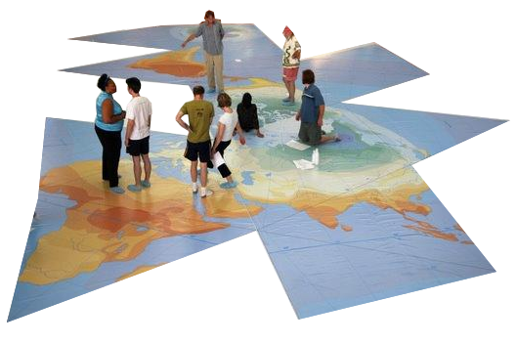
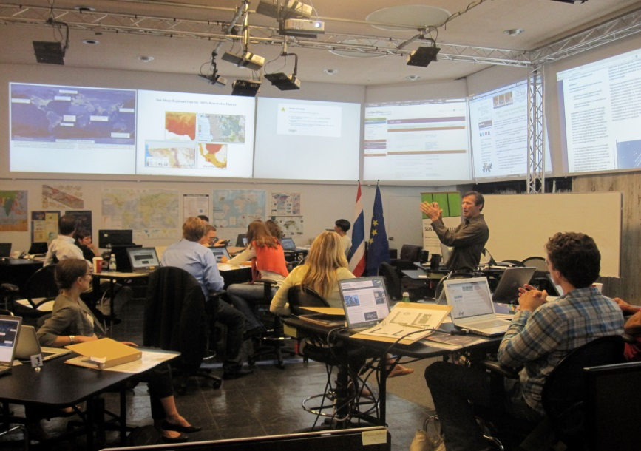
Who uses the SIMCenter?
Strategic Planners for regional government planning: energy, water, food, transport
Corporation events and long-range planners
Non-profit organizations sharing work-space can be more effective
Global education for students – playing the Global Game regularly
Conference venue – providing a unique facility for deeper understanding of the issues in any industry
Public Events – evenings and weekends for the public to hear from subject matter experts
SIM Center Austin

Slide 9
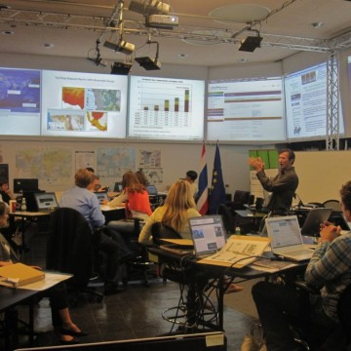
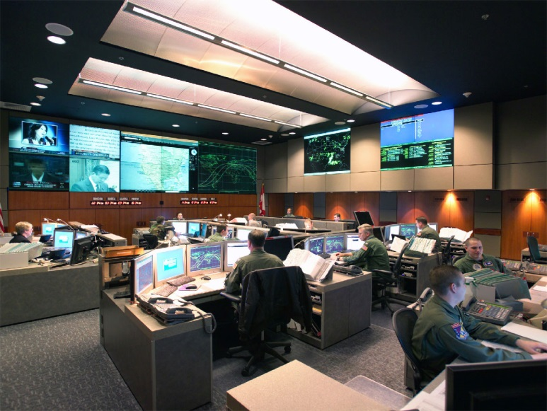
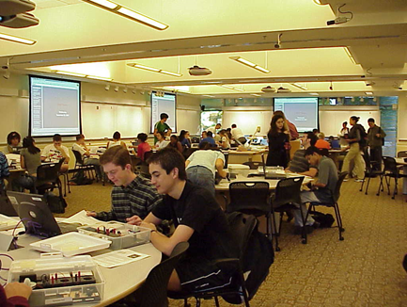
Are there any other SIMCenter models?
San Diego:
A small-scale demonstration facility for global and local impact
War rooms, Fusion centers: high-tech, real-time visualization spaces to prevent attacks and respond to threats
MIT TEAL (Technology Enabled Active Learning) – a collaborative student teaching facility.

Slide 10
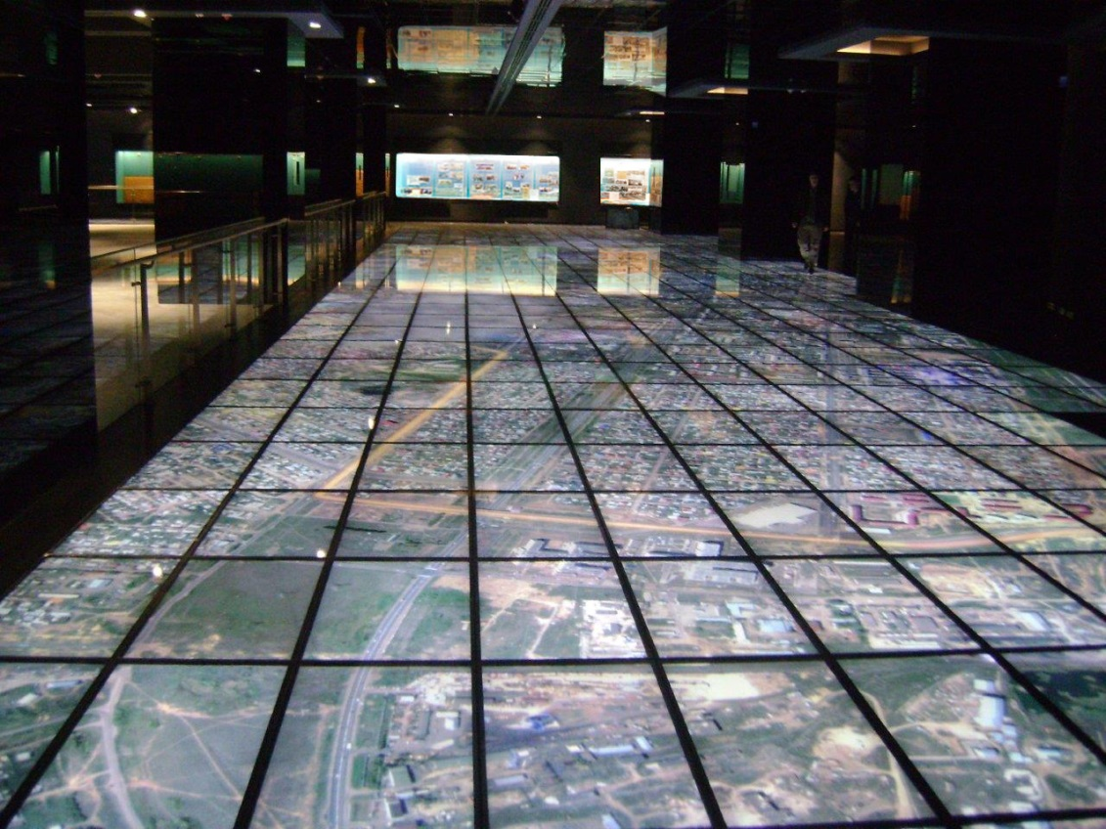
What technology is required?
40x80 foot digital interactive floor map
Multiple large-display screens surrounding main hall
High-speed band width
Simulation software
GIS mapping tools
Network servers
Multiple work stations
Digital tables and boards
Audio/Visual production
An example:
GDS design of the world's largest digital floor display

Slide 11
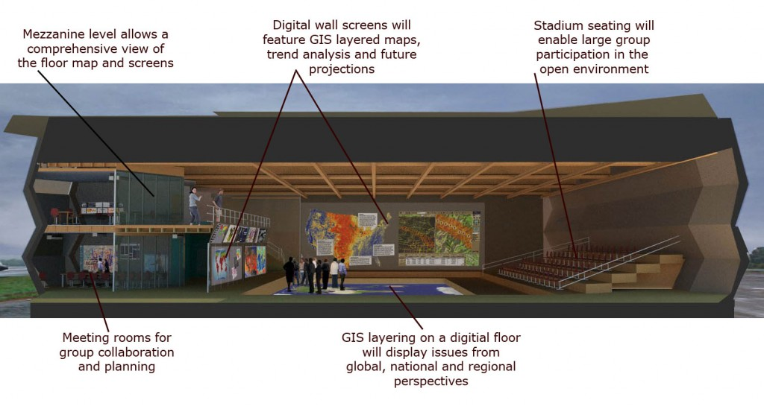
What is the cost?
$8 – $12 million to build full-scale facility*
* If started from ground up

Slide 12
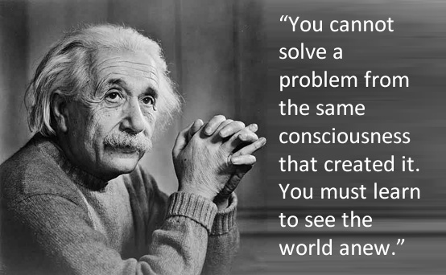
Why is Design thinking is required?
Comprehensive anticipatory design science requires us to:
Look at the interconnectedness of all issues
Anticipate the trends and future needs of society
Use our best scientific knowledge
Design and engineer the optimal solutions for Humanity

Slide 13
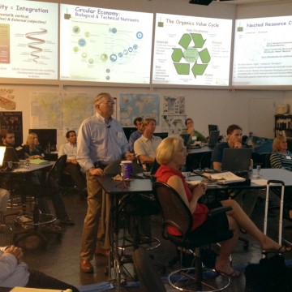
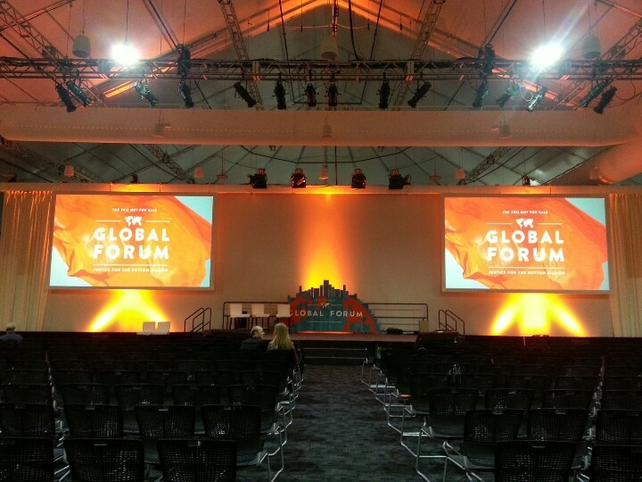
What are the revenue streams?
Global Games with students
Conference rentals
Public event registrations
Strategic planning facilitation
Corporate sponsorships
Individual memberships
SIMCenter Austin

Slide 14
Who benefits from an Austin SIMCenter? We all do.
Austin residents, schools and companies
Texas citizens looking for solutions to the energy, water, food, sustainability nexus
United States in our relationships with 197 countries
197 nations who gain access to best practices and solutions by other countries
The planet as we attempt to heal the wounds and create a more sustainable earth for future generations
Why now?
Because it’s time!

Slide 15
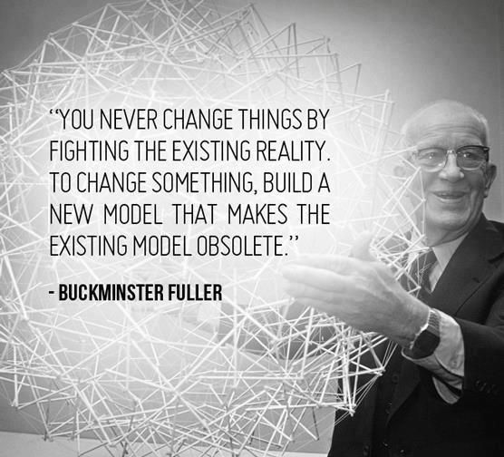
How do I get involved?
Join the Core Team:
> Technology
> Marketing
> Facilities
> Sponsor and funding development
Fund this project :
> Legacy Grant
> Corporate sponsorship
Contact :
> Peter Meisen: peter@wrsc.org
> Susan Meredith: susan@efficientenergy.us

Slide 16
SIMCenter Austin
Visualizing sustainable solutions to global and local problems so we make informed choices quicker.
World Resources Simulation Center
www.wrsc.org
Austin: Susan Meredith (512) 554-6218
San Diego: Peter Meisen (619)234-1088

