Slide 1
What does a climate scientist think we should do about climate change?
Richard C. J. Somerville
Scripps Institution of Oceanography
University of California, San Diego http://richardsomerville.com

Slide 2
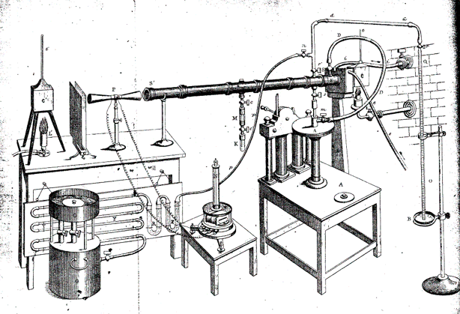

Slide 3
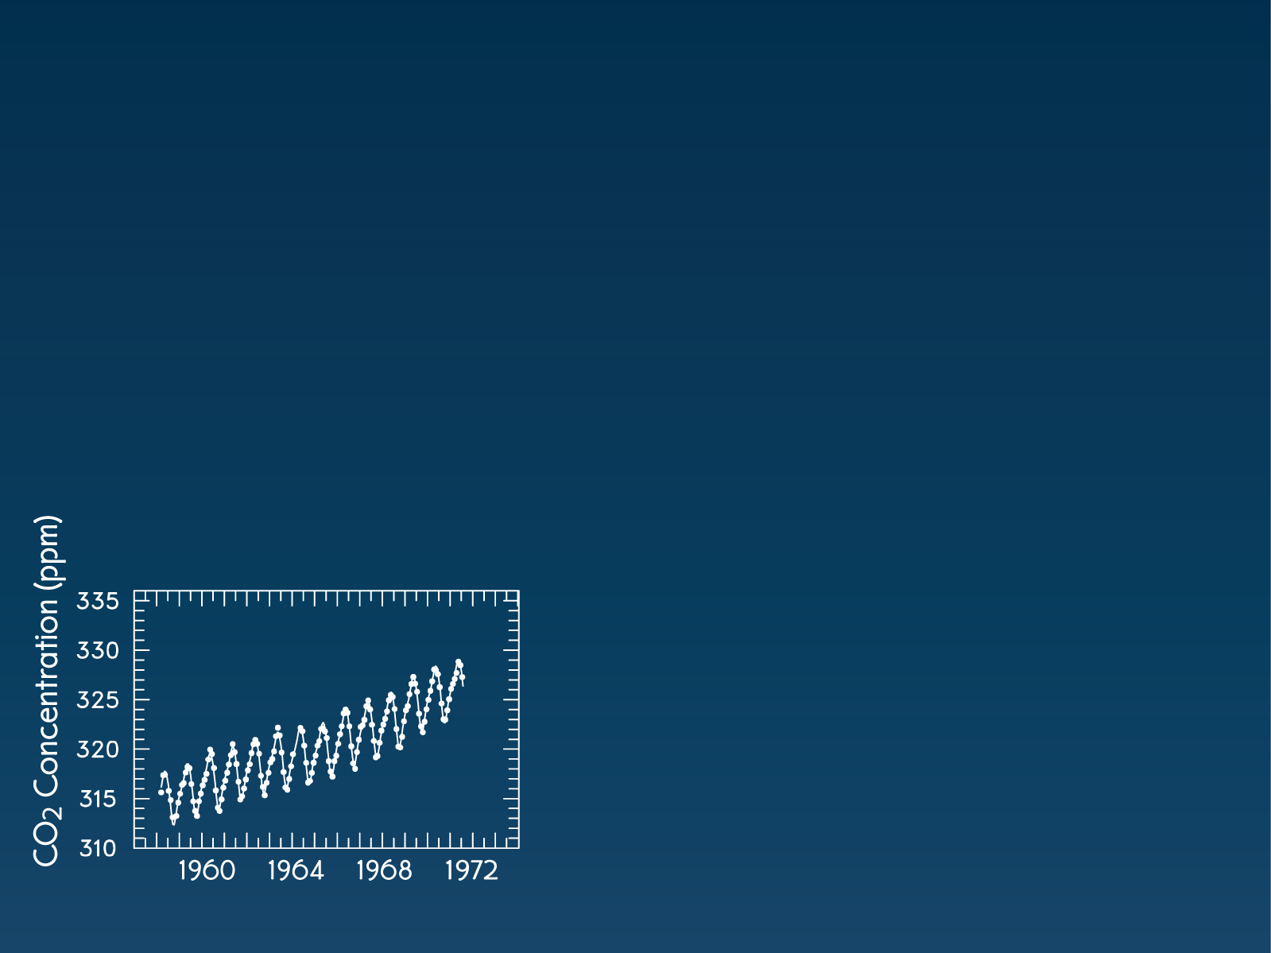
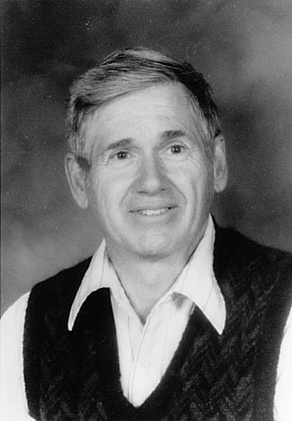
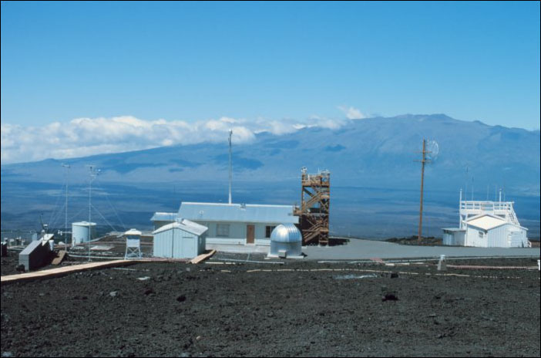

Measuring the amount of carbon dioxide in the atmosphere
Charles D. Keeling (1928-2005)
Mauna Loa Observatory, Hawaii

Slide 5
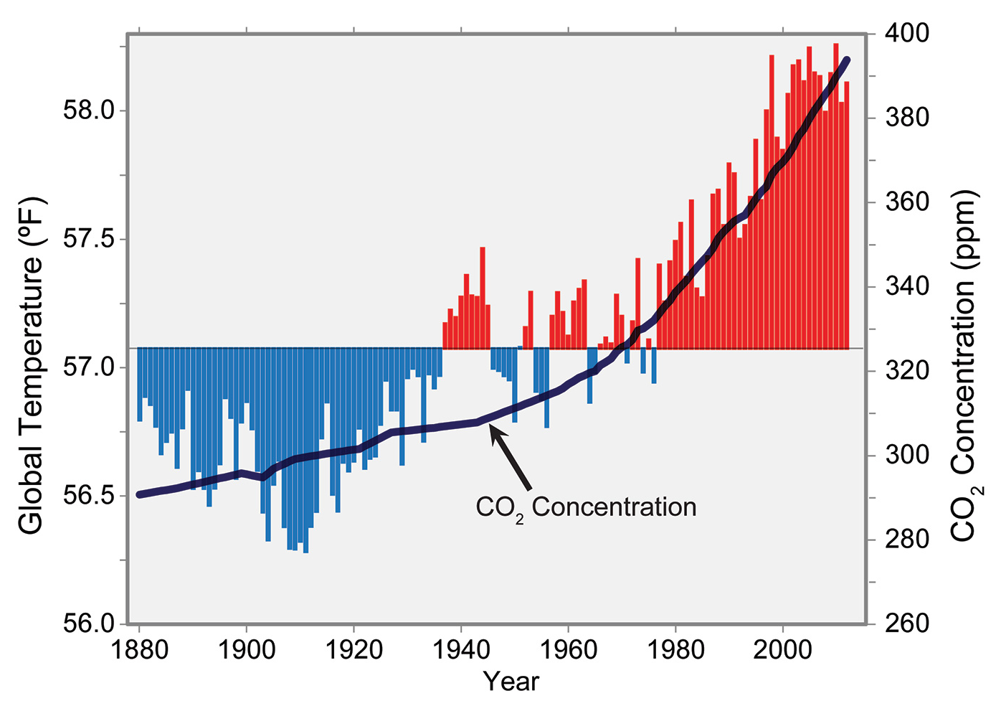
Global Temperature and Carbon Dioxide
Notes:
Global annual average temperature (as measured over both land and oceans) has increased by more than 1.5°F (0.8°C) since 1880 (through 2012). Red bars show temperatures above the long-term average, and blue bars indicate temperatures below the long-term average. The black line shows atmospheric carbon dioxide (CO2) concentration in parts per million (ppm). While there is a clear long-term global warming trend, some years do not show a temperature increase relative to the previous year, and some years show greater changes than others. These year-to-year fluctuations in temperature are due to natural processes, such as the effects of El Niños, La Niñas, and volcanic eruptions. (Figure source: updated from Karl et al. 2009¹).

Slide 6
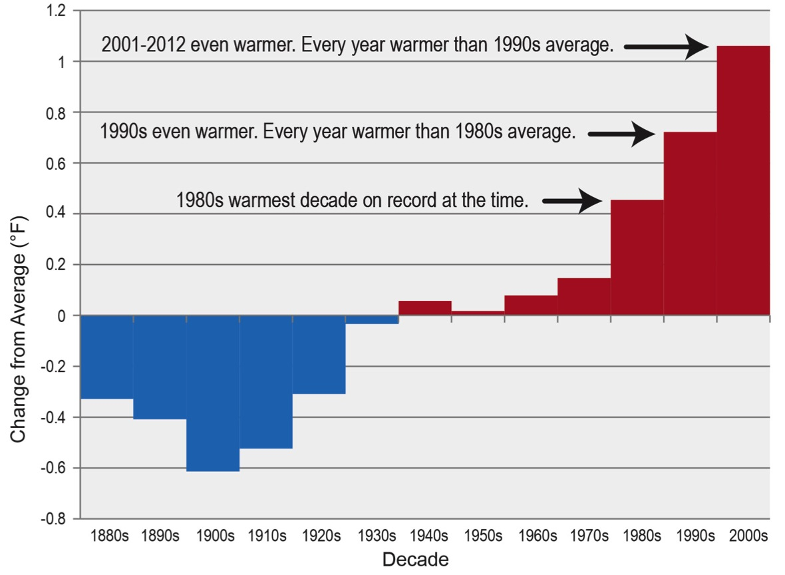
Each New Decade is the Warmest
Notes:
The last five decades have seen a progressive rise in the Earth’s average surface temperature. Bars show the difference between each decade’s average temperature and the overall average for 1901-2000. (Figure source: NOAA NCDC).

Slide 7
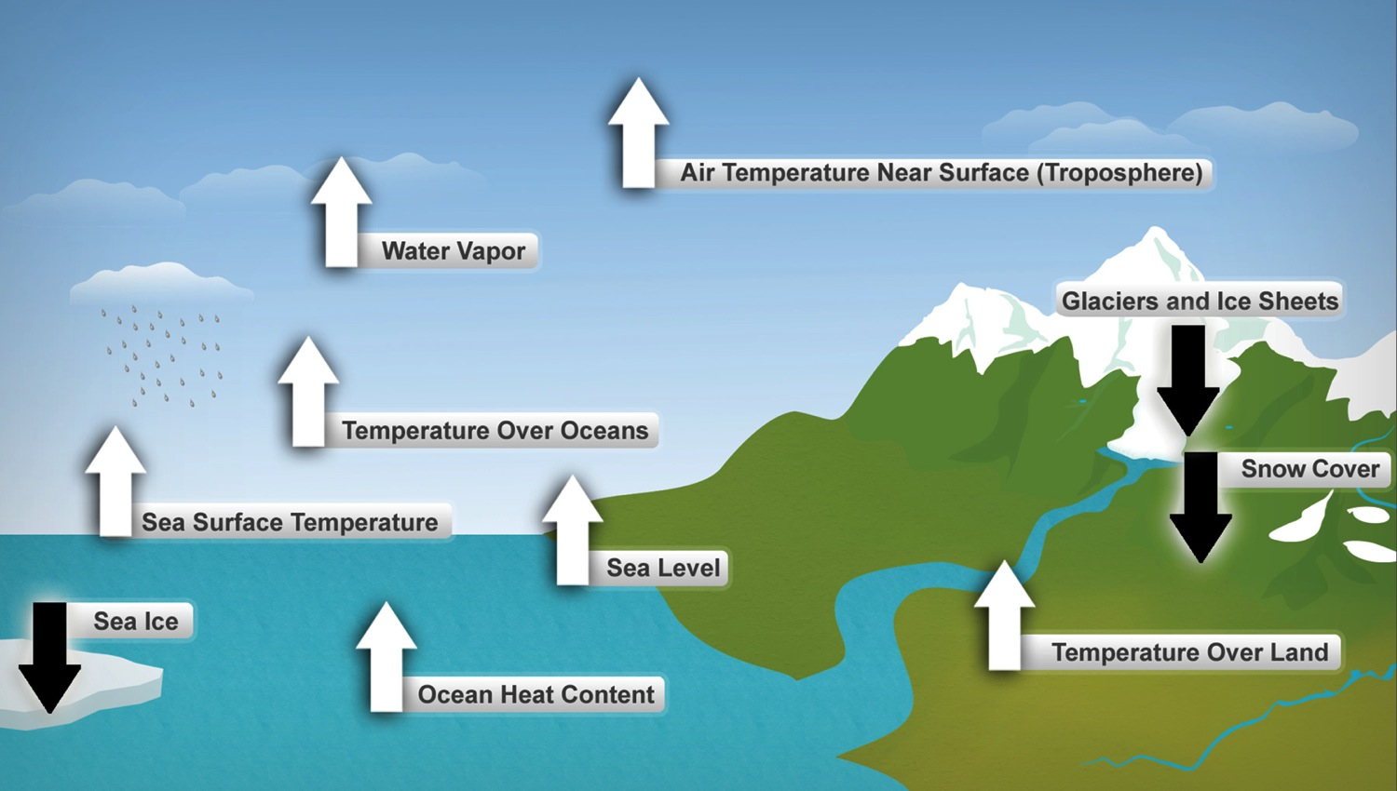
Many Observations Prove Warming
Notes:
These are just some of the indicators measured globally over many decades that show that the Earth’s climate is warming. White arrows indicate increasing trends; black arrows indicate decreasing trends. All the indicators expected to increase in a warming world are increasing, and all those expected to decrease in a warming world are decreasing. (Figure source: NOAA NCDC, based on data updated from Kennedy et al. 2010).

Slide 8
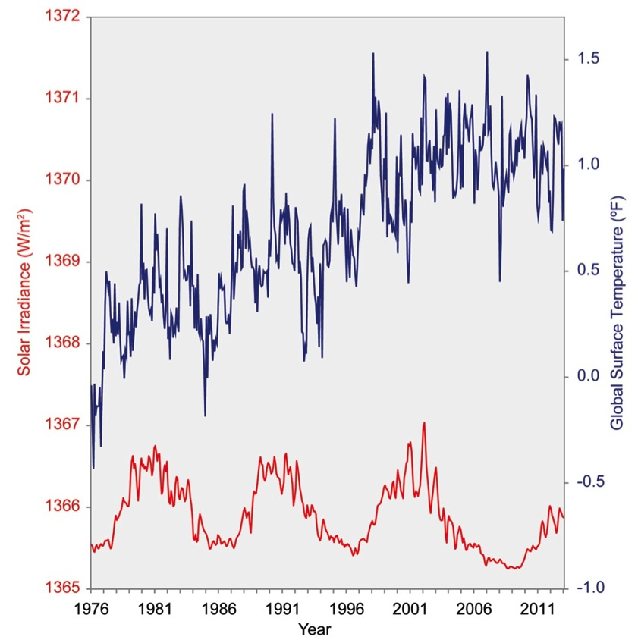
The Sun Did Not Cause the Warming
Notes:
The full record of satellite measurements of the sun’s energy received at the top of the Earth’s atmosphere is shown in red, following its natural 11-year cycle of small ups and downs, without any net increase. Over the same period, global temperature relative to 1961-1990 average (shown in blue) has risen markedly. This is a clear indication that changes in the sun are not responsible for the observed warming over recent decades. (Figure source: NOAA NCDC / CICS-NC).

Slide 9
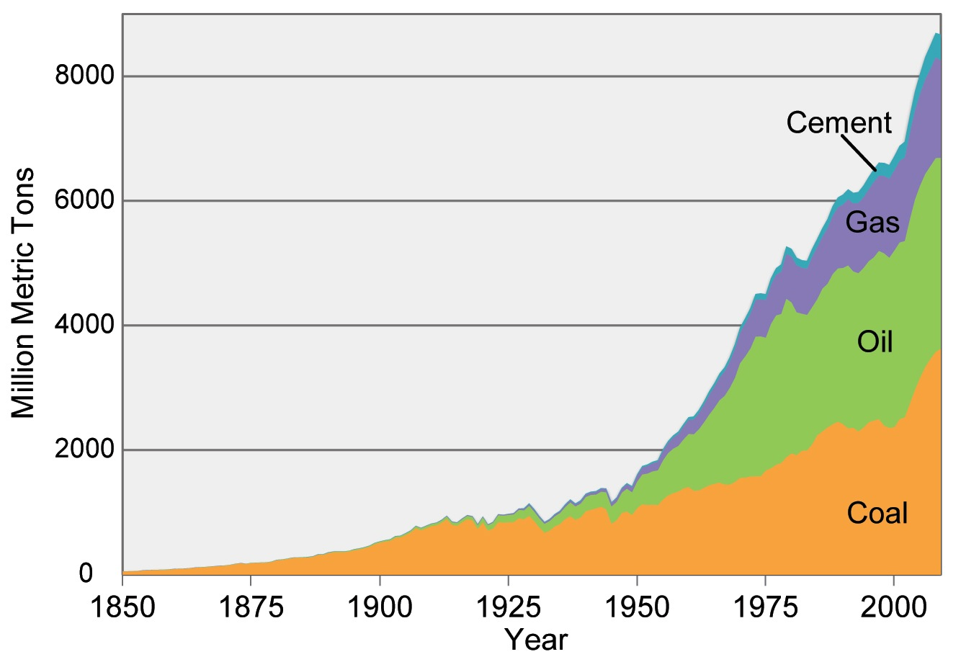
Carbon Emissions Grew Explosively
Notes:
Carbon emissions from burning coal, oil, and gas and producing cement, in units of million metric tons of carbon. These emissions account for about 80% of the total emissions of carbon from human activities, with land-use changes (like cutting down forests) accounting for the other 20% in recent decades. (Data from Boden et al. 2012¹⁵).

Slide 10
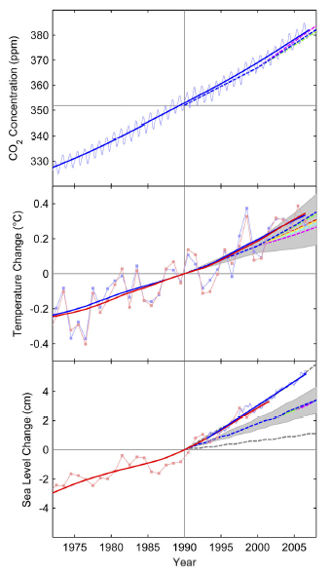
Rahmstorf et al., Science, 316, 709 (2007).
CO₂ amount,
Temperature,
Sea level,
observations and IPCC projections

Slide 11
“Overall, these observational data underscore the concerns about global climate change. Previous projections, as summarized by the IPCC, have not exaggerated but may in some respects even have underestimated the change, in particular for sea level.”
Rahmstorf et al., Science, 316, 709 (2007)

Slide 12
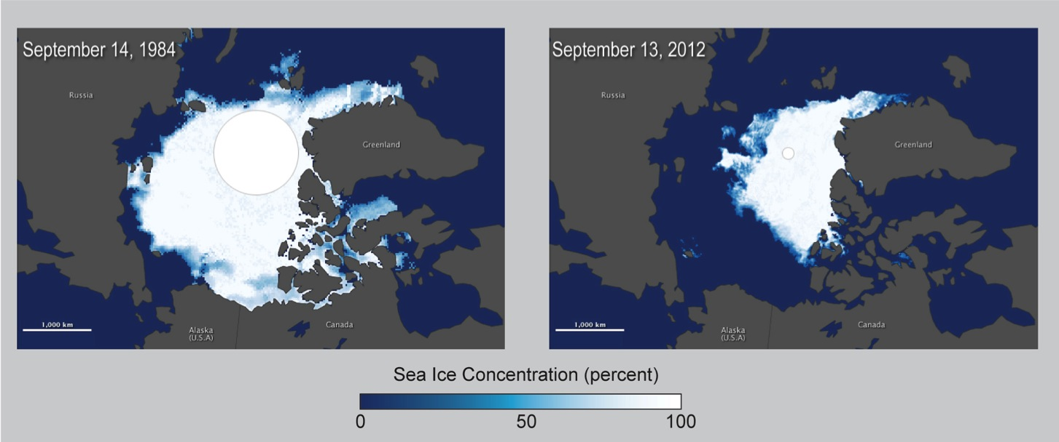
Arctic Sea Ice Declined Dramatically
Notes:
The retreat of sea ice has occurred faster than climate models had predicted. Image on left shows Arctic minimum sea ice extent in 1984, which was about 2.59 million square miles, the average minimum extent for 1979-2000. Image on right shows that the extent of sea ice had dropped to 1.32 million square miles at the end of summer 2012. The dramatic loss of Arctic sea ice increases warming and has many other impacts on the region. Marine mammals including polar bears and many seal species depend on sea ice for nearly all aspects of their existence. Alaska Native coastal communities rely on sea ice for many reasons, including its role as a buffer against coastal erosion from storms and as a platform for hunting. (Figure source: NASA Earth Observatory 2012).

Slide 13
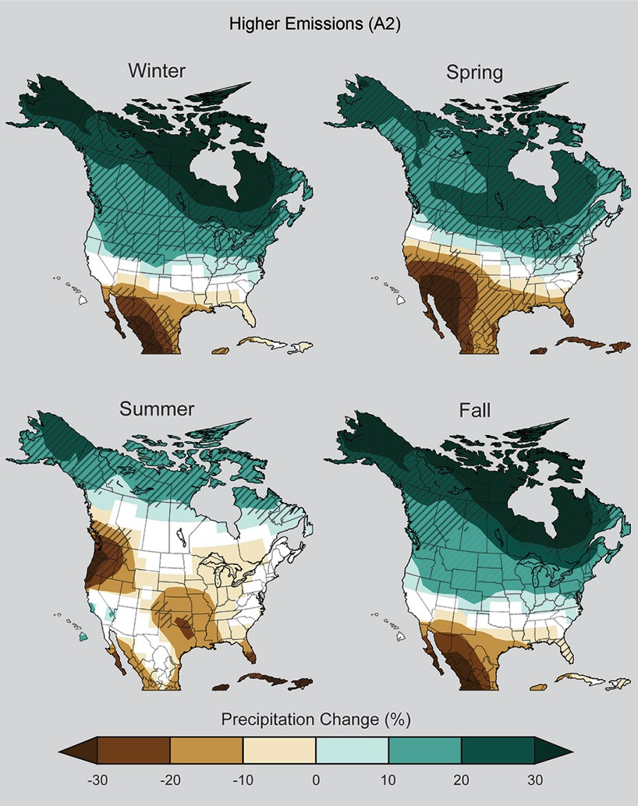
Precipitation Patterns
Will Change Dramatically Unless We Reduce Carbon Emissions
Quickly
Notes:
Climate change affects more than just temperature. The location, timing, and amounts of precipitation will also change as temperatures rise. Maps show projected percent change in precipitation in each season for 2071-2099 (compared to the period 1970-1999) under an emissions scenario that assumes continued increases in emissions (A2). Teal indicates precipitation increases, and brown, decreases. Hatched areas indicate that the projected changes are significant and consistent among models. White areas indicate that the changes are not projected to be larger than could be expected from natural variability. In general, the northern part of the U.S. is projected to see more winter and spring precipitation, while the southwestern U.S. is projected to experience less precipitation in the spring. Wet regions are generally projected to become wetter while dry regions become drier. Summer drying is projected for parts of the U.S., including the Northwest and southern Great Plains. (Figure source: NOAA NCDC / CICS-NC).

Slide 14
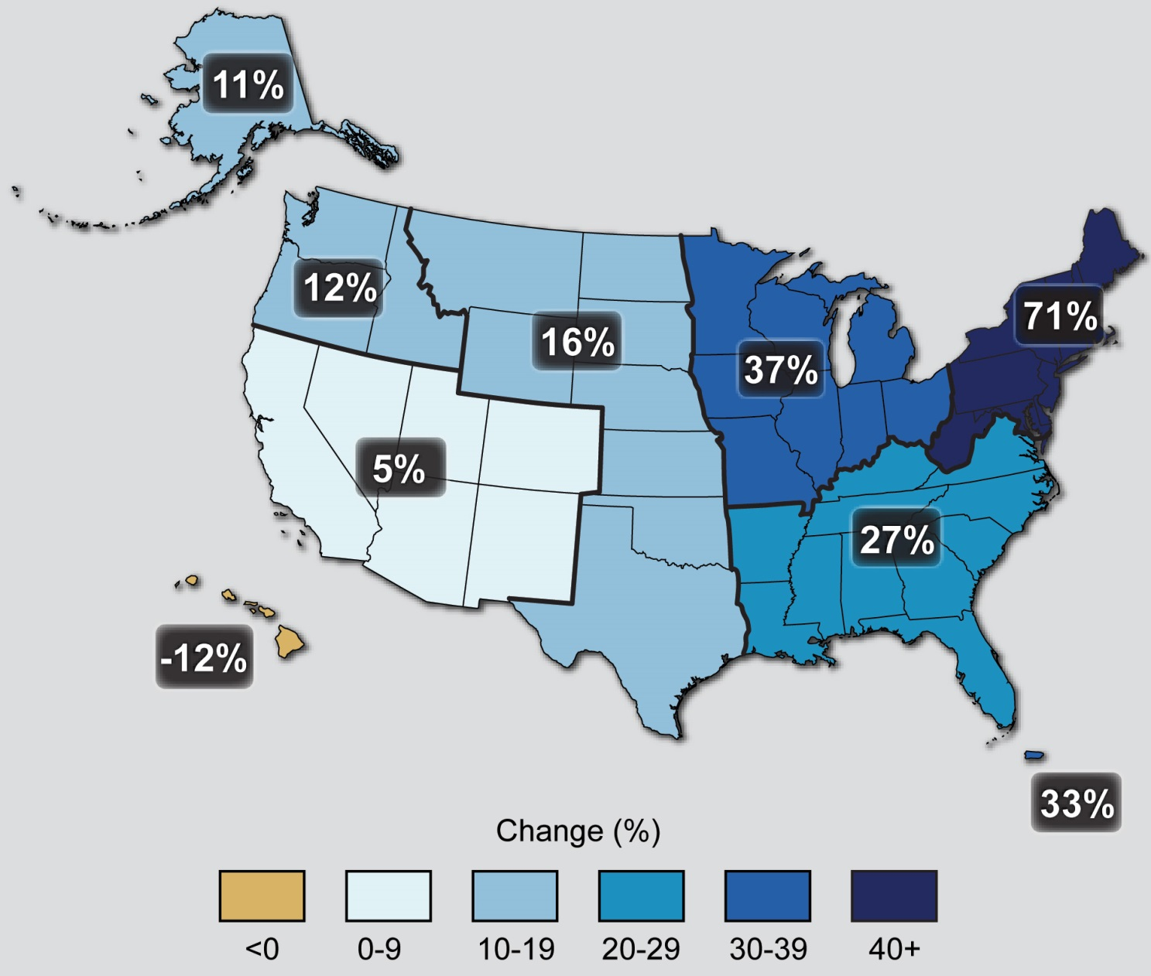
Observed Change in Very Heavy Precipitation
Notes:
Percent changes in the amount of precipitation falling in very heavy events (the heaviest 1%) from 1958 to 2012 for each region. There is a clear national trend toward a greater amount of precipitation being concentrated in very heavy events, particularly in the Northeast and Midwest. (Figure source: updated from Karl et al. 2009^{c} ).

Slide 15
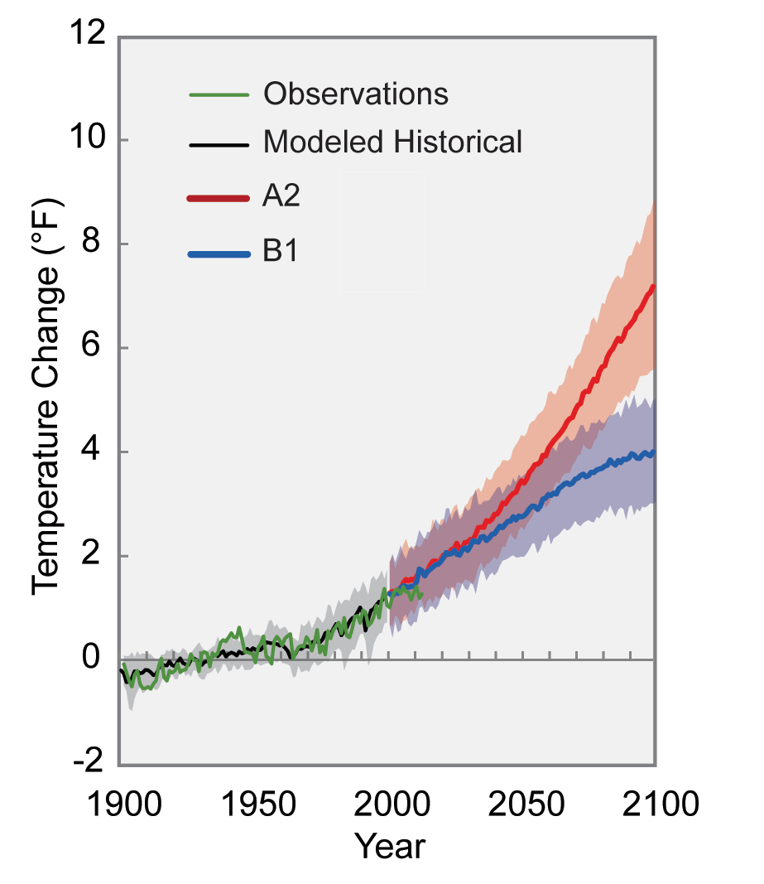
Projected global temperature change for increasing emissions
(scenario A2) and for decreasing emissions
(scenario B1)
Notes:
Different amounts of heat-trapping gases released into the atmosphere by human activities produce different projected increases in Earth’s temperature. The lines on the graph represent a central estimate of global average temperature rise (relative to the 1901-1960 average) for the two main scenarios used in this report. A2 assumes continued increases in emissions throughout this century, and B1 assumes significant emissions reductions, though not due explicitly to climate change policies. Shading indicates the range (5 to 95 percentile) of results from a suite of climate models. In both cases, temperatures are expected to rise, although the difference between lower and higher emissions pathways is substantial. (Figure source: NOAA NCDC / CICS-NC).

Slide 16
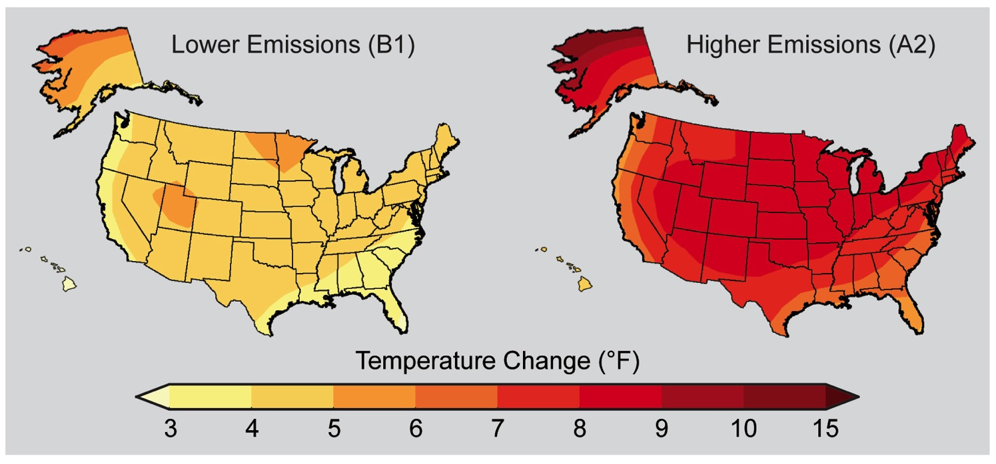
Our Decisions Determine Our Future
Notes:
Maps show projected change in average surface air temperature in the later part of this century (2071-2099) relative to the later part of the last century (1970-1999) under a scenario that assumes substantial reductions in heat trapping gases (B1, left) and a higher emissions scenario that assumes continued increases in global emissions (A2, right). These scenarios are used throughout this report for assessing impacts under lower and higher emissions. (Figure source: NOAA NCDC / CICS-NC).

Slide 17
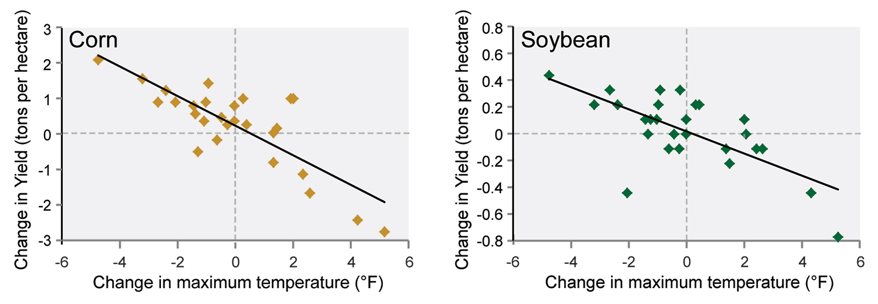
Crop Yields Decline under
Higher Temperatures
Notes:
Crop yields are very sensitive to temperature and rainfall. They are especially sensitive to high temperatures during the pollination and grain-filling period. For example, corn (left) and soybean (right) harvests in Illinois and Indiana, two major producers, were lower in years with average maximum summer (June, July, and August) temperatures that were higher than the 1980-2007 average. Most years with below-average yields are both warmer and drier than normal.^{1,2} There is a very high correlation between warm and dry conditions during Midwest summers³ due to similar meteorological conditions and drought-caused changes⁴ in the surface. (Figure source: redrawn from Mishra and Cherkauer 2010¹).

Slide 18
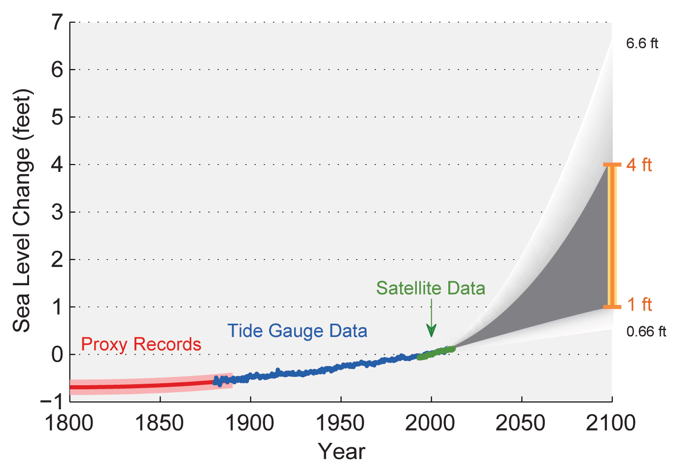
Past and Projected Changes in
Global Sea Level
Notes:
Figure shows estimated, observed, and possible amounts of global sea level rise from 1800 to 2100, relative to the year 2000. Estimates from proxy data⁴ (for example, based on sediment records) are shown in red (1800-1890, pink band shows uncertainty), tide gauge data in blue for 1880-2009,⁵ and satellite observations are shown in green from 1993 to 2012.⁶ The future scenarios range from 0.66 feet to 6.6 feet in 2100^{.7} These scenarios are not based on climate model simulations, but rather reflect the range of possible scenarios based on other kinds of scientific studies. The orange line at right shows the currently projected range of sea level rise of 1 to 4 feet by 2100, which falls within the larger risk-based scenario range. The large projected range reflects uncertainty about how glaciers and ice sheets will react to the warming ocean, the warming atmosphere, and changing winds and currents. As seen in the observations, there are year-to-year variations in the trend. (Figure source: NASA Jet Propulsion Laboratory).

Slide 19

Carbon dioxide is the steroids of our climate system.

Slide 20
It’s warming.
It’s us.
It hasn’t stopped.
The heat is mainly in the sea.
Sea level is rising.
Ice is shrinking.
CO₂ makes the sea more acidic.
CO₂ in the air is up 40% since the 1800s.
It’s now the highest in 800,000 years.
Cumulative emissions set the warming.
Reducing emissions limits the warming.
Climate change will last for centuries.

Slide 21
A prediction made in 1978:
“If the global consumption of fossil fuels continues to grow at its present rate, atmospheric CO₂ content will double in about 50 years. [The resulting warming] could start rapid deglaciation of West Antarctica, leading to a 5 meter rise in sea level.”
J. H. Mercer, “West Antarctic ice sheet and CO₂ greenhouse effect: a threat of disaster.” Nature, 26 Jan. 1978.

Slide 22
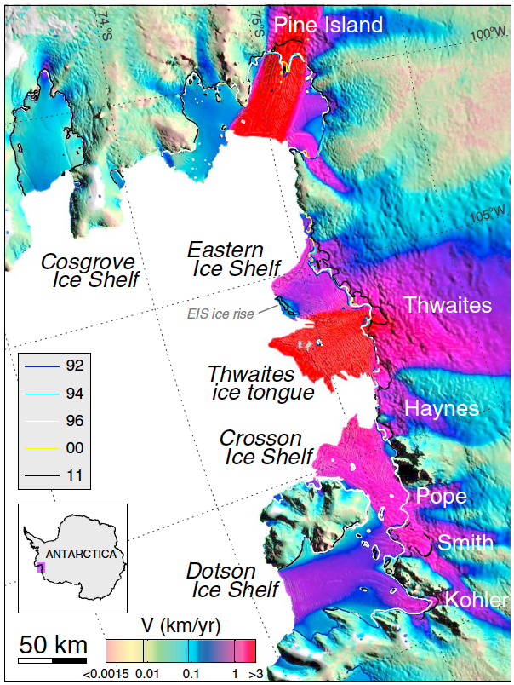

Slide 23
Collapse of West Antarctic Ice Sheet begins (2014):
“We announced that we had collected enough observations to conclude that the retreat of ice in the Amundsen sea sector of West Antarctica was unstoppable, with major consequences – it will mean that sea levels will rise one meter worldwide. What's more, its disappearance will likely trigger the collapse of the rest of the West Antarctic ice sheet, which comes with a sea level rise of between three and five meters. Such an event will displace millions of people worldwide.”
-- Eric Rignot, JPL and UC Irvine, May, 2014

Slide 24
Two papers in May 2014 announced the discovery that part of the West Antarctic Ice Sheet had begun an apparently unstoppable collapse. Thus a “tipping point” that had been predicted has now been passed:
Rignot et al., 2014: Geophysical Research Letters, 41, doi: 10.1002/2014GL060140.
Joughlin et al., 2014: Science, 344, 735-738.

Slide 25
Mechanism for ice sheet collapse
The mechanism for ice sheet collapse involves the lack of pinning points that could help stabilize the ice sheet, plus a sea floor that slopes downward toward the continent.

Slide 26
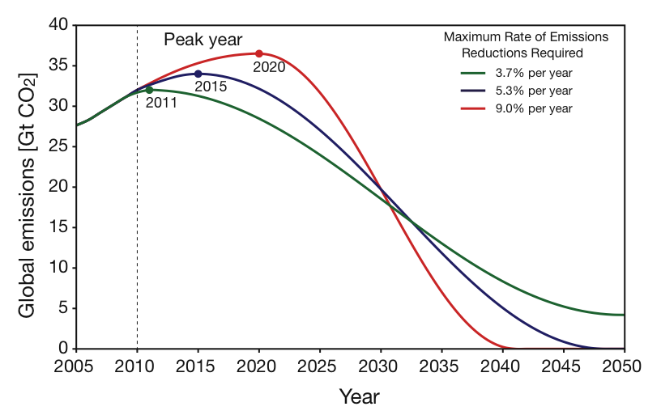
Emissions pathways to give 67% chance of limiting global warming to 2º Celsius (3.6º Fahrenheit) above the temperatures of the 1800s.

Slide 27
"After all, what's the use of having developed a science well enough to make predictions, if in the end all we're willing to do is stand around and wait for them to come true!“
F. Sherwood Rowland, 1984

Slide 28
skepticalscience.com
good responses to “climate myths”
climatecommunication.org
effective ways to communicate science
richardsomerville.com
many useful links and downloads

Slide 29
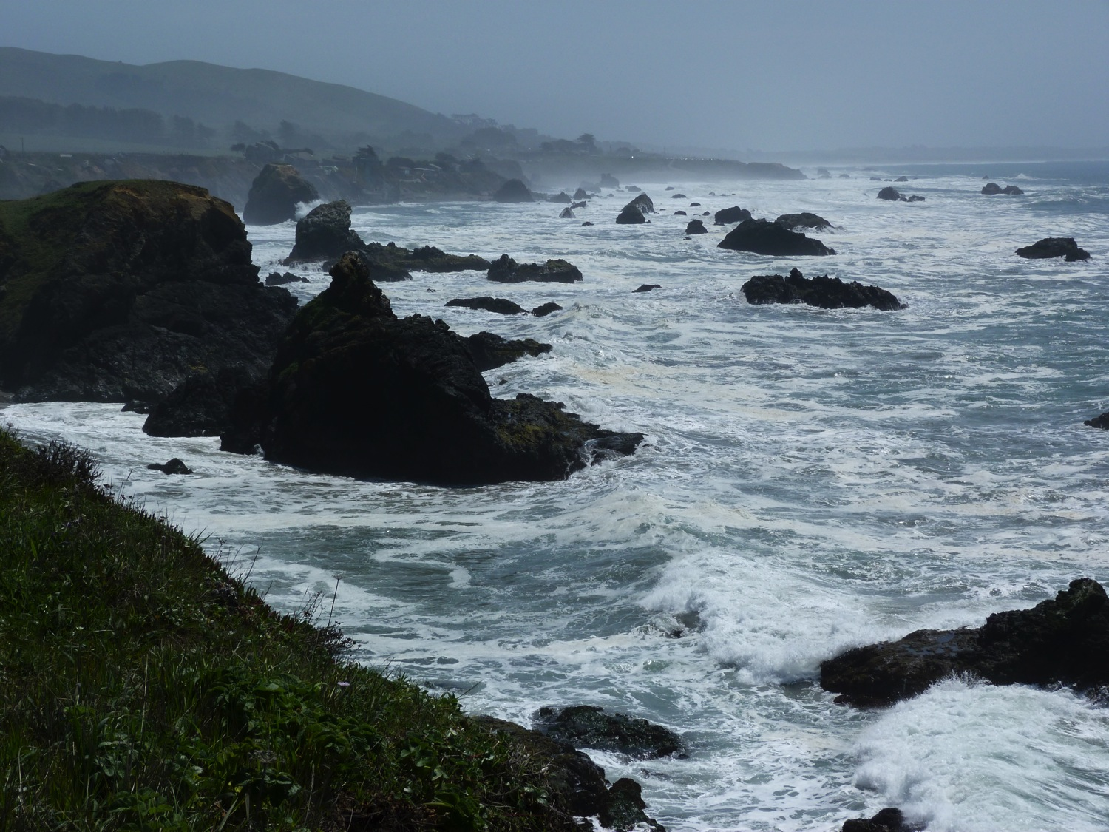

Slide 30
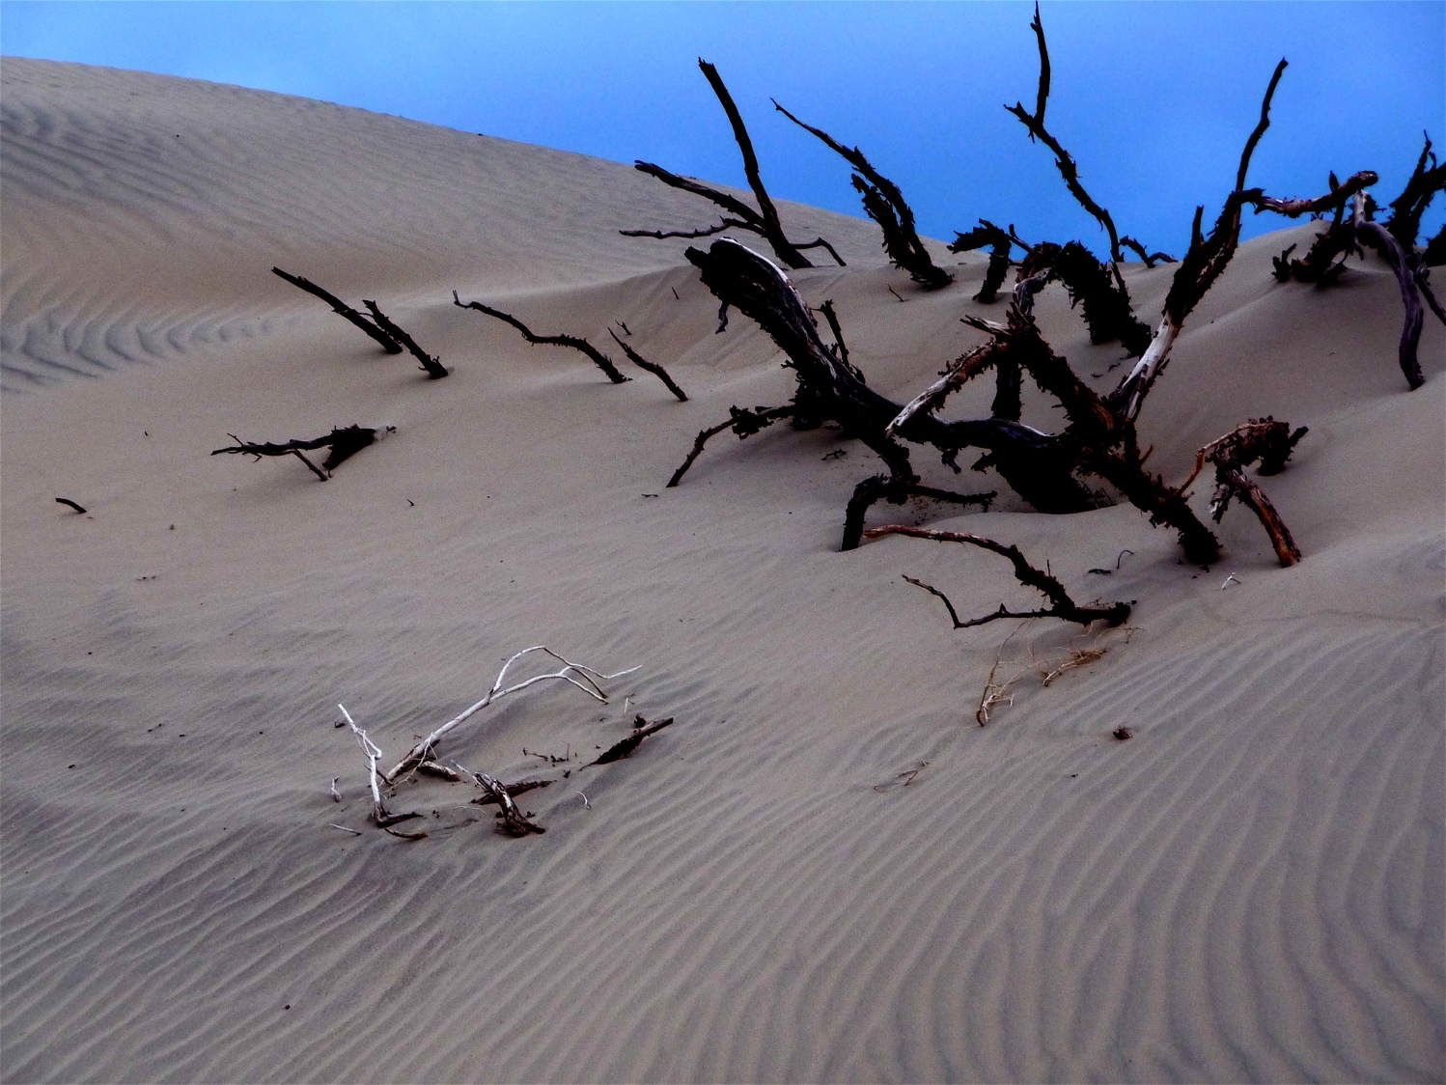

Slide 31
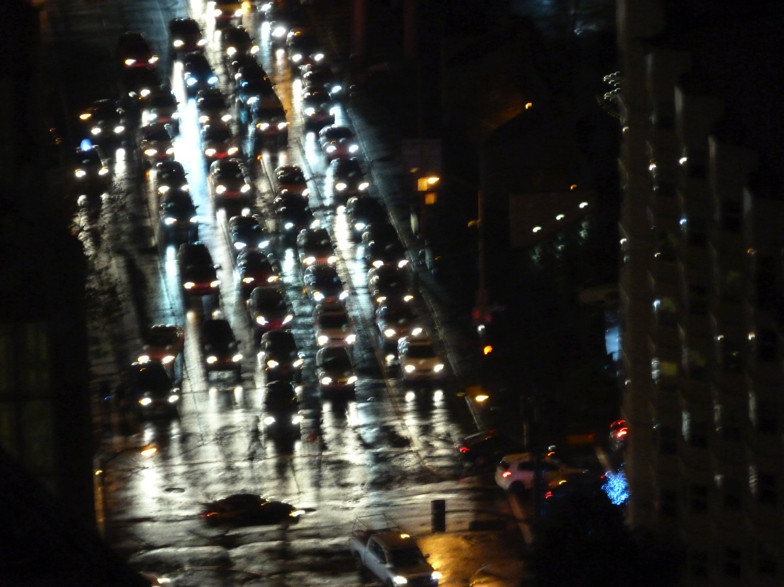

Slide 32
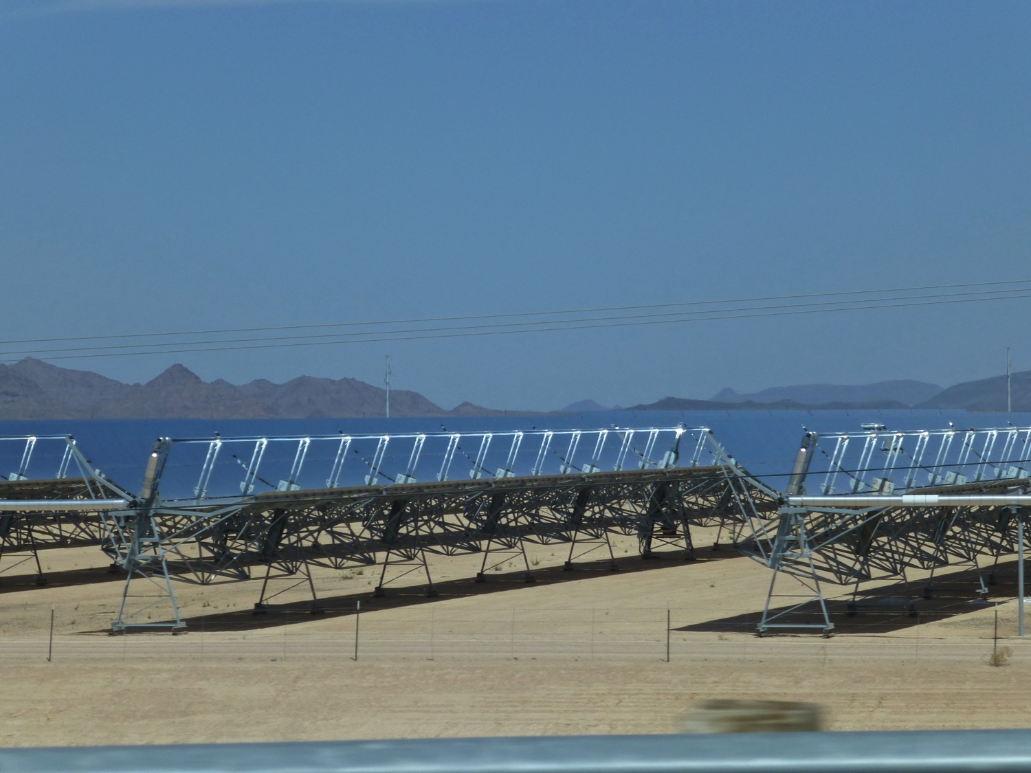

Slide 33
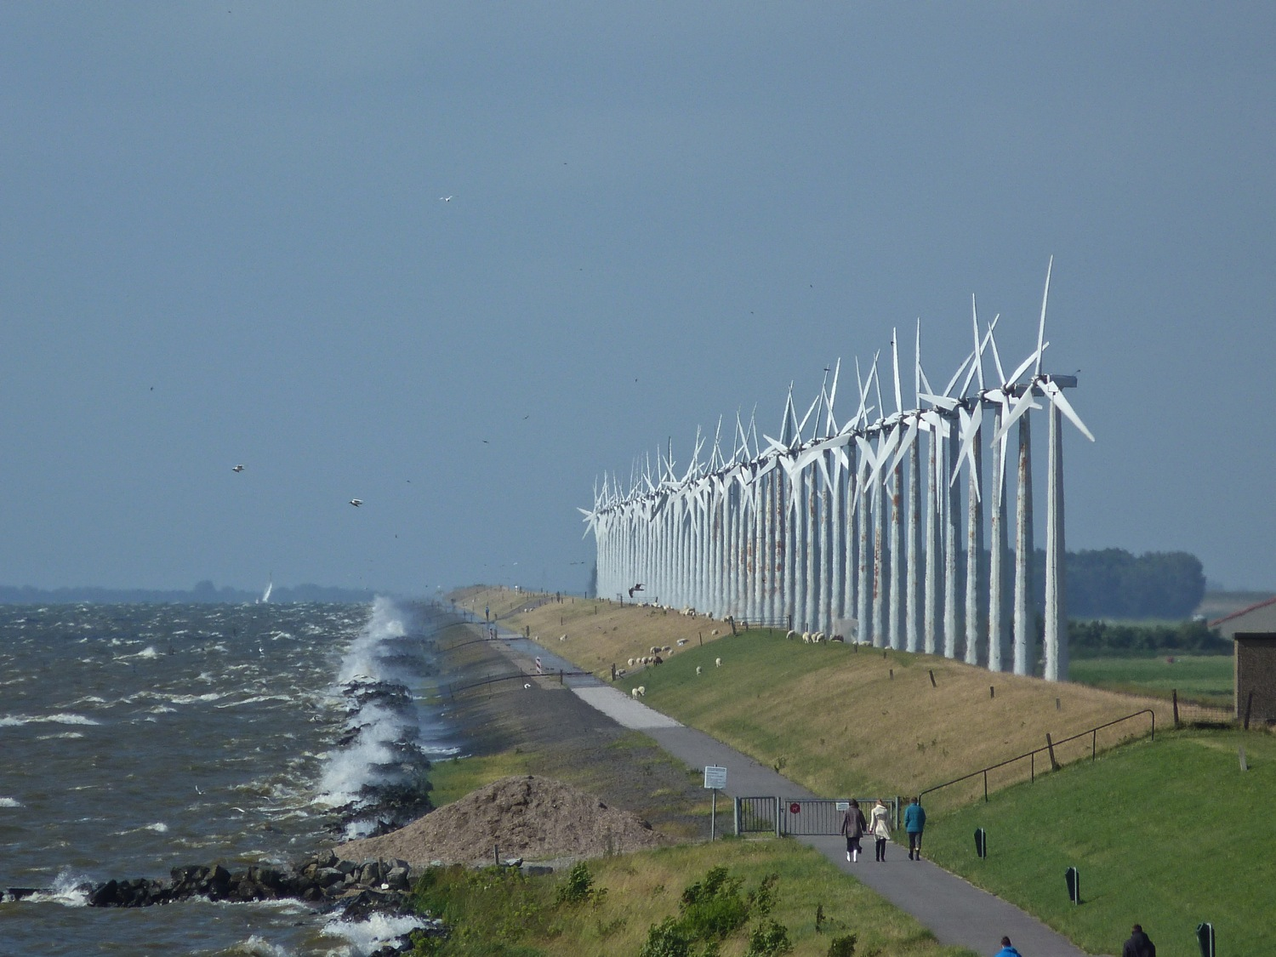

Slide 34
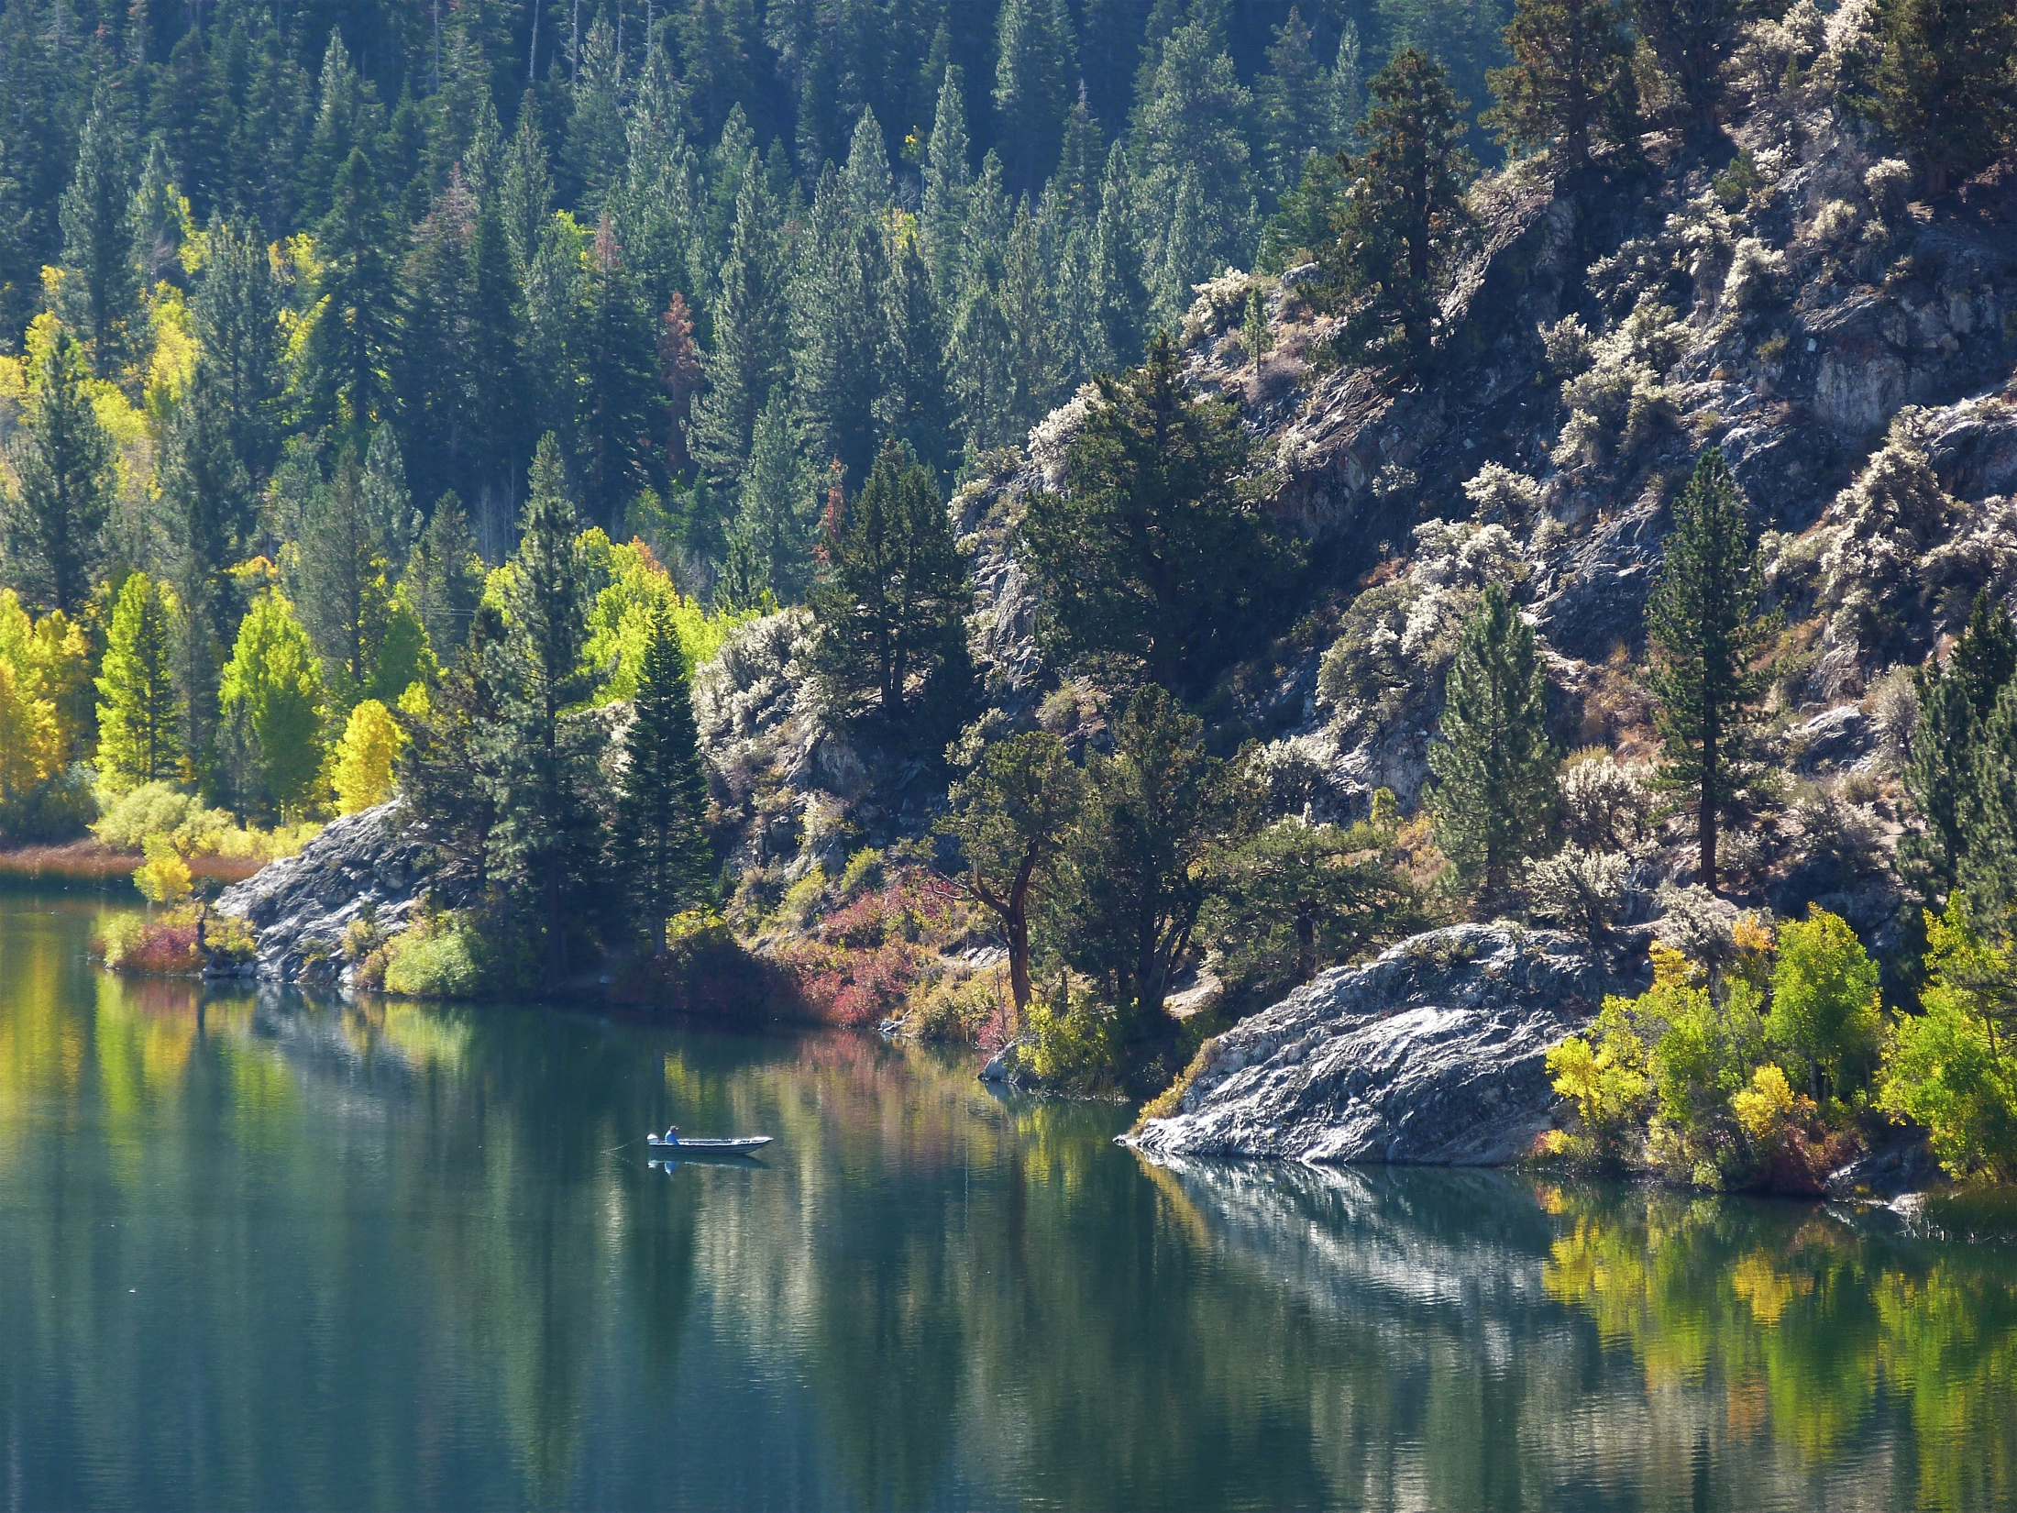

Slide 35
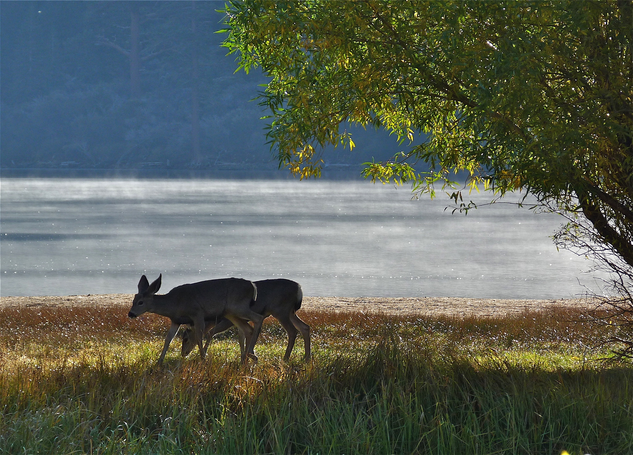

Slide 36
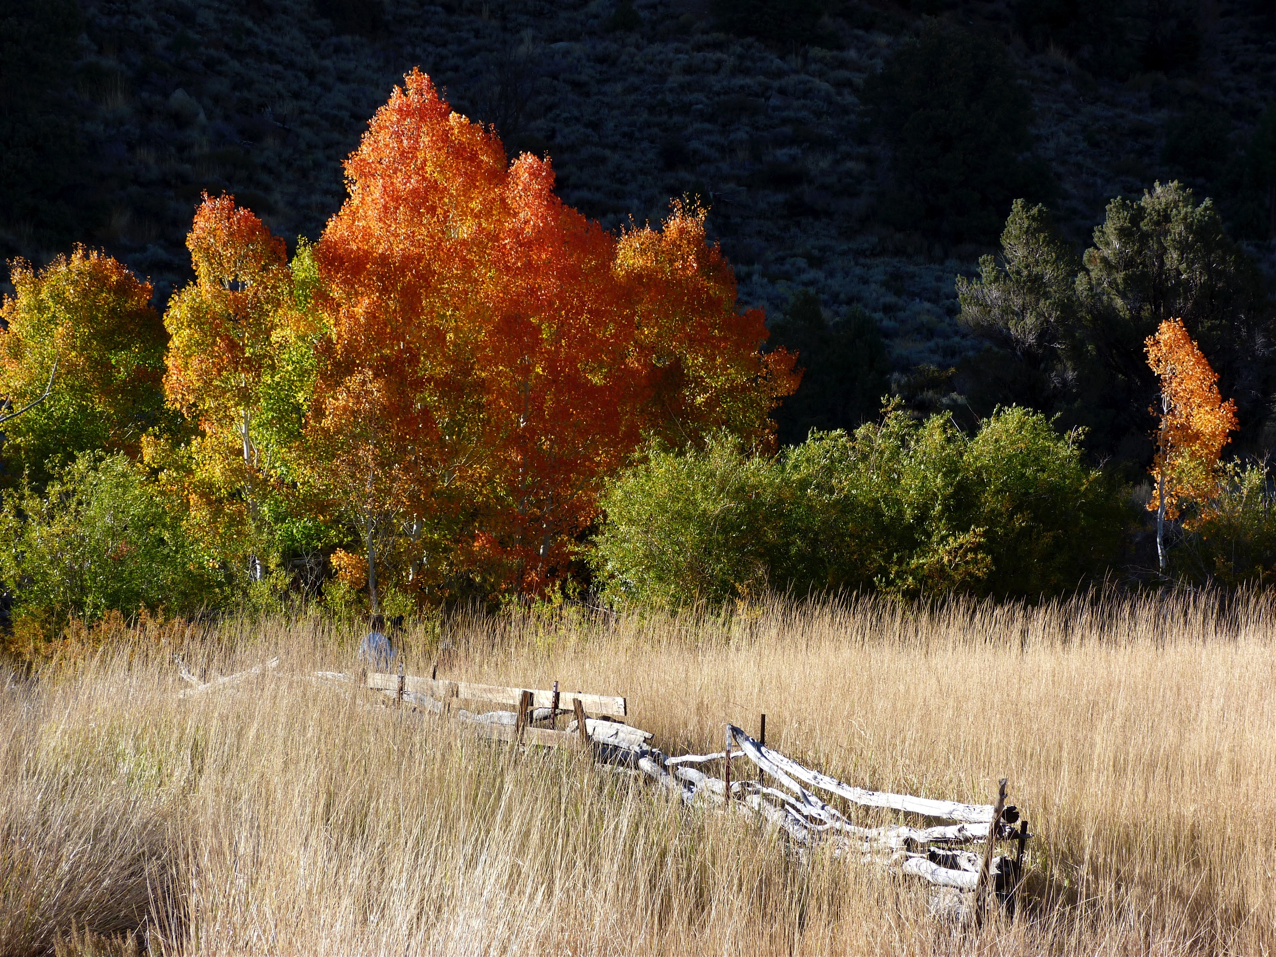

Slide 37
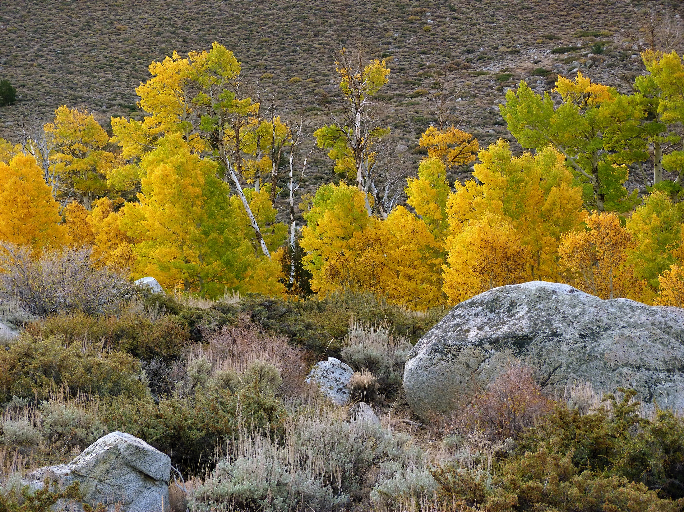

Slide 38
It’s warming.
It’s us.
It hasn’t stopped.
The heat is mainly in the sea.
Sea level is rising.
Ice is shrinking.
CO₂ makes the sea more acidic.
CO₂ in the air is up 40% since the 1800s.
It’s now the highest in 800,000 years.
Cumulative emissions set the warming.
Reducing emissions limits the warming.
Climate change will last for centuries.

Slide 39
What about those who do not accept the basic findings of climate science?
They often repeat old climate myths.
Some of them may be motivated by ideology, or politics, or money.
Some of them are in positions of power.

Slide 40
What do I say to climate deniers, who say climate science is a hoax?
"I beseech you, in the bowels of Christ, think it possible that you may be mistaken. “
Oliver Cromwell, 1650

Slide 41
Acknowledgments
Graphics: 3rd National Climate Assessment
Photographs: © Sylvia Bal Somerville
Scripps Institution of Oceanography, UCSD
The G. Unger Vetlesen Foundation
NSF and CMMAP: www.cmmap.org
E. A. Dickson Emeriti Professorship, UCSD
www.climatecommunication.org

Slide 42
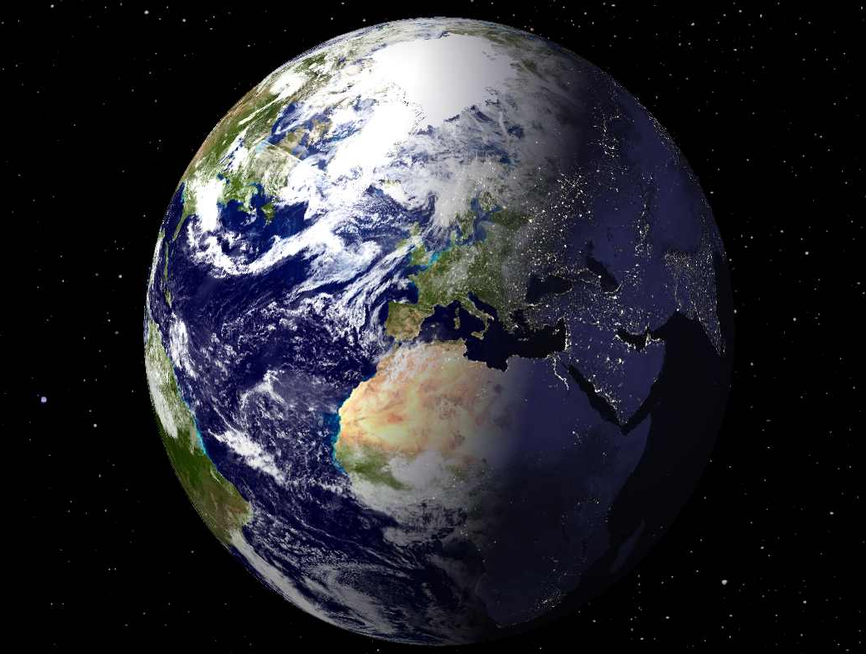
www.richardsomerville.com

